Slide 1
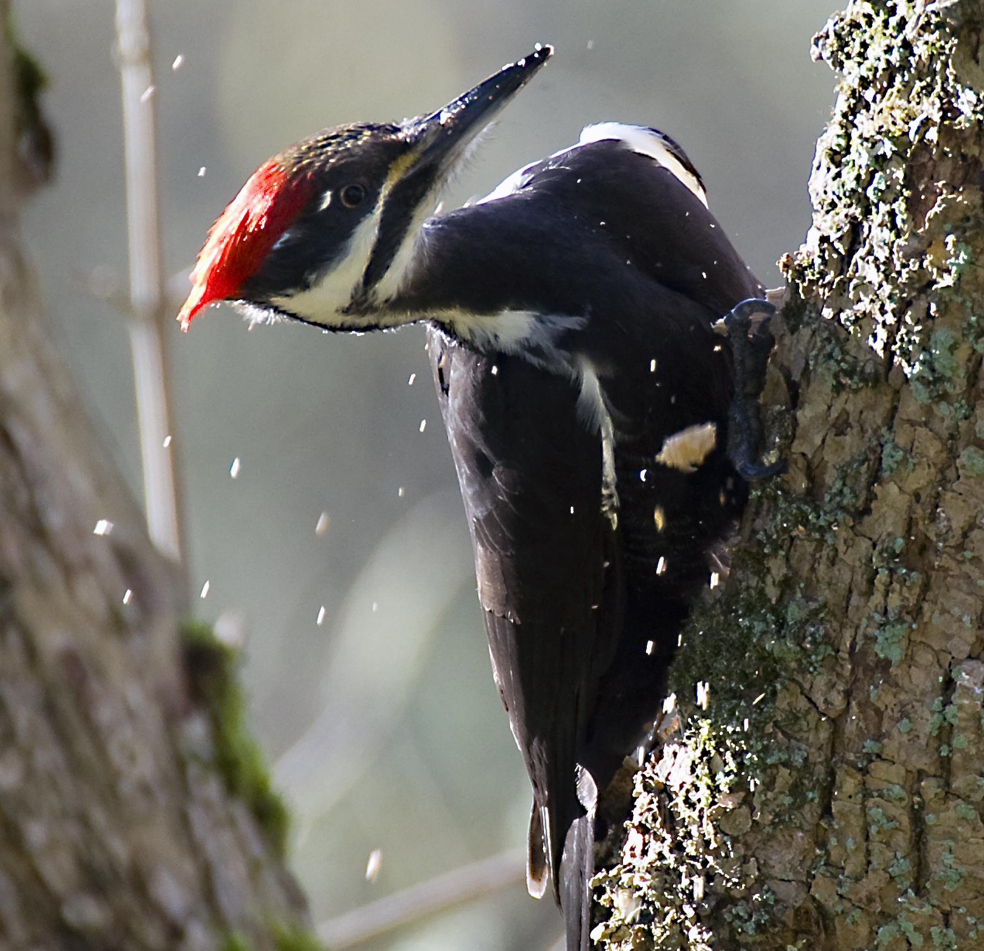
North Creek Forest
Priority Species
Saving Bothell’s Last Great Forest
OUR MISSION: Maintain and Improve the ecological function of North Creek Forest
through stewardship, education and conservation in perpetuity.

Slide 2
North Creek Forest
Bothell
Lake Washington
Seattle
LOCATION

Slide 3
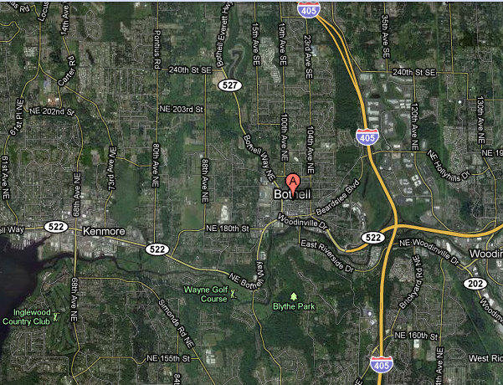
Wildlife Corridor

Slide 4
North Creek Forest
UW Wetlands
Cascadia CC
UW Bothell

Slide 5
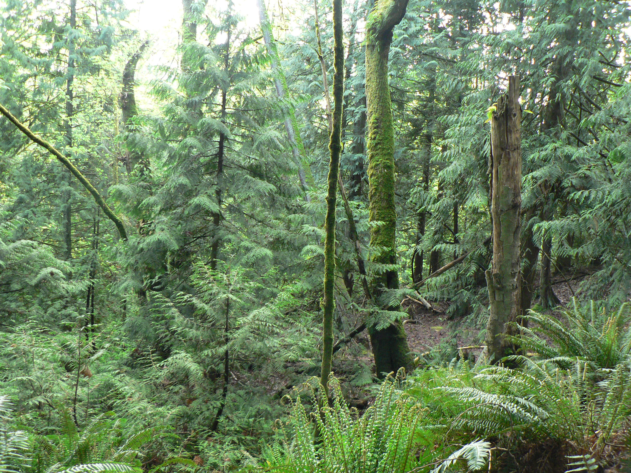
Priority Habitat

Slide 6
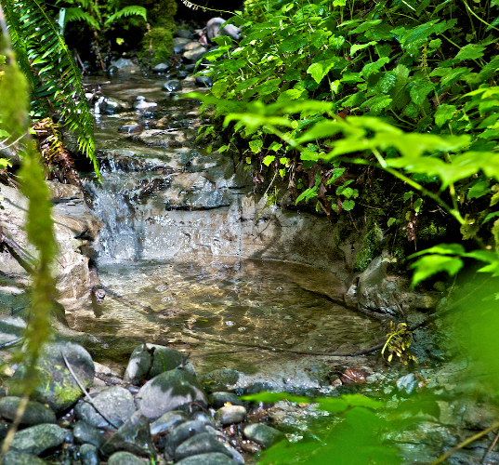
LAND and WATER

Slide 7
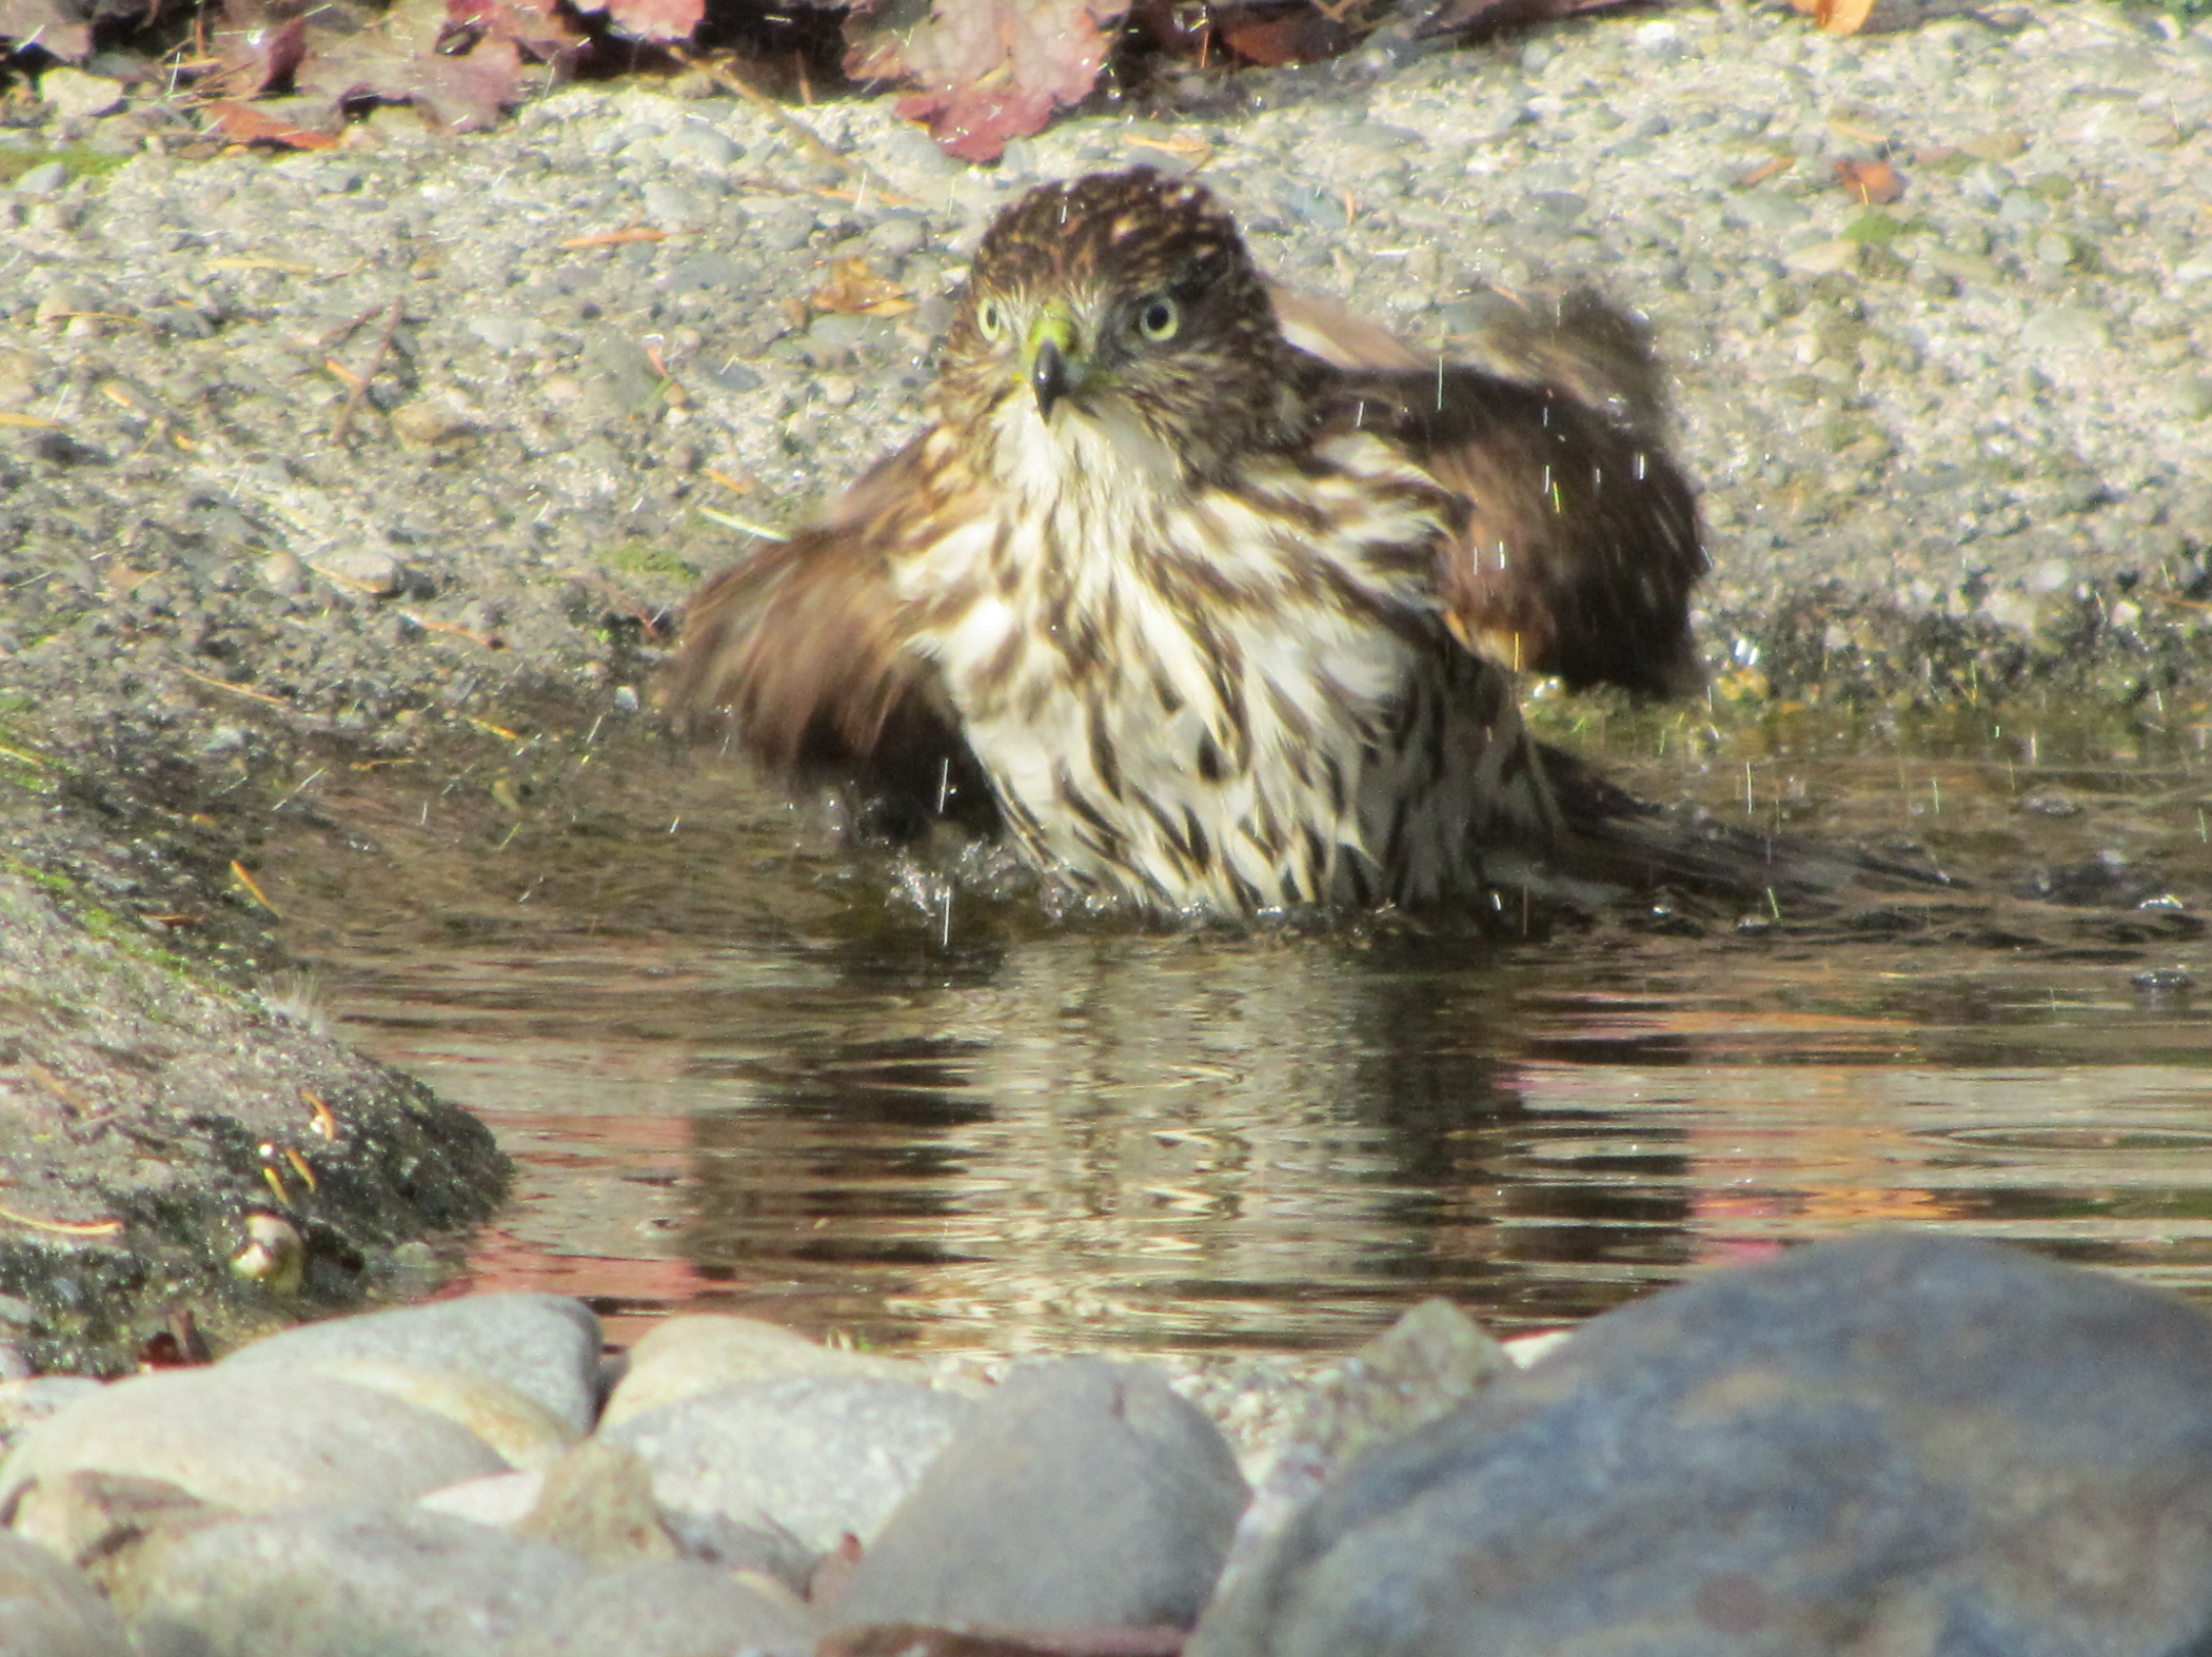
SHARP SHINNED HAWK:
INDICATES RICH HABITAT
DEPENDS ON LARGE BIRD POPULATION

Slide 8
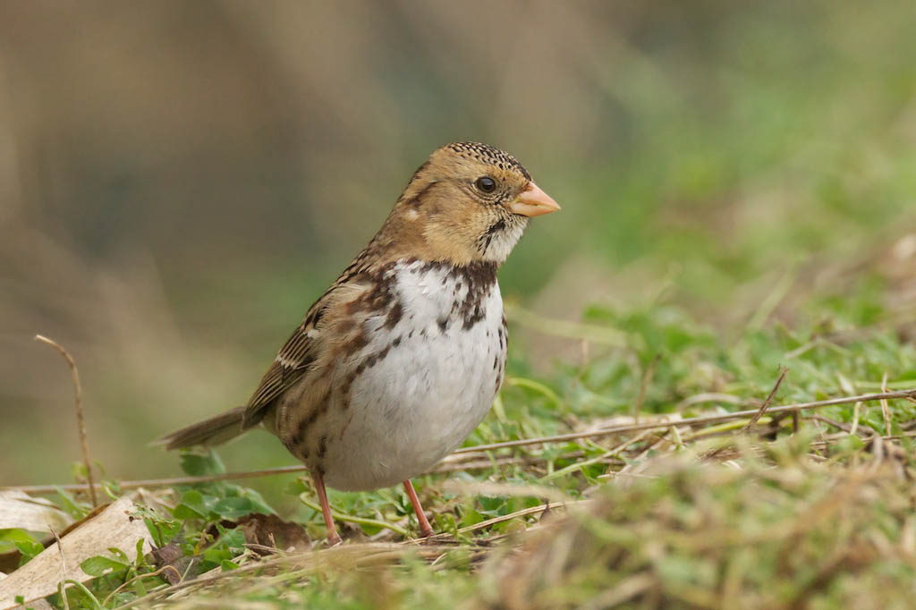
HARRIS SPARROW:
VERY RARE WEST OF CASCADES
DEPENDS ON RICH HABITAT

Slide 9
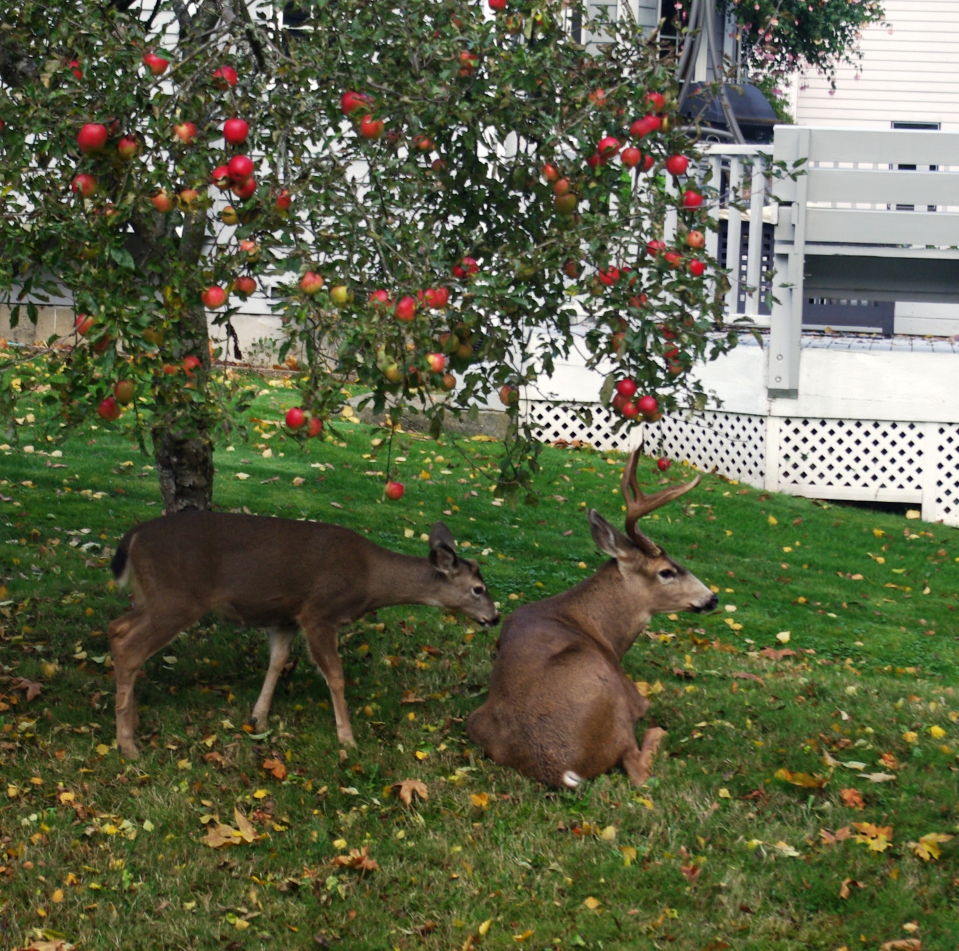
FATHER AND SON:
BREEDING POPULATION
IN AN URBAN FOREST

Slide 10
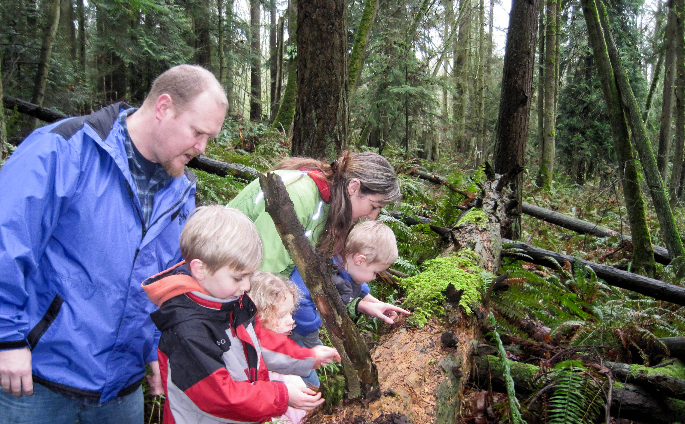
How else do we learn about a forest?

Slide 11
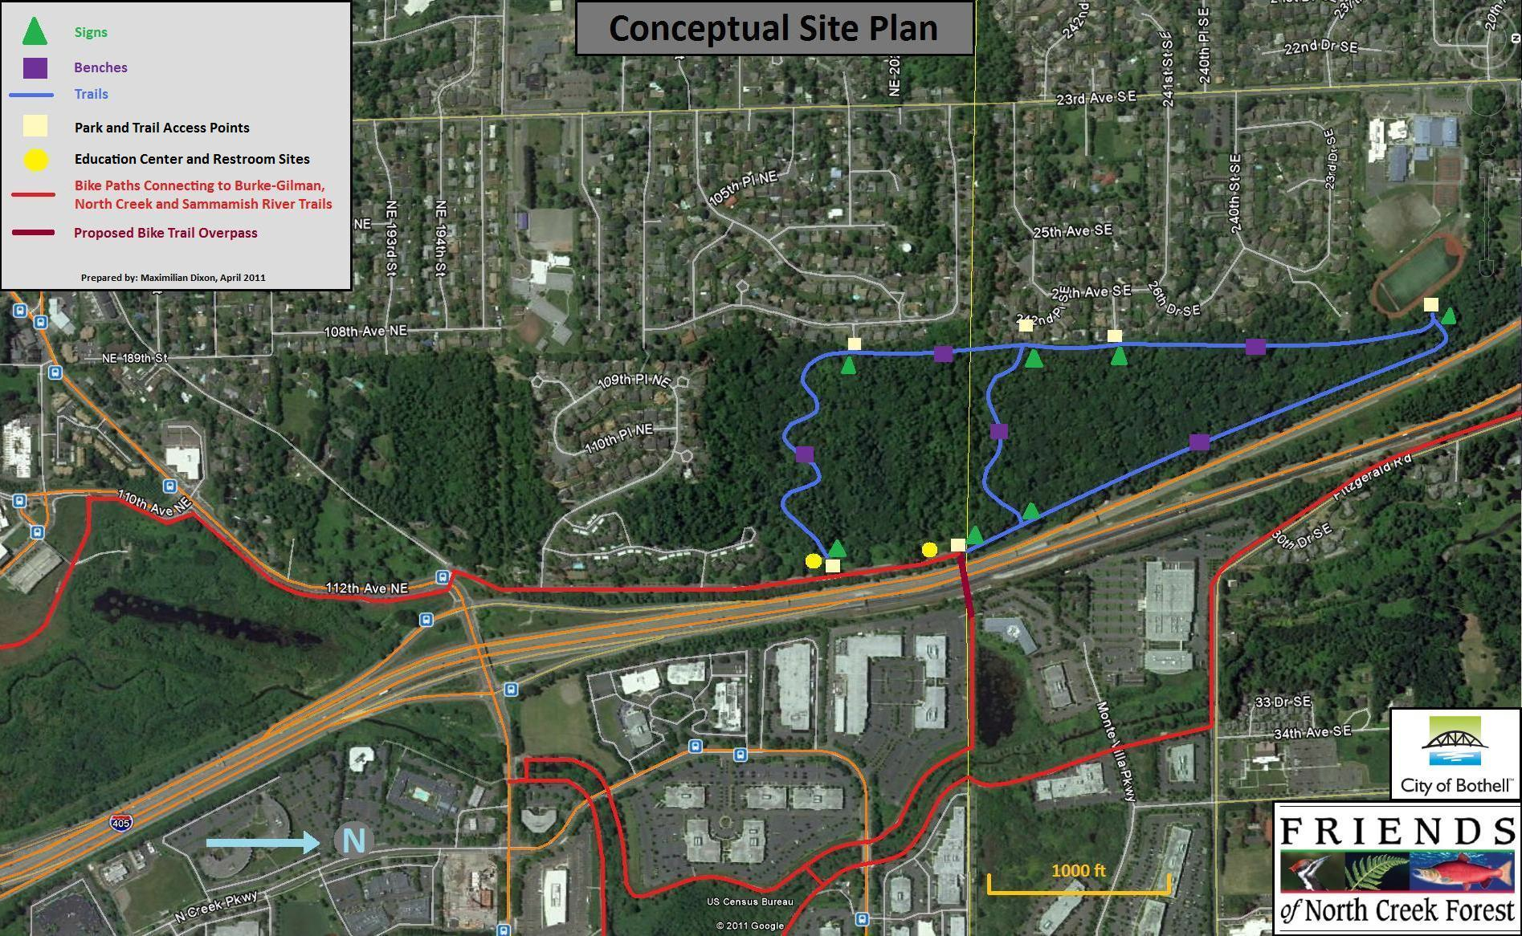
Conceptual Site Plan
SCORP
P
Residential Neighborhoods and Canyon Park JHS Running Track
W W
W
W
W
P
W – Walk in only
P – Auto parking
Workplace

Slide 12
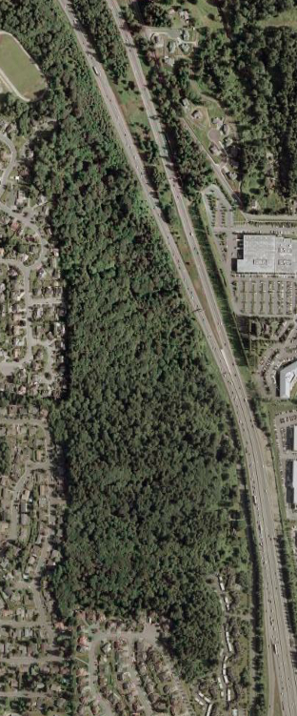
6
North Creek Forest
4
3
5
5
Bothell
City Hall
7
2
1
9000 Students
within walking distance

Slide 13
Phase One Goal:
Acquire 2 parcels…
35 acres
Purchased December 2011
Snohomish Co.
King Co.
6 acres
Purchase complete in
Summer 2012
CamWest 4.21 Acres

Slide 14
Phase TWO Goal:
Acquire connecting parcel…
Snohomish Co.
King Co.
8.8 acres
Direct purchase through
Grants and private
Awards
Need willing seller
CamWest 4.21 Acres

Slide 15
Phase Three Goal:
Acquire remaining two parcels
through direct purchase
and/or TDR
Snohomish Co.
King Co.
CamWest 4.21 Acres

Slide 16
Establish perpetual conservation
and Friends partnership
with the City of Bothell
Snohomish Co.
King Co.
CamWest 4.21 Acres

Slide 17
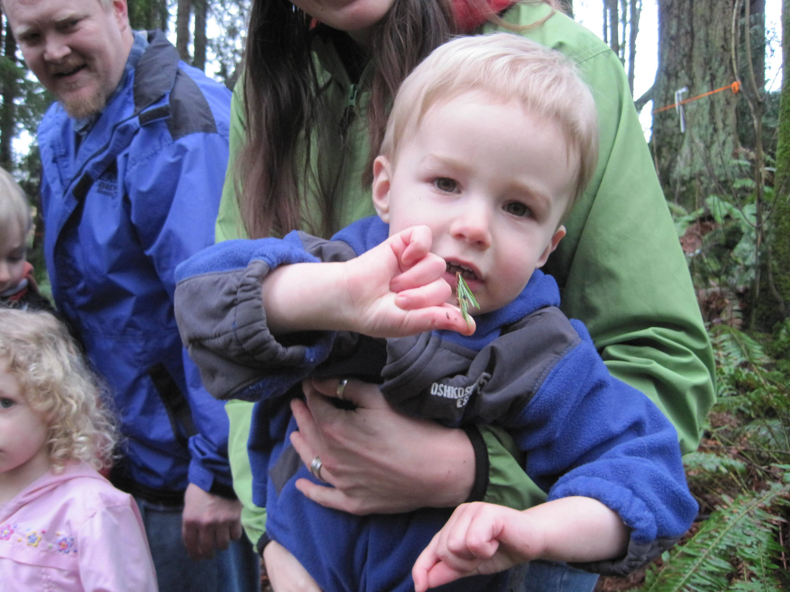
DISCOVERY

Slide 18
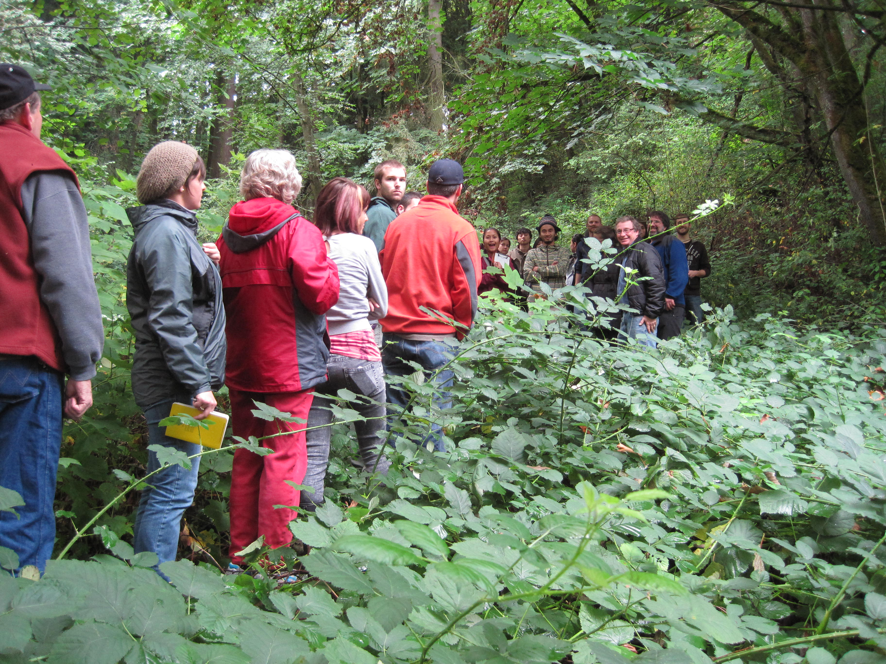
EDUCATION

Slide 19
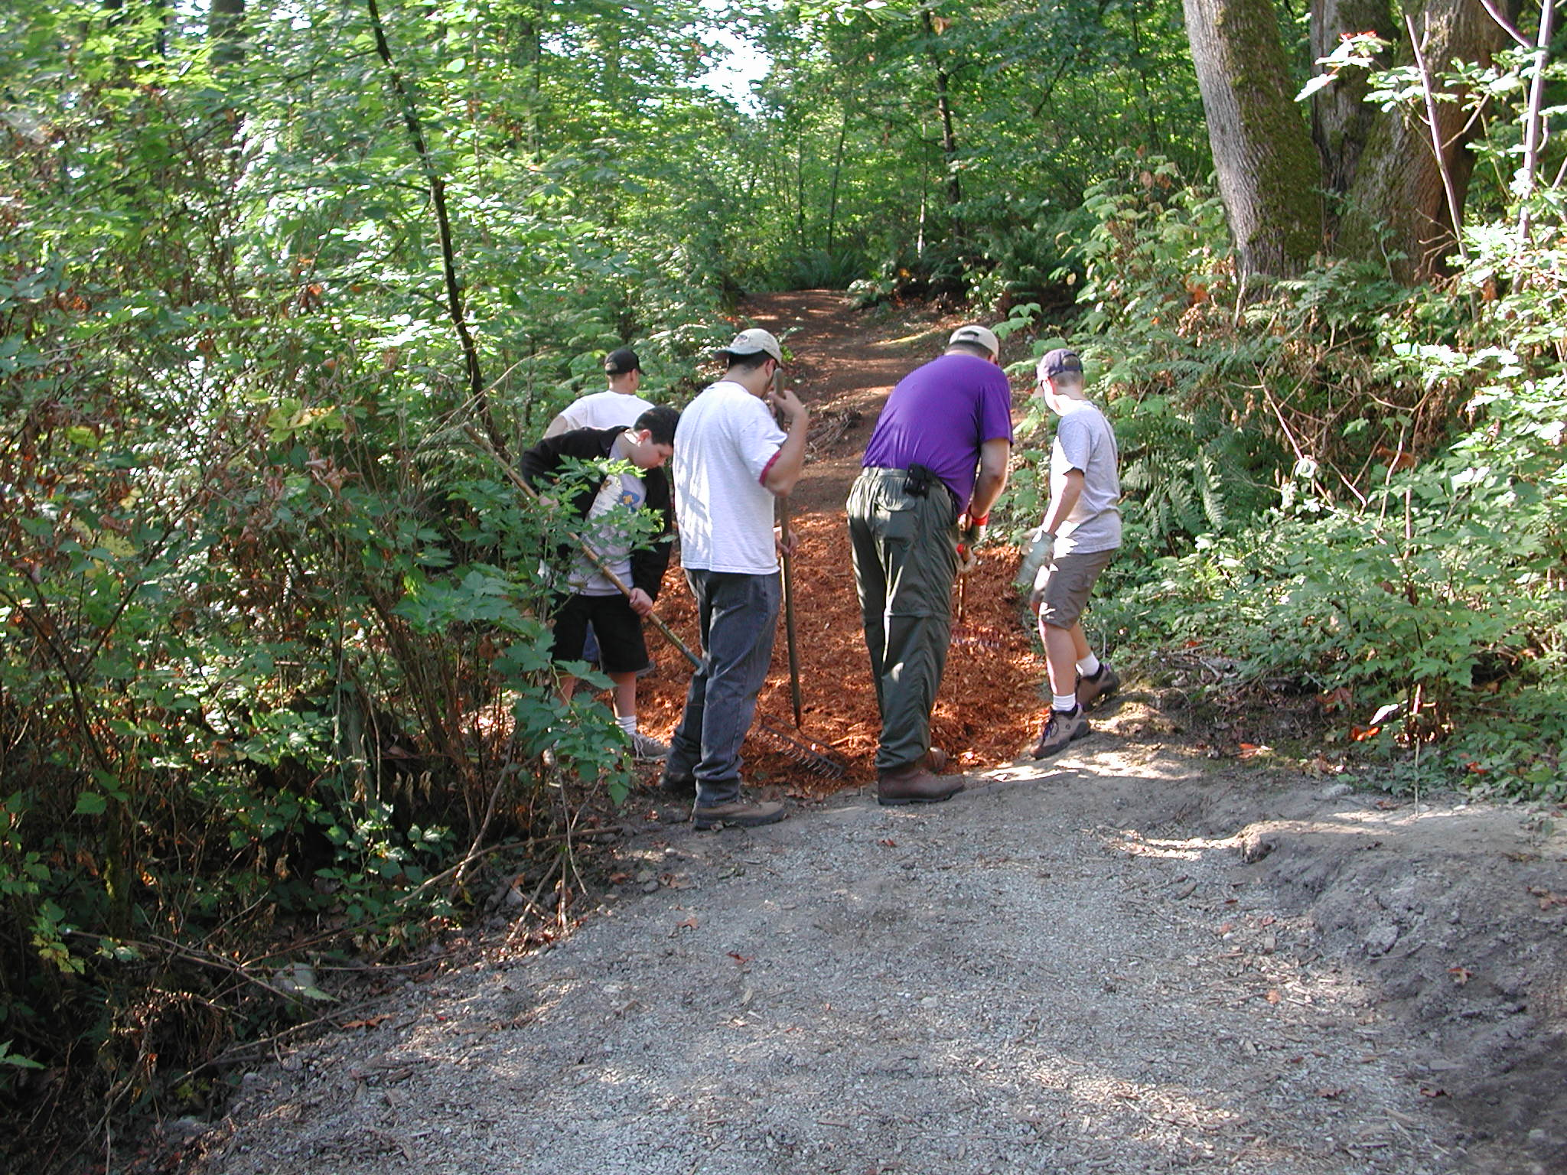
STEWARDSHIP

Slide 20
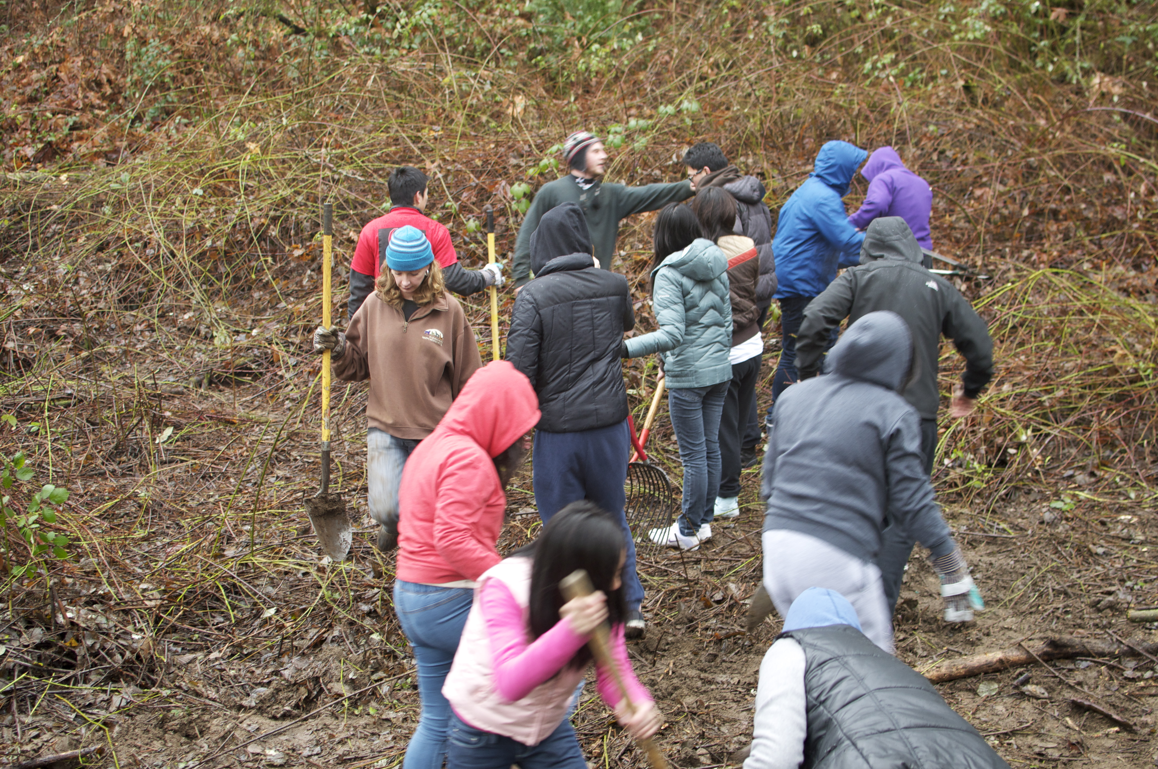
STEWARDSHIP

Slide 21
