Slide 1
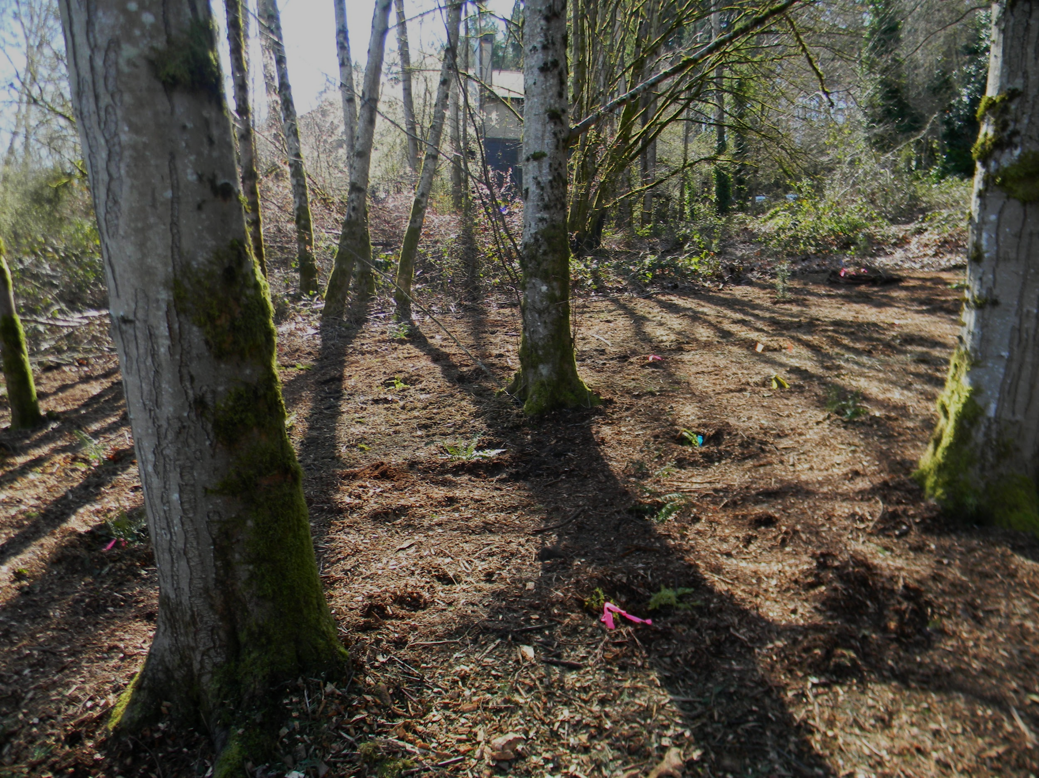
North Creek Forest
Project Site 7
UW REN Team 2017-2018
Rebecca Bruemmer | Mahleah Grant | Candice Magbag
Kendra Potoshnik | Johnathon Rutledge

Slide 2
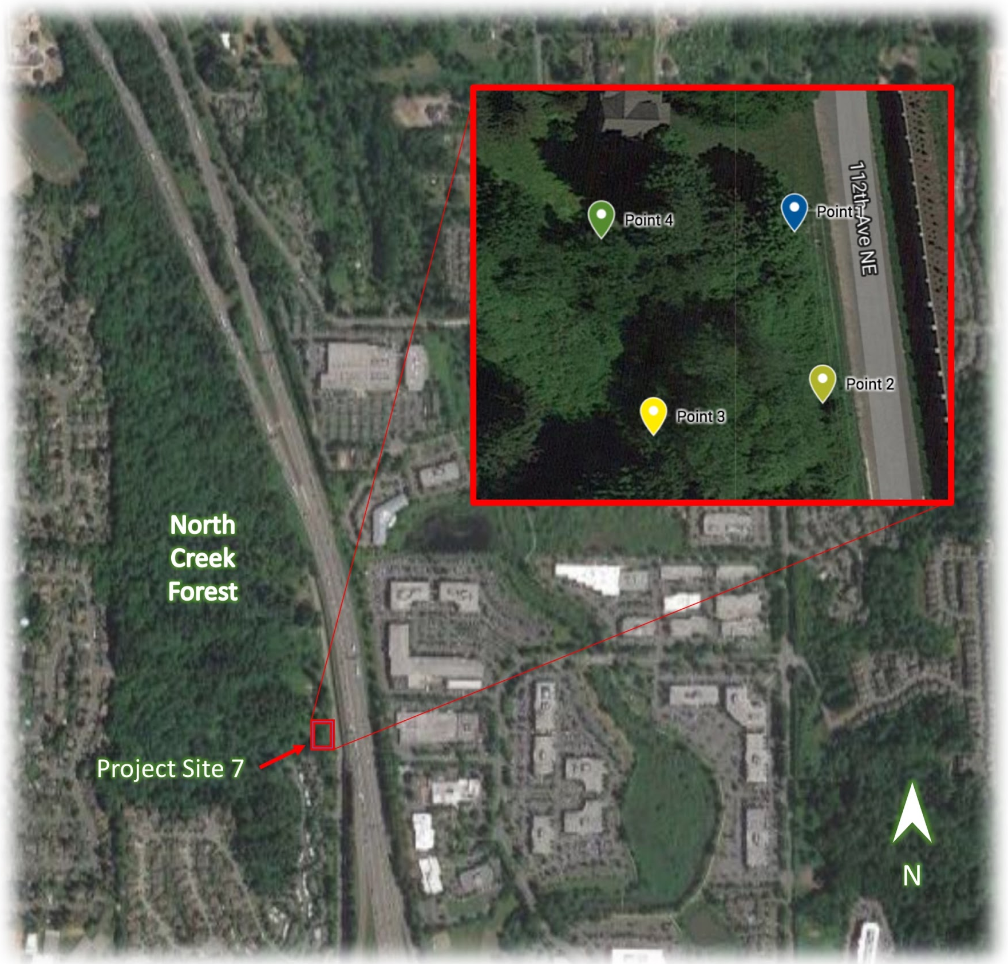

Slide 3
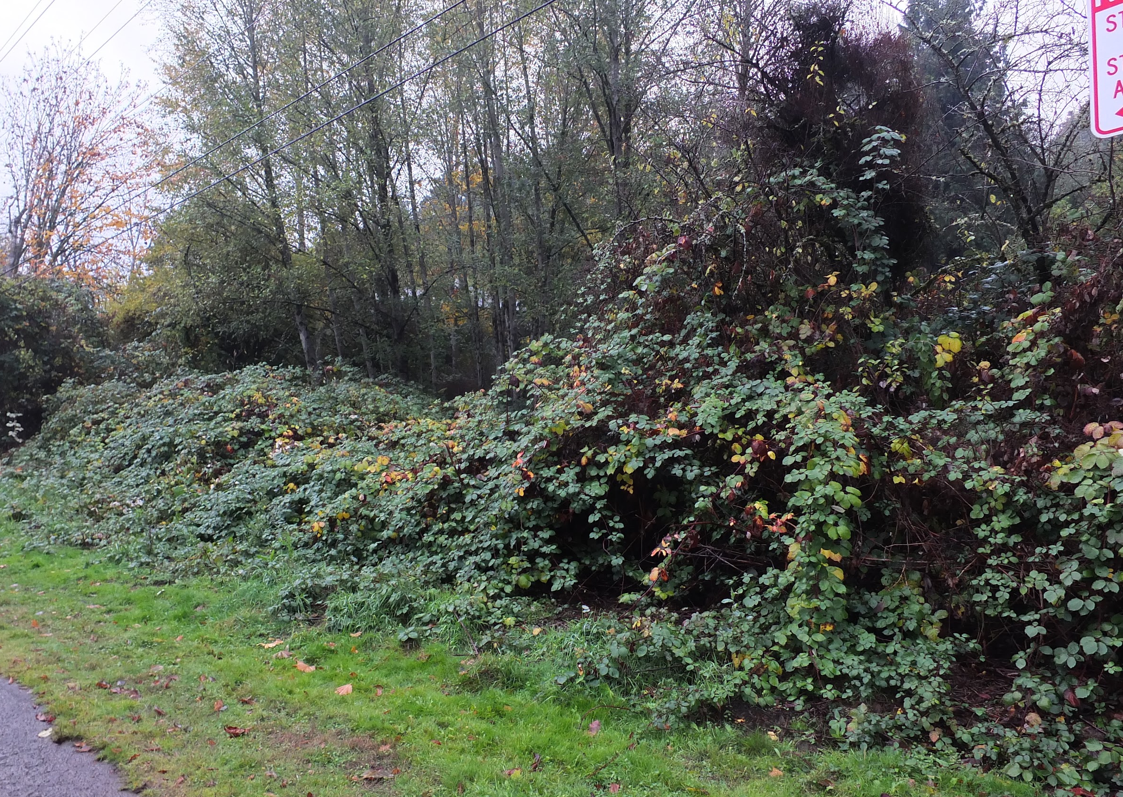
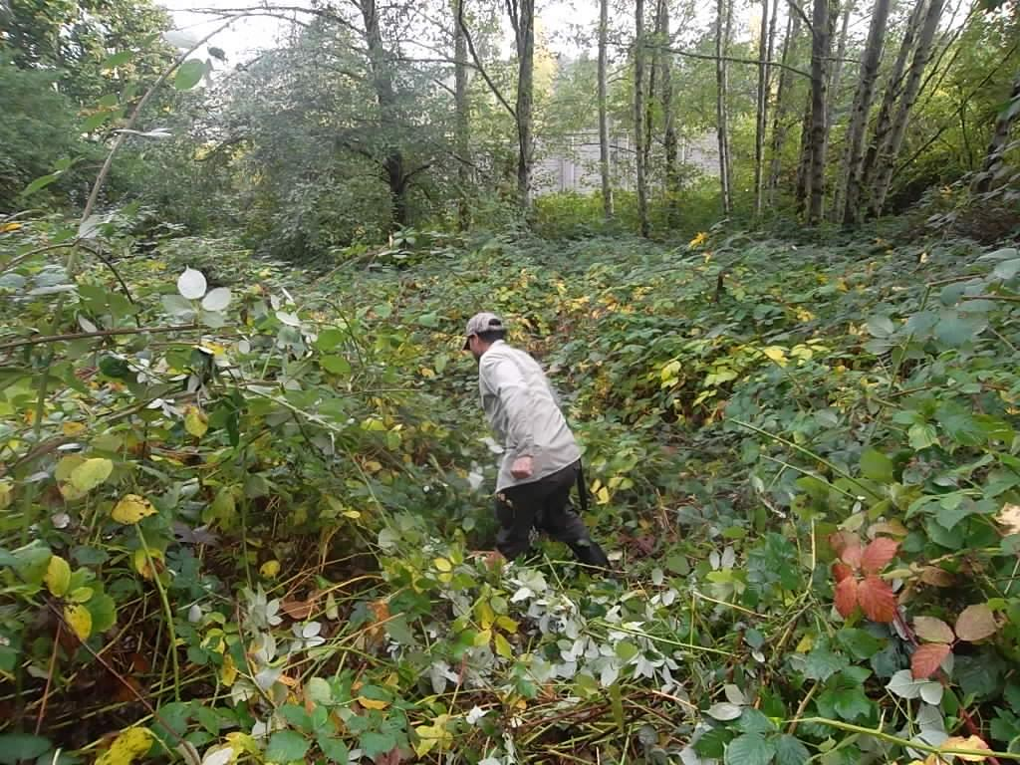
Site Assessment - October 2017

Slide 4
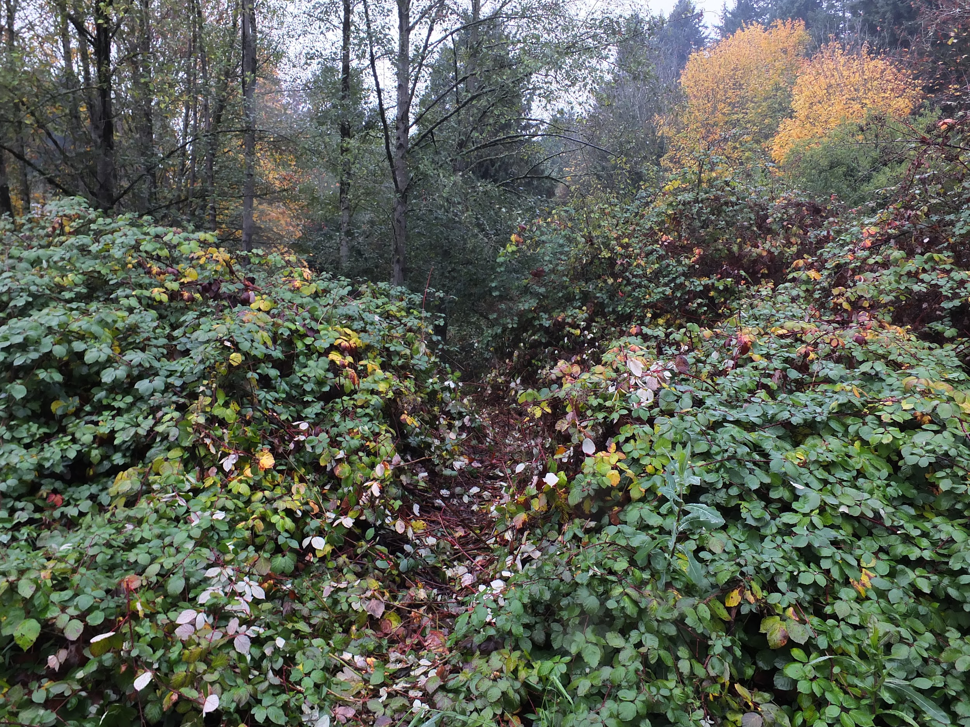
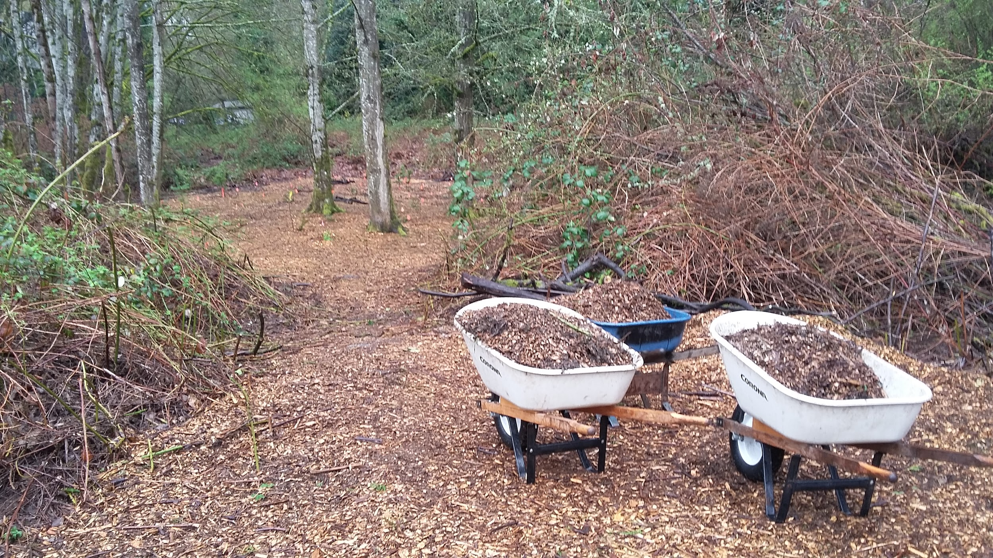
Invasive Species Removal
Before (11/11/17)
After (03/07/18)

Slide 5
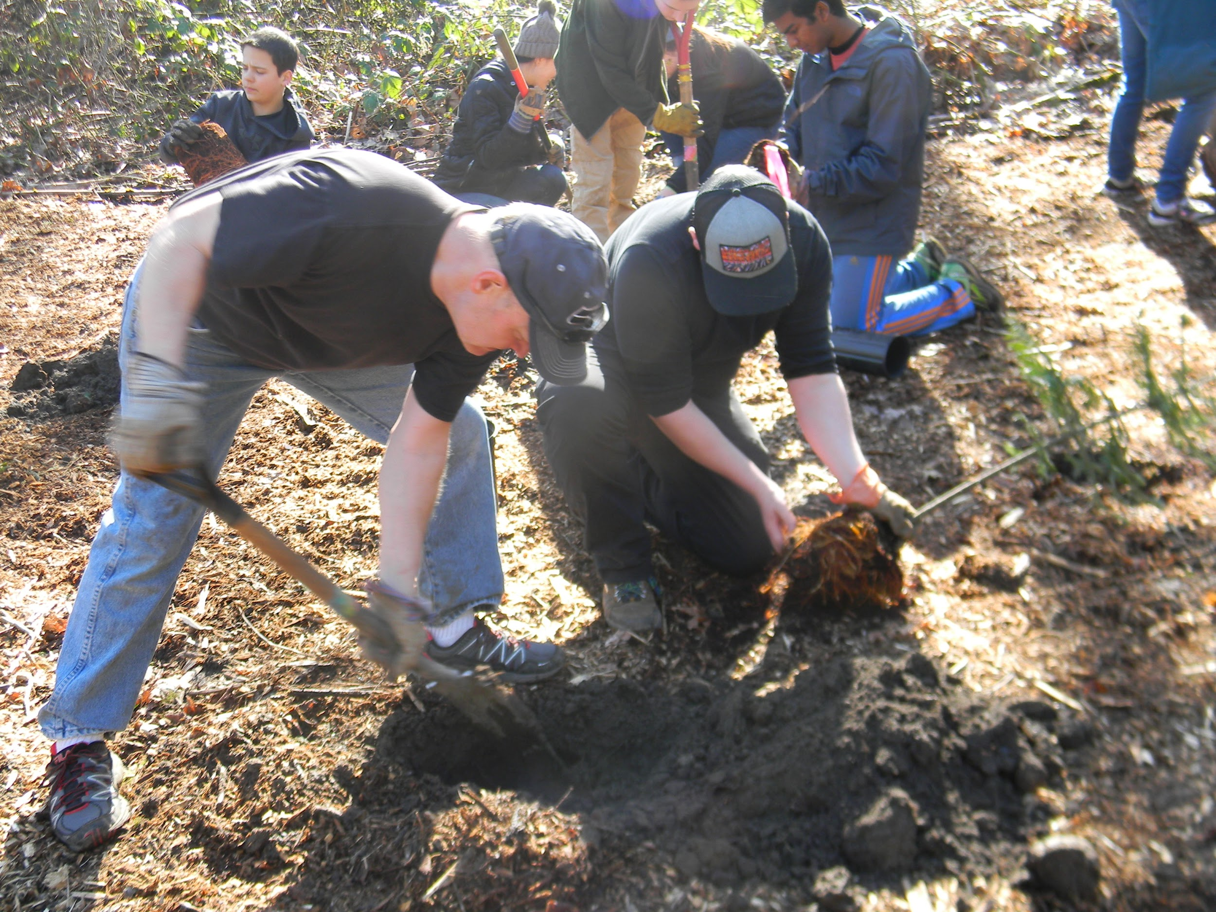
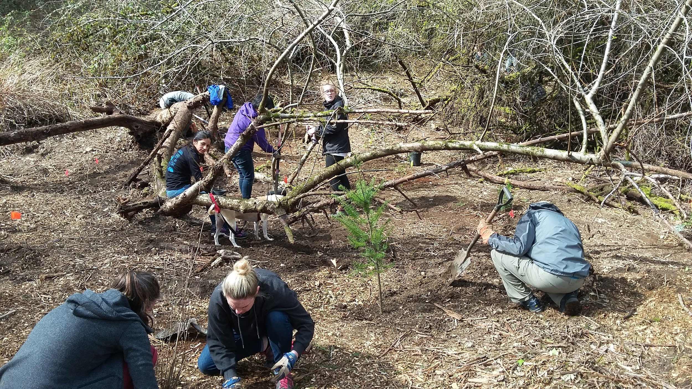
Plant Installation

Slide 6
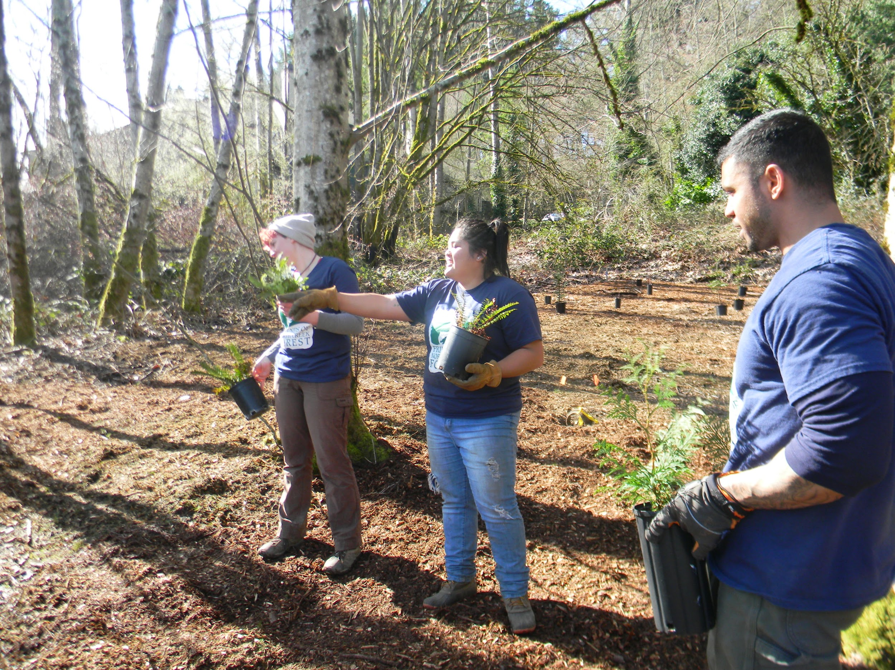
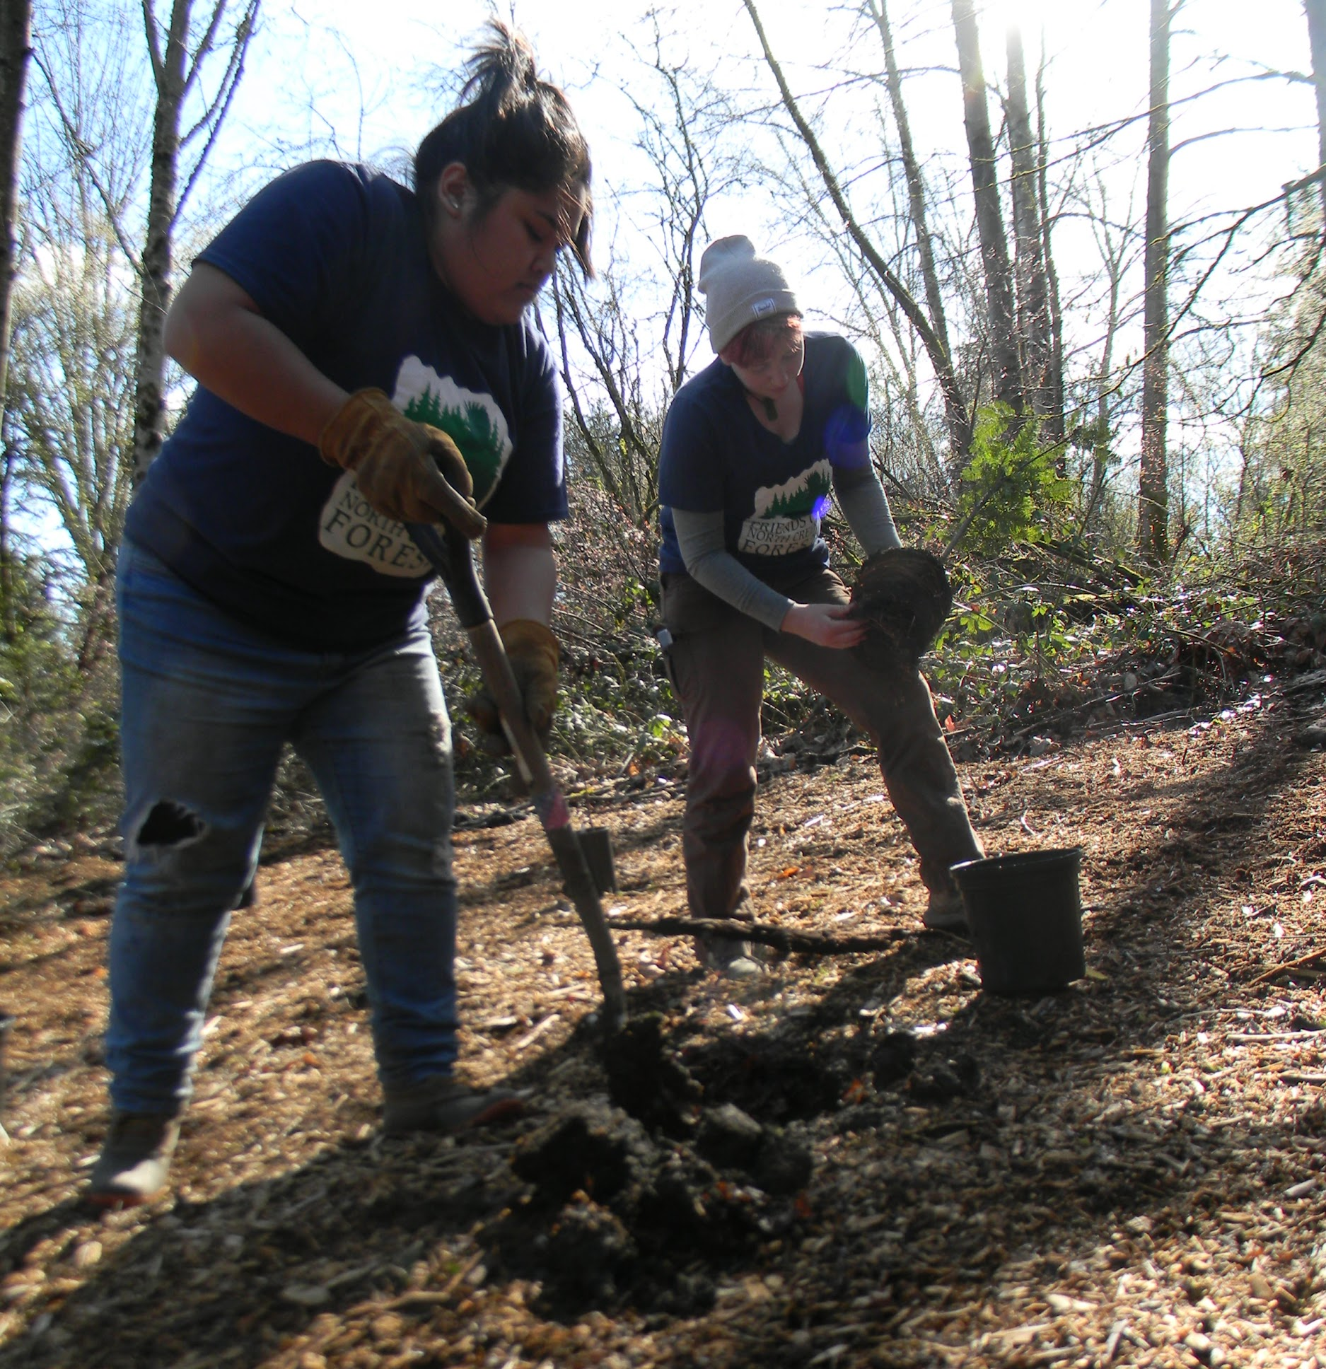
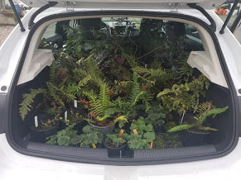
Plant Installation
Approx. 180 plants installed
At least 35 plants will be salvaged from other parts of the forest
Livestakes of Indian plum, Pacific willow, and Salmonberry

Slide 7
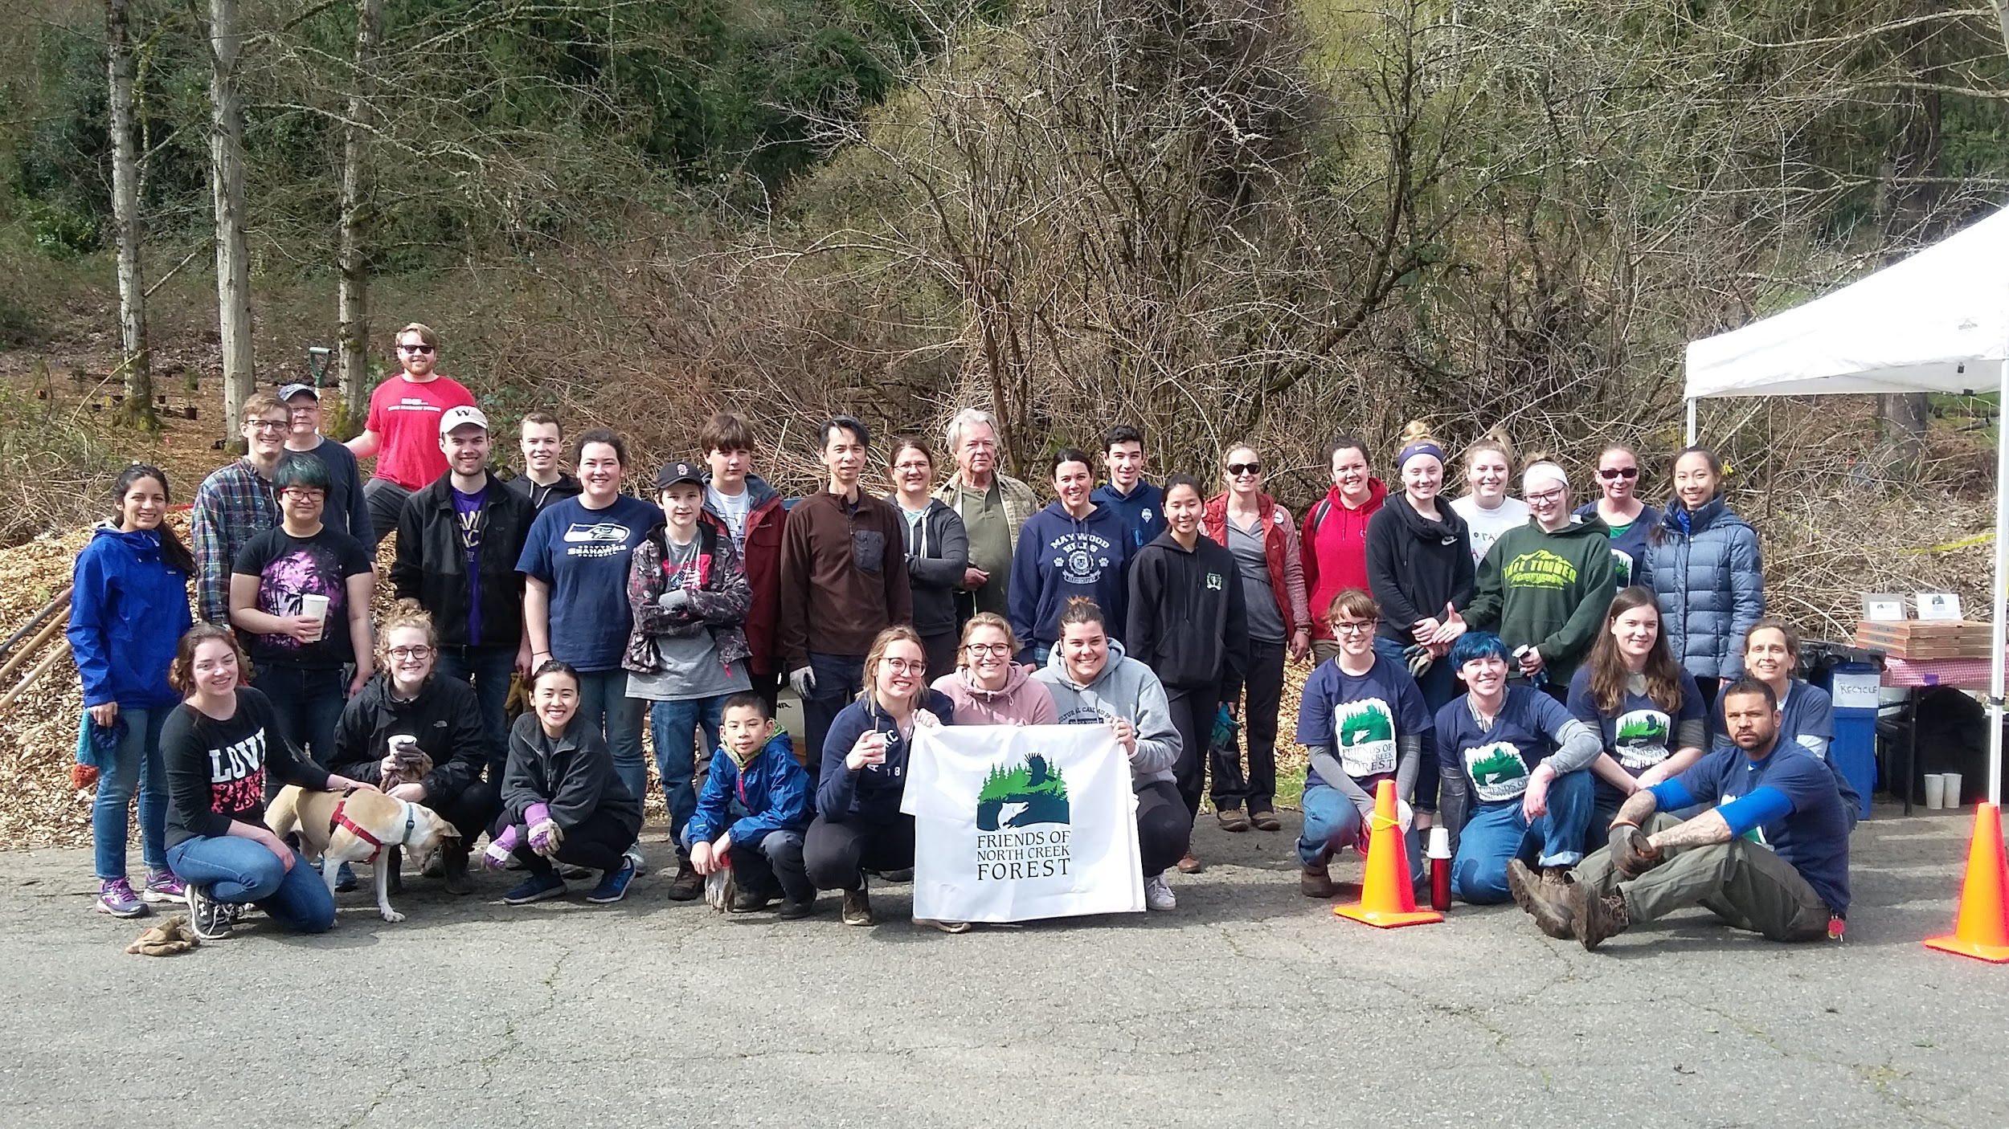
Community Involvement
8 volunteer work parties
Community service hours for high school Honor Roll students
Volunteer groups from Allstate and Target
UWB Intro to Restoration class, Outdoor Wellness
Class from Soundview School
Featured by KING5 and UWB News

Slide 8
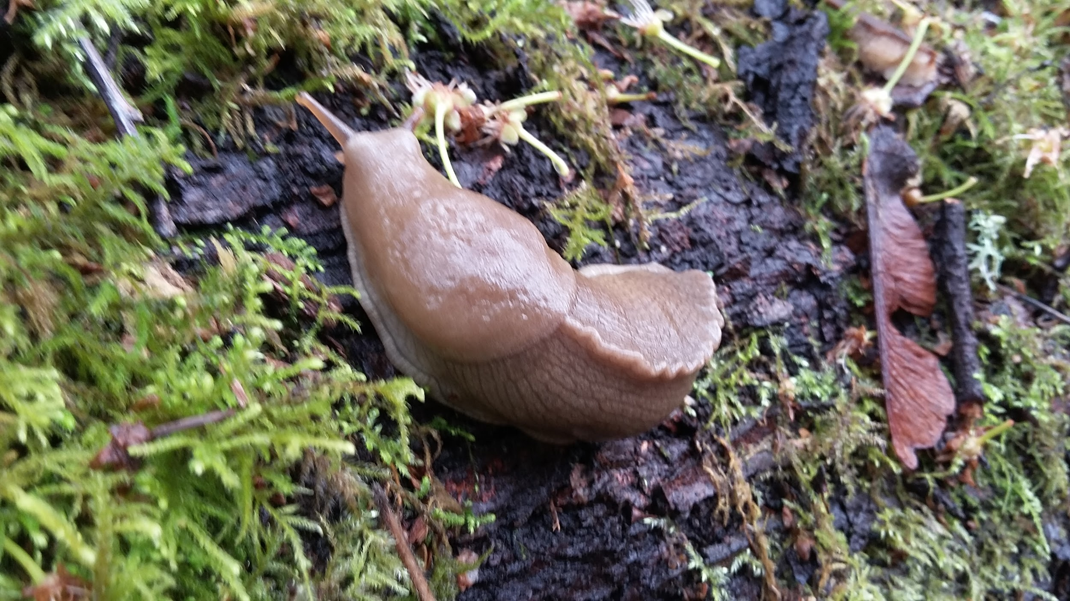
Final Work Parties/ End of Project
Finish plant salvage and live-staking
Mulch 3” deep, all holes filled
Remove any returning invasives
Train “Forest Stewards” for watering and site monitoring
Final Assignments: Stewardship Plan, Final Report
Poster Presentation: Save the Date!!
May 31st, 6-8 PM, Douglas Research Conservatory at the CUH

Slide 9
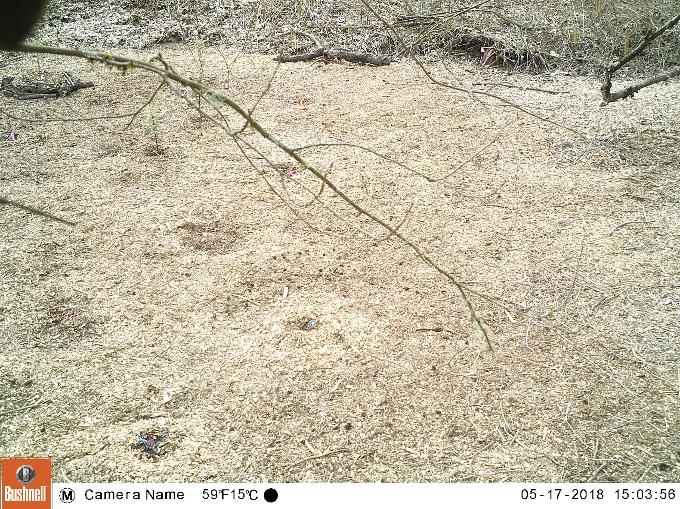
Trail Camera

Slide 10
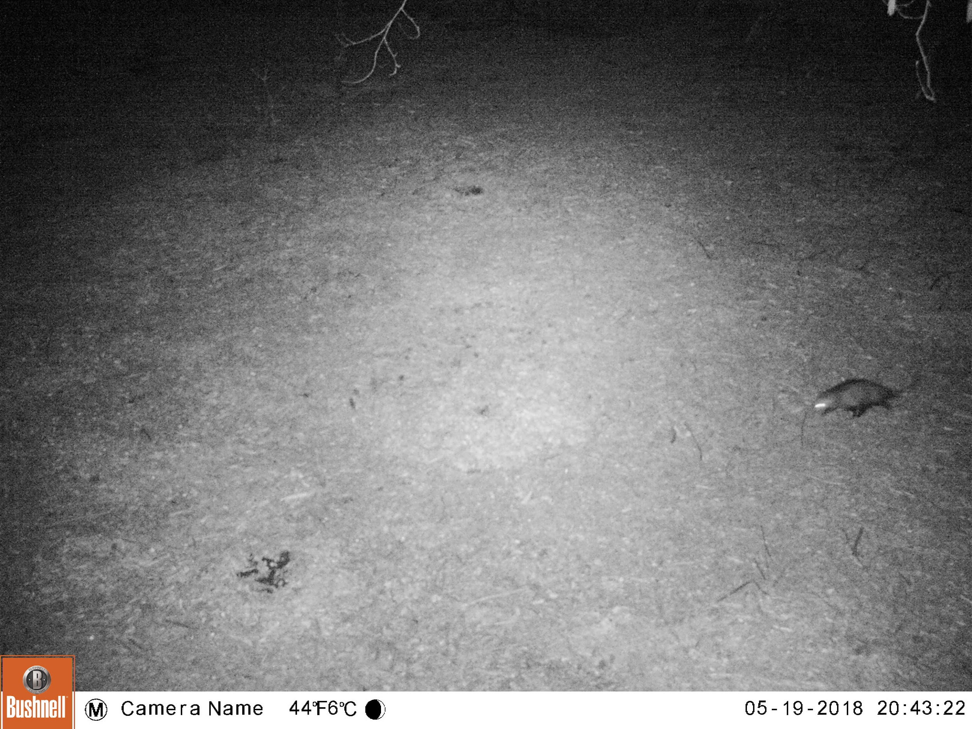

Slide 11
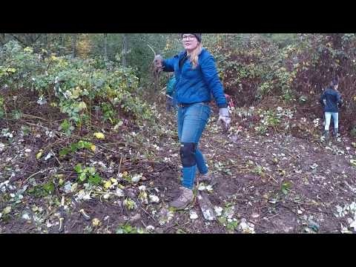

Slide 12
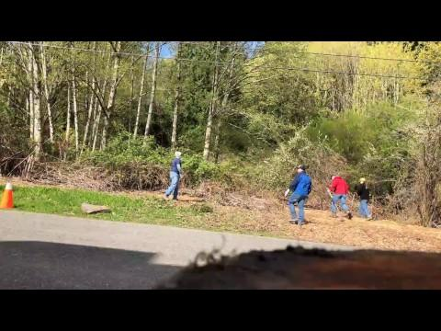

Slide 13
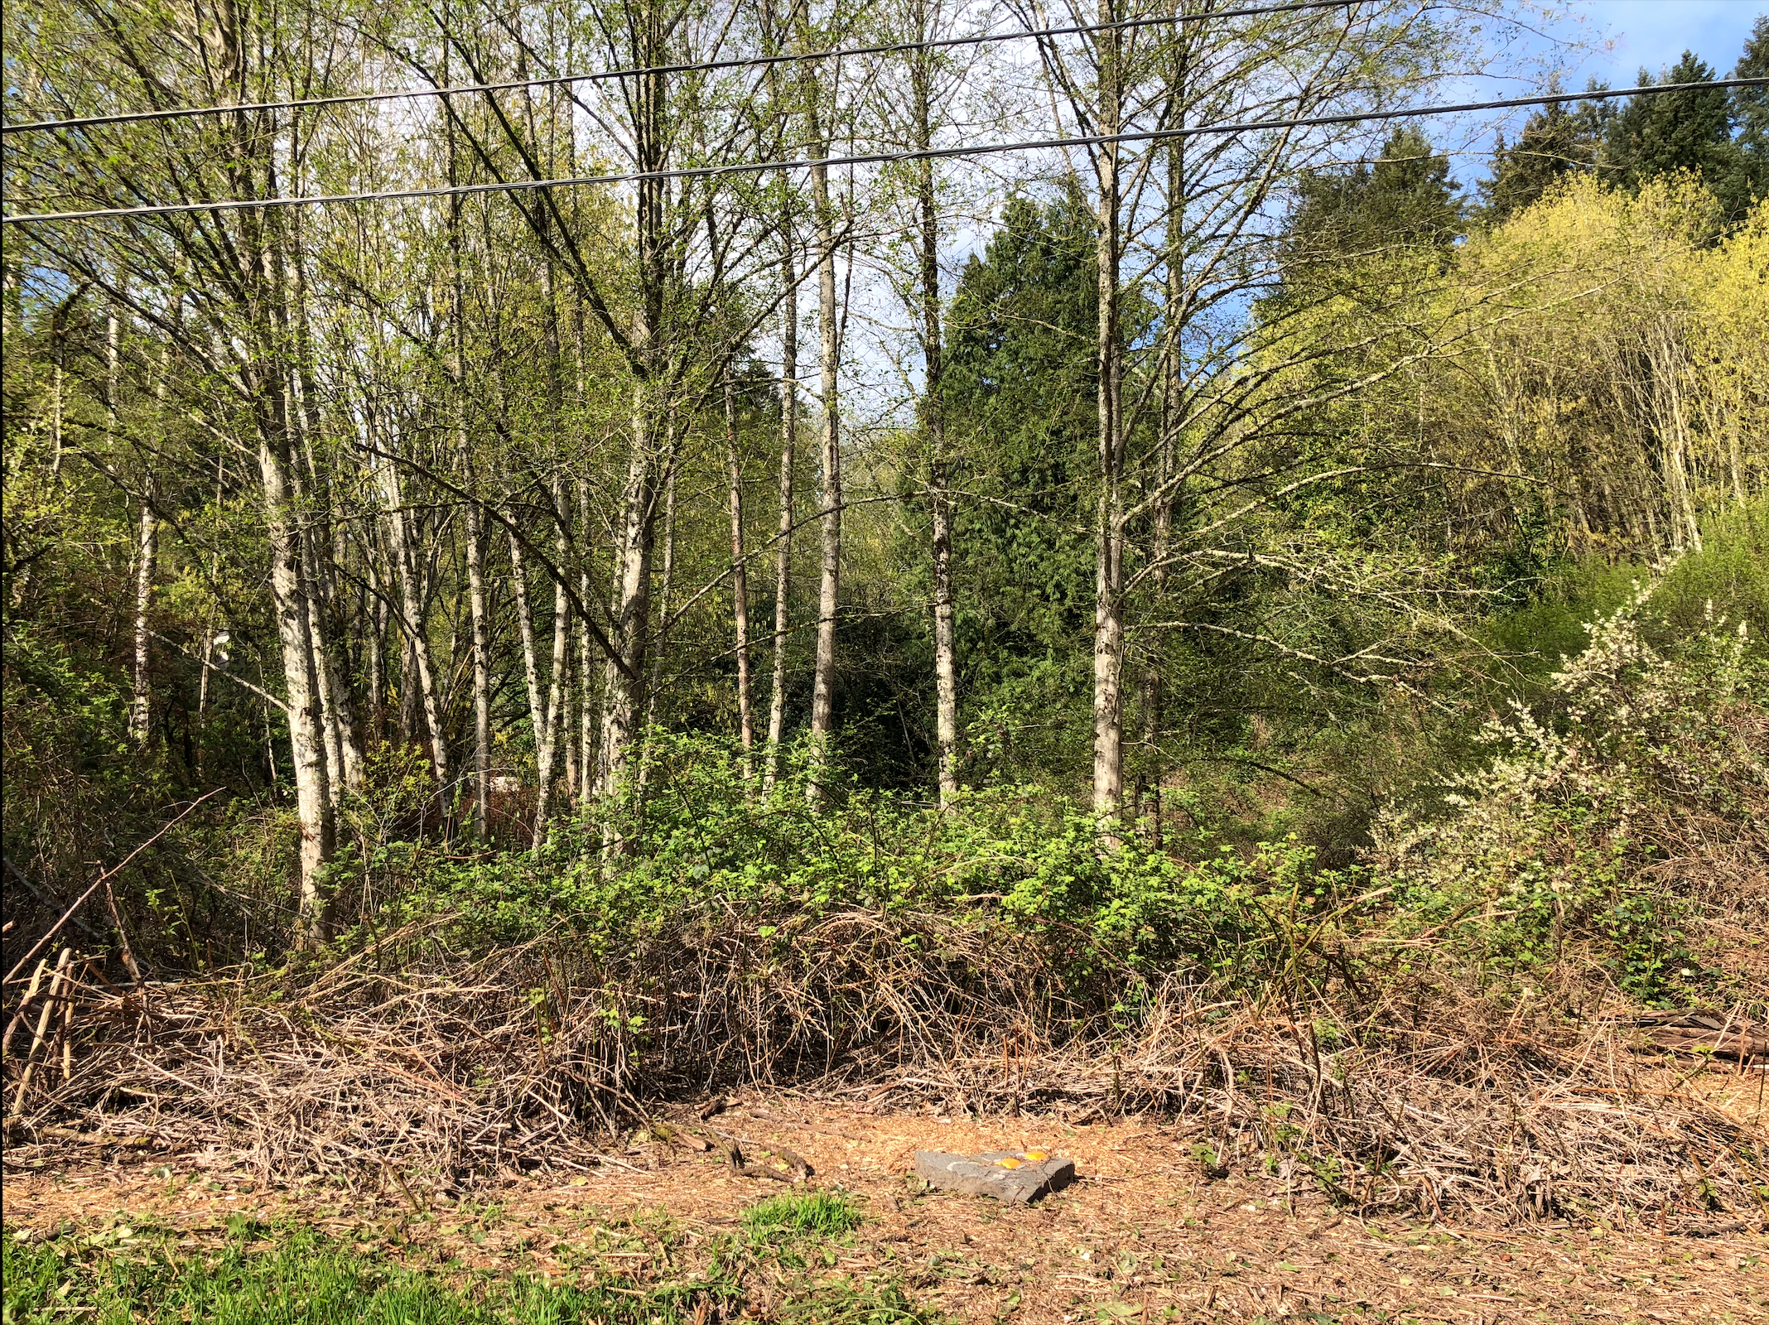
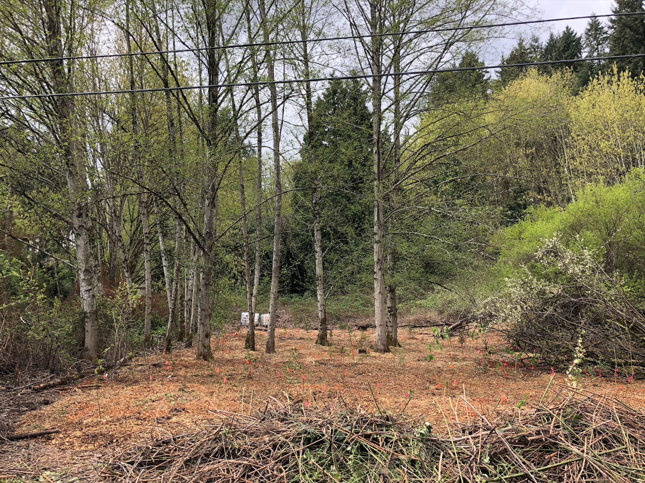
April 21, 2018 Work Party
Before
After

Slide 14
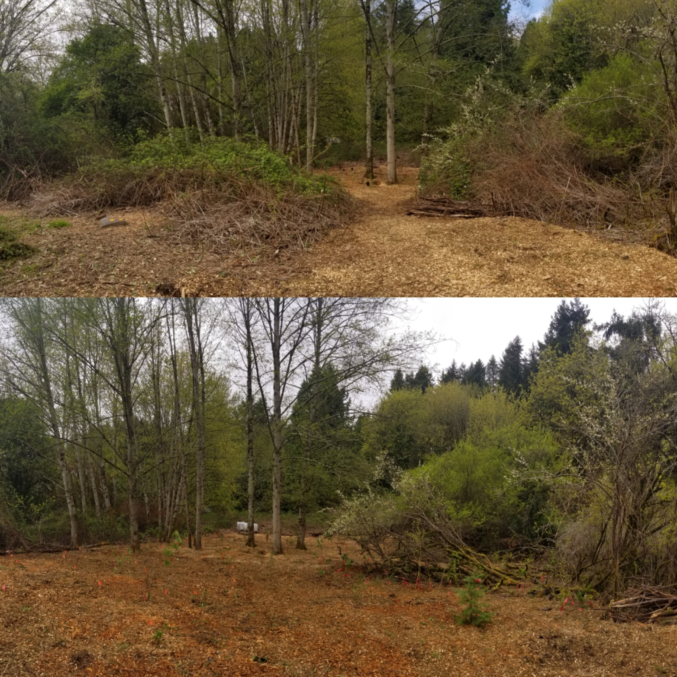

Slide 15
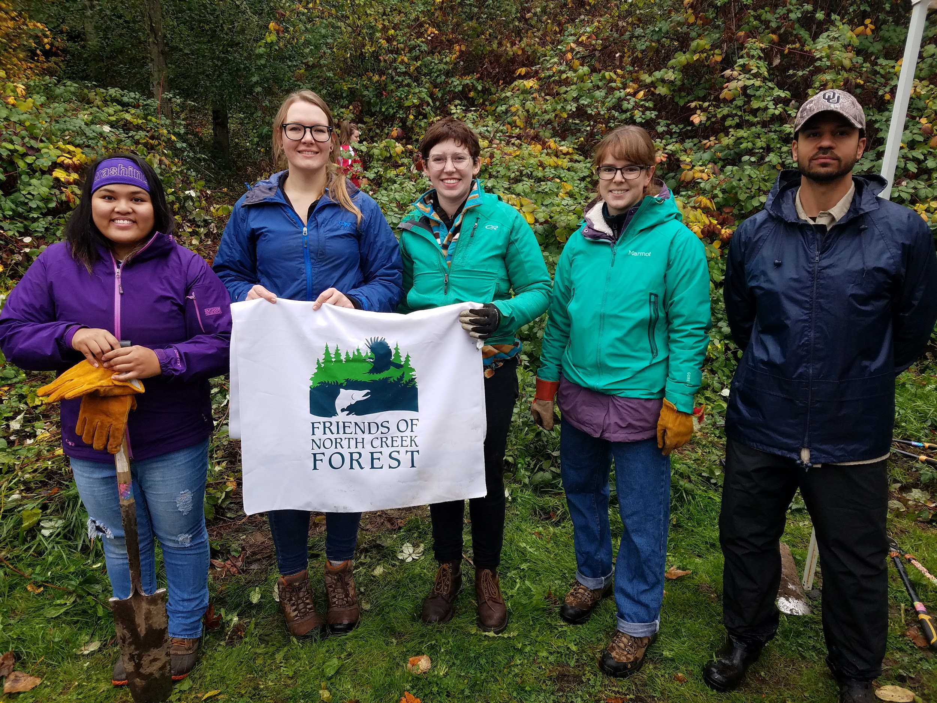
Thank You!
Questions?

