Slide 1
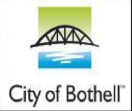
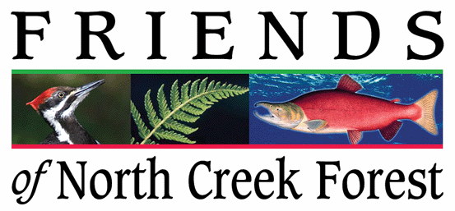
Notes:
OUR GOAL IS TO CREATE A 64 ACRE, ECOLOGICALLY SIGNIFICANT, PARK LAND WITHIN THE CITY LIMITS OF BOTHELL, WASHINGTON FOR RECREATION, EDUCATION AND THE CONSERVATION OF WILDLIFE HABITAT. TODAY THE CITY OF BOTHELL AND A CITIZENS GROUP, FRIENDS OF NORTH CREEK FOREST, SEEK A GRANT TO AQUIRE A 6 ACRE PARCEL WITHIN THIS LARGER FOREST.

Slide 2
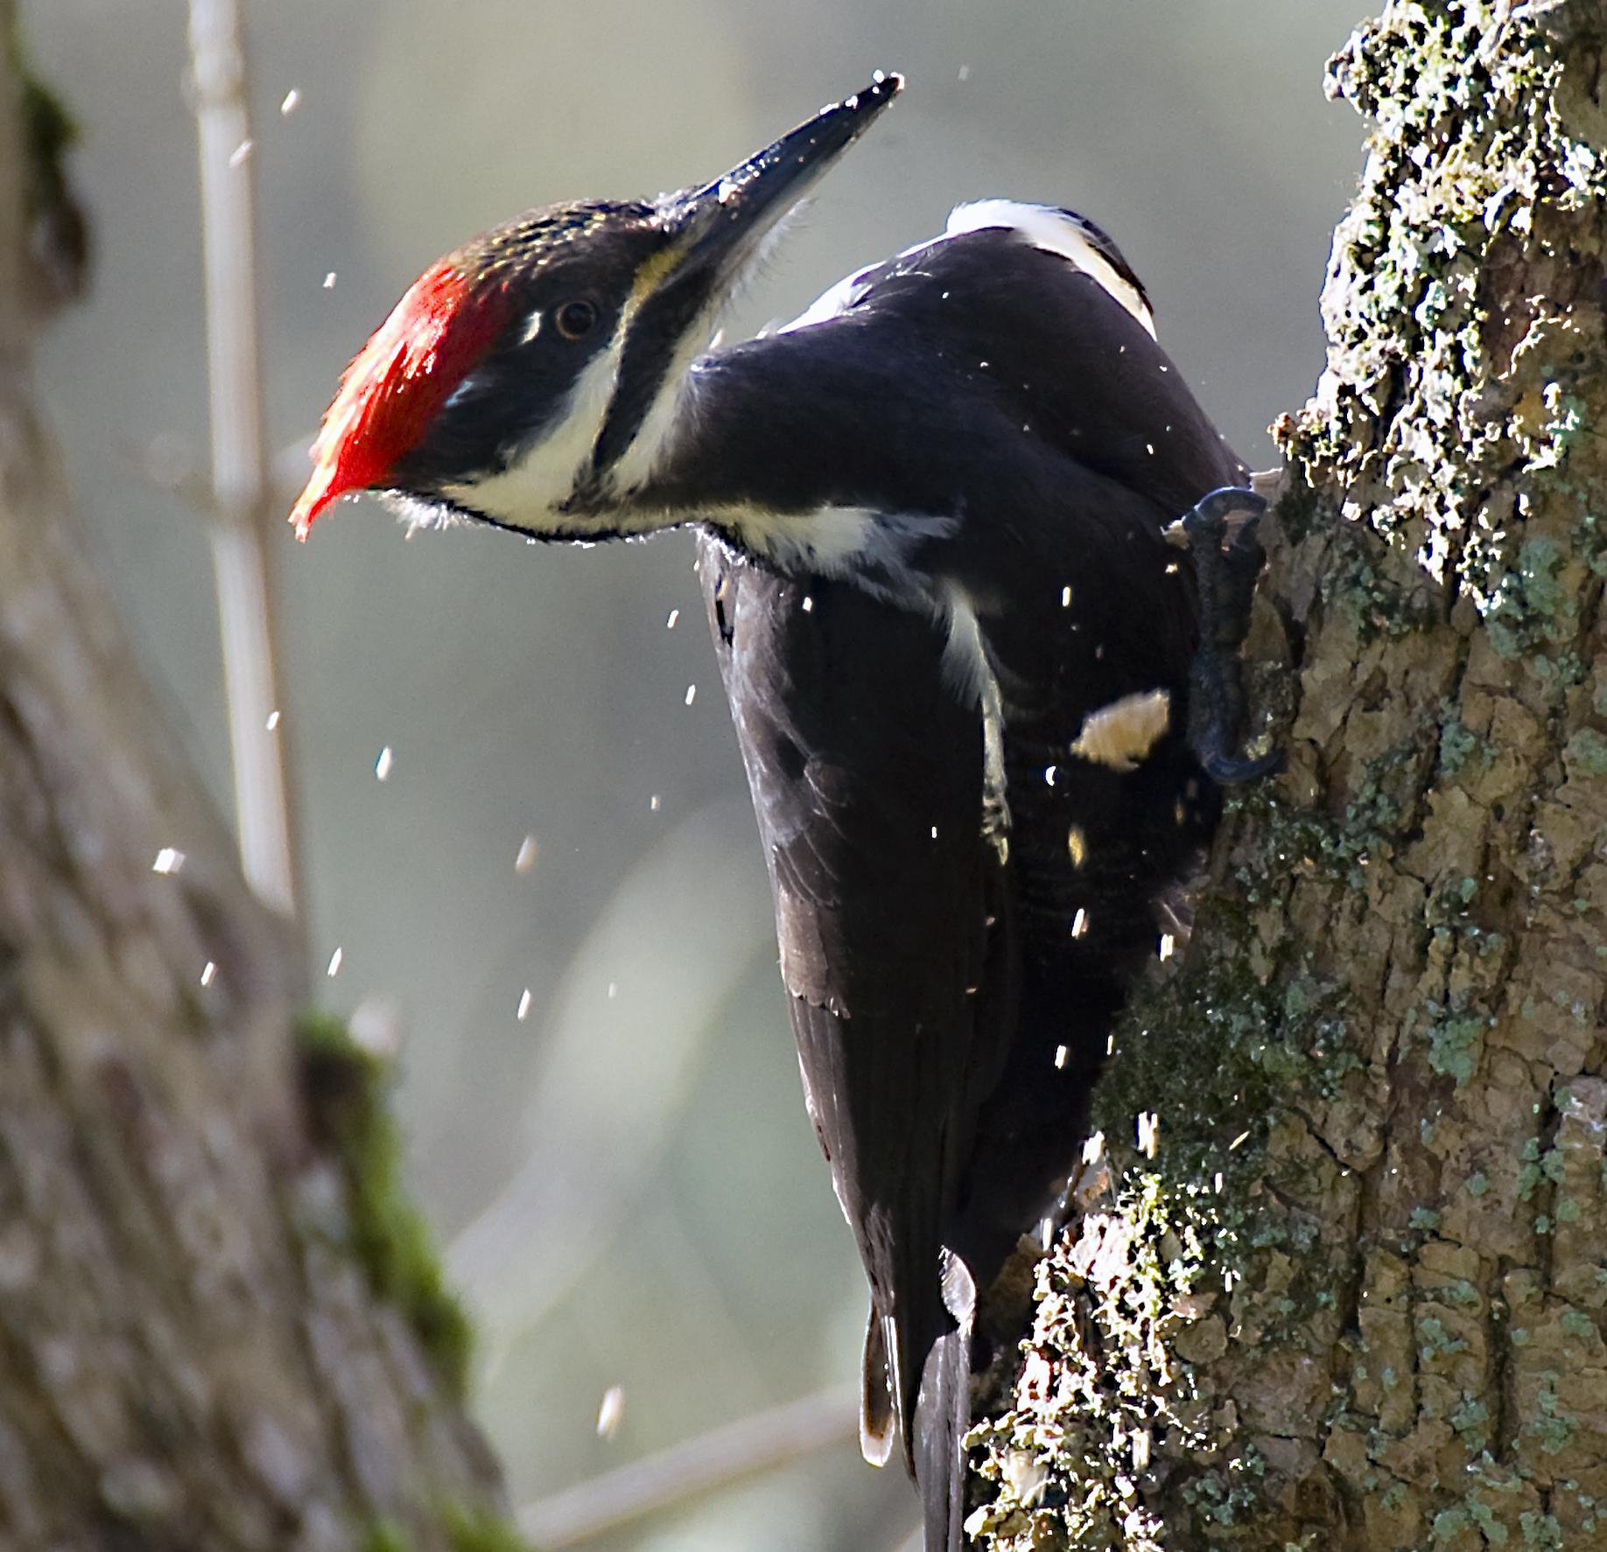
North Creek Forest
Priority Species
Saving Bothell’s Last Great Forest
Notes:
NORTH CREEK FOREST IS RICH IN DIVERSITY, BOTH IN WILDLIFE AND NATIVE PLANTS. THIS IS BOTHELL’S LAST GREAT FOREST.

Slide 3
Bothell, Washington
Notes:
THE FOREST AND THE CITY OF BOTHELL SPAN ACROSS TWO COUNTIES, KING AND SNOHOMISH.

Slide 4
North Creek Forest
Bothell
Lake Washington
Seattle
LOCATION
Notes:
BOTHELL IS LOCATED TEN MILES NORTHEAST OF SEATTLE. THE FOREST IS ABOUT ONE MILE FROM BOTHELL’S CITY HALL.

Slide 5
Phase One Goal:
Acquire 2 parcels…
35 acres
In purchase negotiations
Snohomish Co.
King Co.
6 acres
Subject of current application
CamWest 4.21 Acres
Notes:
NORTH CREEK FOREST IS COMPOSED OF 5 PARCELS. THREE GRANTS HAVE MADE IT POSSIBLE FOR BOTHELL TO ENTER INTO NEGOTIATIONS TO PURCHASE THE TOP 35 ACRES. THE HIGHLIGHTED 6 ACRE PARCEL IS THE SUBJECT OF TODAY’S APPLICATION.

Slide 6
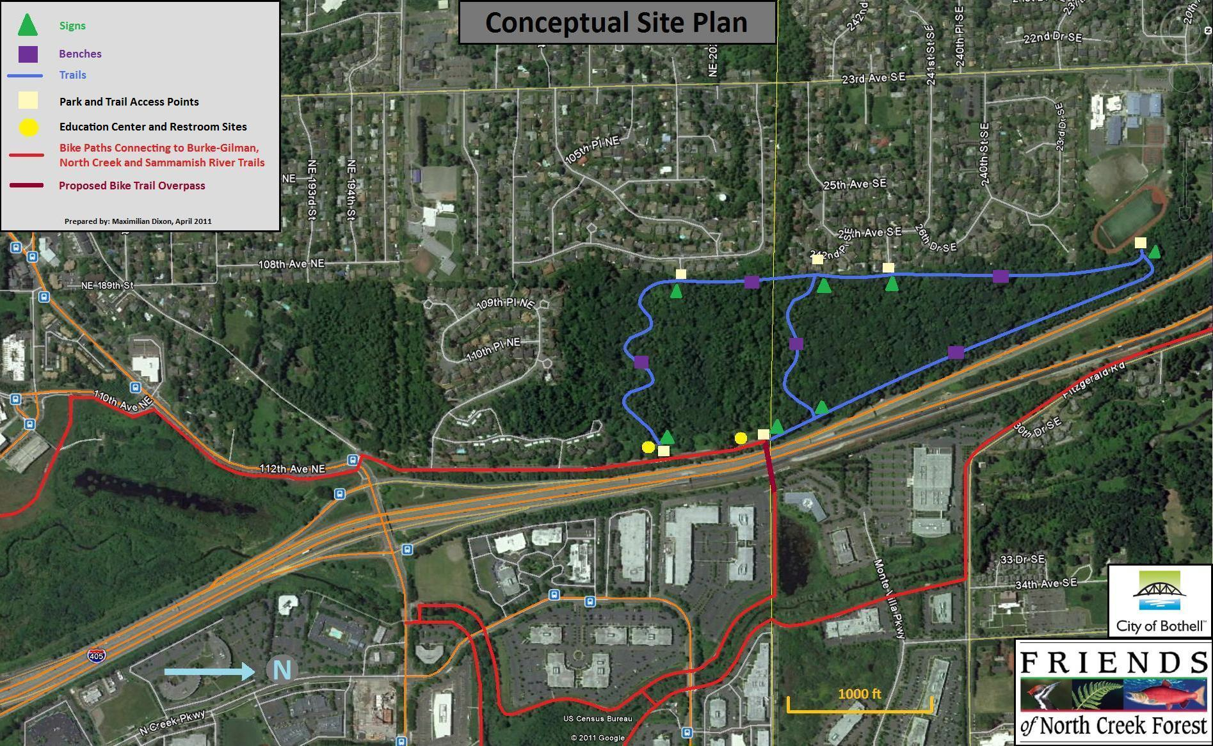
Conceptual Site Plan
SCORP
P
Residential Neighborhoods and Canyon Park JHS Running Track
W W
W
W
W
P
W – Walk in only
P – Auto parking
Workplace
Notes:
OK, LETS DISCUSS SCORP AND OVERALL CONCEPTUAL DESIGN : OUR CURRENT APPLICATION IS FOR ACQUISITION. PLANNED RECREATIONAL USES WILL INCLUDE WALKING
(TRAILS IN BLUE), HIKING, CROSS COUNTRY RUNNING, SOME LEVEL, LOW STRESS WALKING SECTIONS AND CONNECTION TO A REGIONAL TRAIL SYSTEM (IN RED). PROPOSED
ACCESS POINTS AND TRAILS PROVIDE ACTIVE CONNECTIONS TO THE WORKPLACE, FOREST, NEIGHBORHOODS AND SCHOOL. PARKING IS SHOWN IN TWO LOCATIONS WITH WALK IN
ACSESS AT FIVE POINTS.

Slide 7
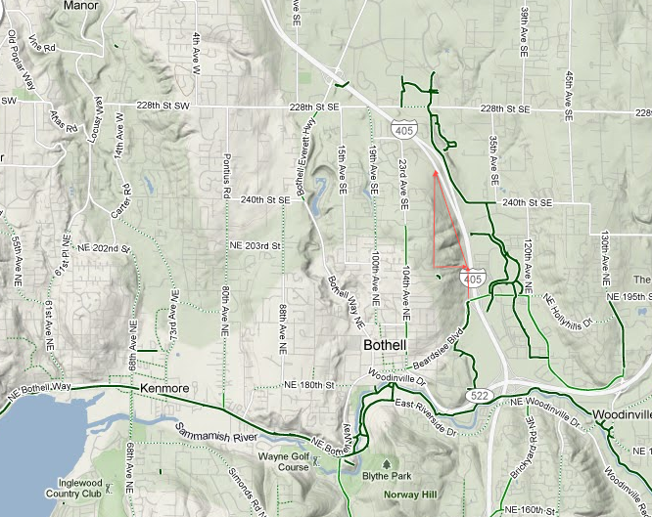
SCORP
Active Connections
North Creek Trail
Burke-Gilman Sammamish River
Regional Trail System
Notes:
HERE YOU HAVE A BETTER LOOK AT THE ACTIVE CONNECTION TO THE REGIONAL TRAIL SYSTEM. THE BURKE-GILMAN SAMMAMISH RIVER TRAIL SYSTEM (IN YELLOW) JOINS WITH
THE NORTH CREEK TRAIL (IN GREEN). THE RED CONNECTING LINE REPRESENTS A DEAD END ROAD, 112TH AVE NE, LINKING THE FOREST TO THE TRAIL SYSTEM. A SIMPLE BICYCLE AND
WALKING LANE DEMARCATION ALONG THIS ¼ MILE ROAD IS ALL THAT IS NEEDED TO PROVIDE A SAFE LINK TO THESE REGIONAL TRAILS.

Slide 8
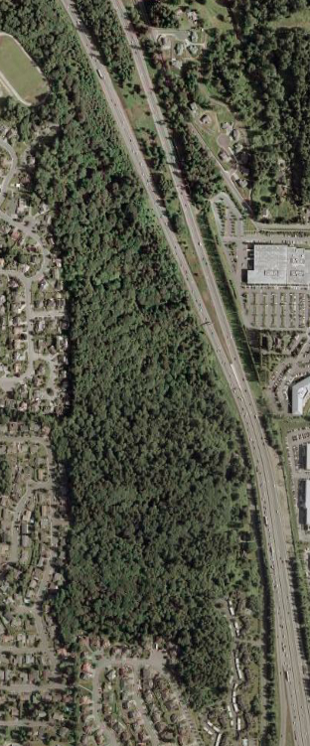
SCORP
Active Connections
6
North Creek Forest
4
3
5
5
8
Bothell
City Hall
7
2
1
9000 Students
within walking distance
1 UW BOTHELL 4 HERITAGE CHRISTIAN SCHOOL 7 BOTHELL HS
2 CASCADIA CC 5 ST BRENDANS SCHOOL 8 WOODINVILLE MONTESSORI
3 MAYWOOD HILLS ELELMENTARY SCHOOL 6 CANYON PARK JHS
Notes:
THE PHOTO ON THE RIGHT VIVIDLY PORTRAYS THE PRESSURE OF URBAN GROWTH…. BUT THERE IS ANOTHER STORY ABOUT THIS FOREST. THE MAP ON THE LEFT DEPICTS EIGHT
SCHOOLS WITH OVER 9000 STUDENTS WITHIN WALKING DISTANCE OF THE FOREST. WITH ACQUISITION STUDENTS CAN EXPERIENCE EDUCATION AND RECREATION
OPPORTUNITIES WITHOUT THE USE OF A CAR…. IN THE PHOTO YOU WILL ALSO NOTE NEIGHBORHOODS TO THE LEFT OF THE FOREST AND A HIGH DENSITY JOBS CORRIDOR TO
THE RIGHT. WALKING LINKS TO JOBS, NEIGHBORHOODS AND PARK LAND OFFER HEALTHY ALTERNATIVES FOR OTHERWISE CAR BOUND CITIZENS.

Slide 9
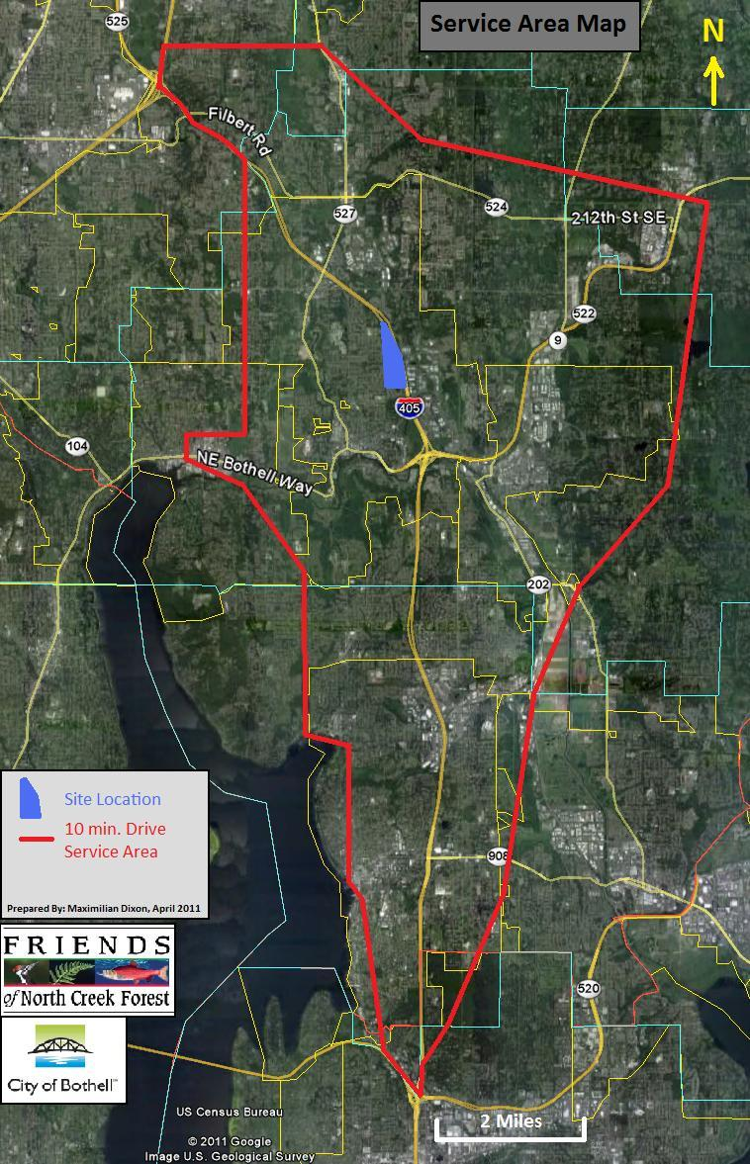
NEED: Inventory of
like sites in Service Area
Centennial Park 54 acres
North Creek Forest 64 acres
Blythe Park 41 acres
185, 000 residents
within a
10 minute drive
Lynnwood
Seattle
Bellevue
Notes:
HERE YOU CAN SEE THE ENTIRE SERVICE AREA…. LOCATED BETWEEN THE MAJOR CITIES OF SEATTLE, BELLEVUE AND LYNNWOOD, NORTH CREEK FOREST IS WITHIN A 10 MINUTE
DRIVE FOR 185,000 RESIDENTS. REGIONAL BIKE TRAILS LINK ALL OF THESE POPULATION CENTERS TO THE FOREST.

Slide 10
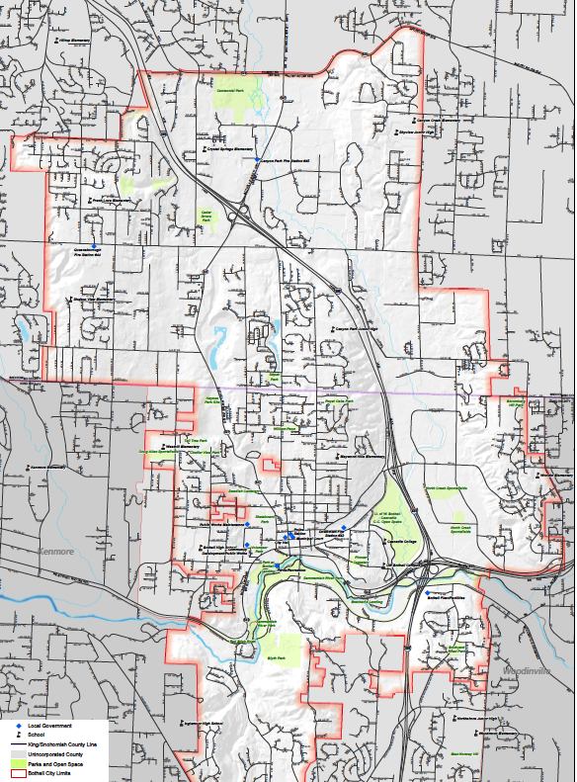
NEED:
Inventory
23
Square
Mile
Projection
CENTENIAL PARK
54 acres
NORTH
CREEK
FOREST
64 acre forest
BLYTHE PARK
41 acres
Notes:
IN THIS CLOSER VIEW YOU CAN SEE THERE ARE NO COMPARABLE PARKLANDS ON THIS 23 SQUARE MILE PROJECTION. NORTH CREEK FOREST IS THE ONLY LOCATION THAT CAN
PROVIDE RECREATION WITHIN A MATURE UPLAND CONIFER FOREST SETTING THAT CITIZENS USUALLY DRIVE BEYOND THE SERVICE AREA AND OFTEN TO THE MOUNTAINS TO
EXPERIENCE. BLYTHE PARK IS PARTLY FORESTED WITH LESS CONNECTION TO NEIGHBORHOODS OR WORKPLACE. CENTENNIAL PARK, A FLOODPLAIN, ALSO HAS LIMITED
CONNECTION TO NEIGHBORHOODS.

Slide 11
NEED: Population underserved:
Almost no mature forest for recreation in the service area
NEED: Amount of current use:
1947 residents per acre of existing comparable sites
NEED: Potential use:
Hiking, running, birding, outdoor education, picnicking,
wildlife photography
Notes:
ON NEED: ALMOST NO MATURE FOREST FOR RECREATION CAN BE FOUND WITHIN THE SERVICE AREA. IN THIS RESPECT NORTH CREEK FOREST IS UNIQUE.

Slide 12
NEED: Population underserved:
Almost no mature forest for recreation in the service area
NEED: Amount of current use:
1947 residents per acre of existing comparable sites
NEED: Potential use:
Hiking, running, birding, outdoor education, picnicking,
wildlife photography
Notes:
WITHIN THE SERVICE AREA THER ARE 1947 RESIDENTS PER ACRE OF EXISTING LARGE PARK LANDS.

Slide 13
NEED: Population underserved:
Almost no mature forest for recreation in the service area
NEED: Amount of current use:
1947 residents per acre of existing comparable sites
NEED: Potential use:
Hiking, running, birding, outdoor education, picnicking,
wildlife photography
Notes:
THE POTENTIAL USE OF NORTH CREEK FOREST INCLUDES HIKING, RUNNING, BIRDING, OUTDOOR EDUCATION, PICNICKING AND WILDLIFE PHOTOGRAPHY. WHILE ALL OF THE
ACTIVITIES CAN BE PERFORMED ANYWHERE….CLEARLY….THE SETTING PLAYS A SIGNIFICANT ROLL IN ATTRACTING PEOPLE TO THESE ACTIVITIES. NORTH CREEK FOREST
POSSESSES A RICHLY DIVERSE WILDLIFE HABITAT RARELY FOUND IN AN URBAN SETTING.

Slide 14
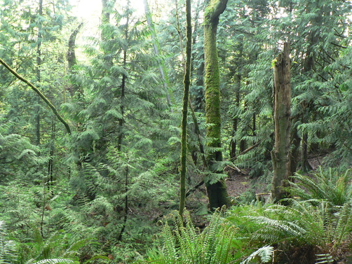
NEED: Identified
Type of Need
Protects land meeting criteria for Washington Department of Fish and Wildlife “Priority Habitat.” (note 4)
Notes:
NORTH CREEK FOREST FITS THE CRITERIA FOR WASHINGTON FISH AND WILDLIFE “PRIORITY HABITAT” DESIGNATION.

Slide 15
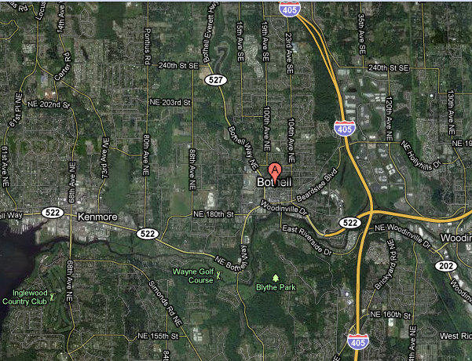
NEED: Identified Type of Need
NEED
Snohomish County Comprehensive Parks and Recreation Plan (note 1)
North Creek Forest
Meets Snohomish County Parks and Recreation need to acquire key habitat parcels that preserve critical corridors
Bothell Parks and Recreation Policy (note 2)
Use image showing corridors
Meets Bothell’s need to connect open space, and create corridors for wildlife migration routes and greenways.
Notes:
SNOHOMISH COUNTY PARKS AND RECREATION PLAN STATES THE NEED TO AQUIRE HABITAT PARCELS THAT PRESERVE CRITICAL CORRIDORS. BOTHELL PARKS AND
RECREATION POLICY ALSO NOTES THE NEED TO CONNECT OPEN SPACE, AND CREATE CORRIDORS FOR WILDLIFE MIGRATION ROUTES AND GREENWAYS.

Slide 16
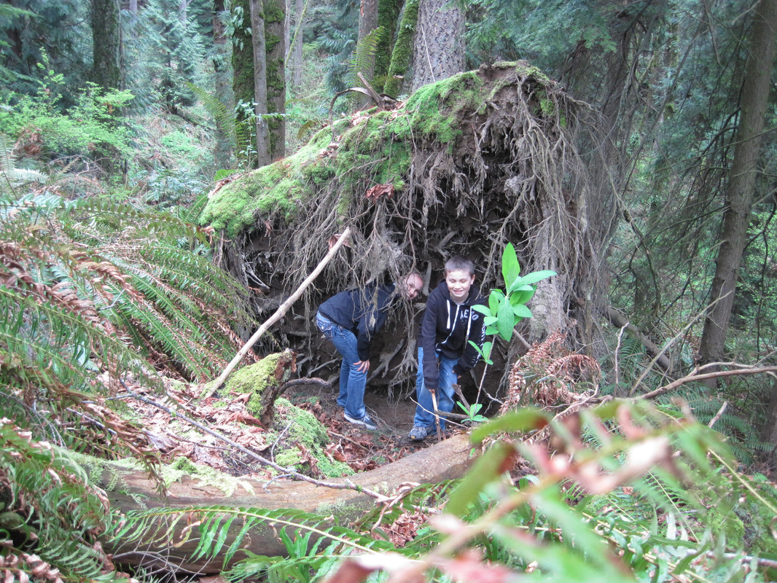
NEED: Identified Type of Need
Bothell Parks and Recreation Policy (note 2)
Meets Bothell’s need to ensure a proper future for urban forests, wildlife and the preservation of ecological systems in the City of Bothell.
Notes:
BOTHELL’S PARKS AND RECREATION POLICY ALSO SPEAKS TO A NEED TO ENSURE A PROPER FUTURE FOR URBAN FORESTS, WILDLIFE AND THE PRESVERVATION OF
ECOLOGICAL SYSTEMS IN THE CITY.

Slide 17
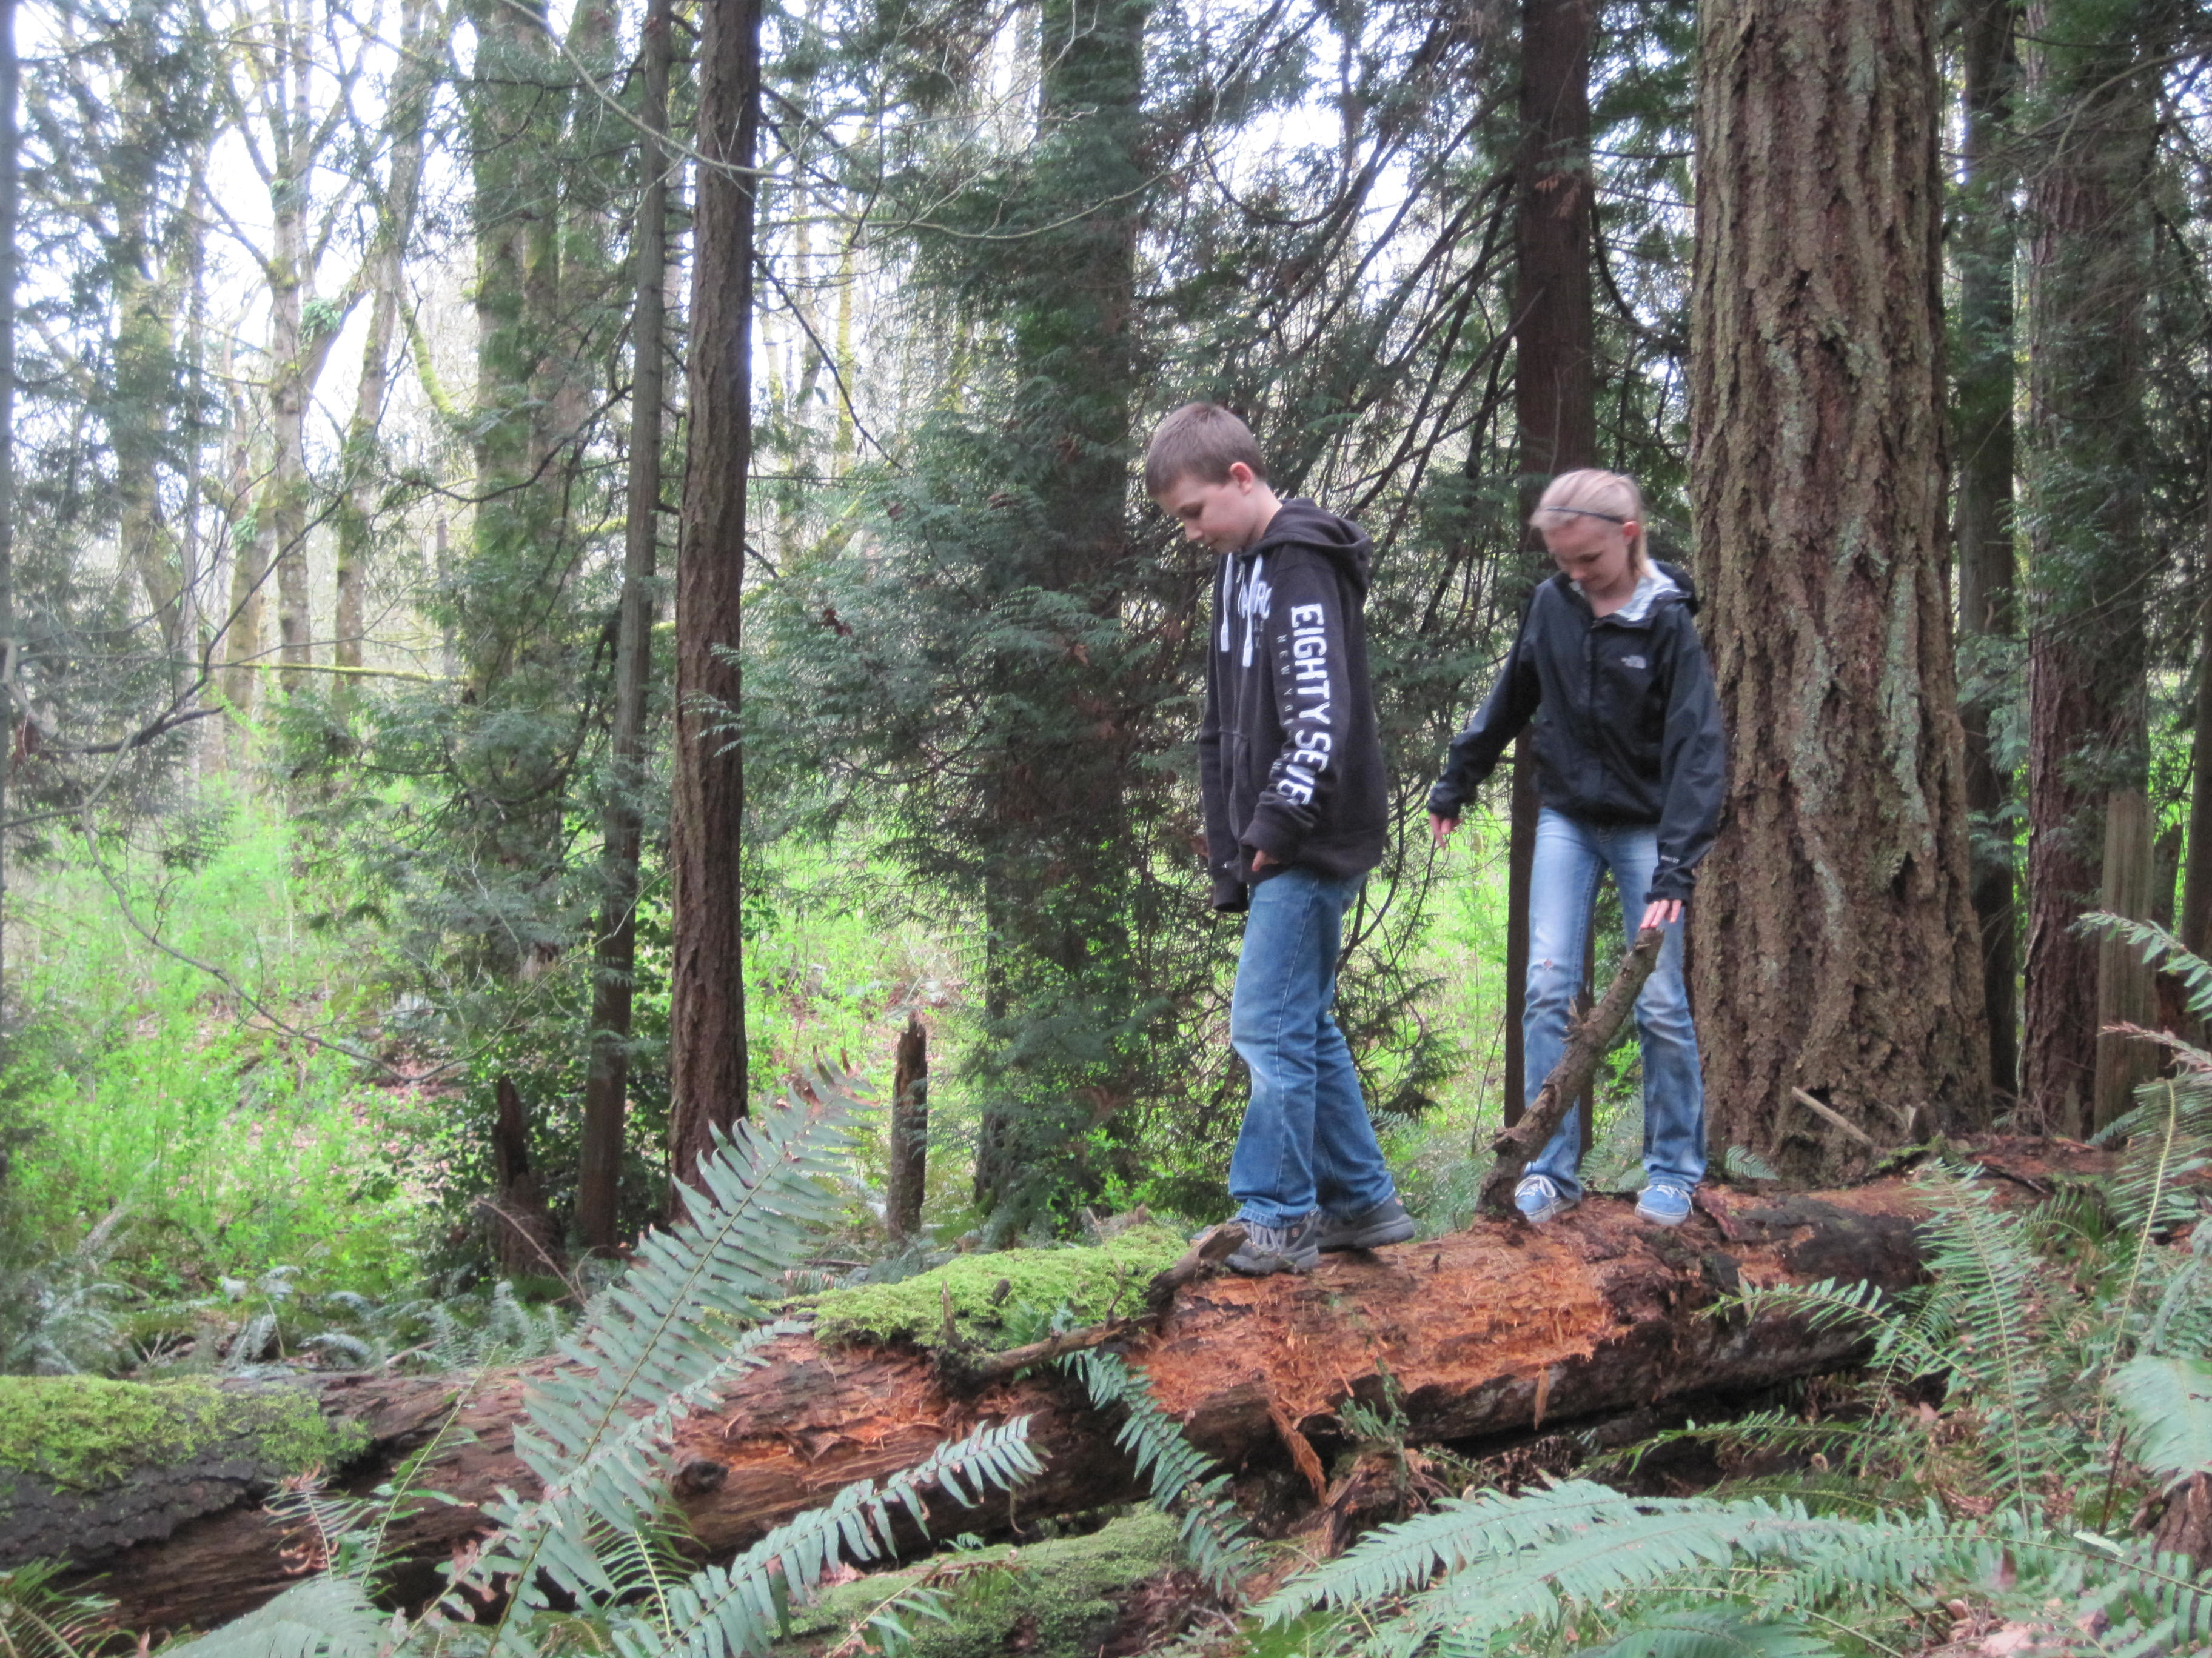
NEED: Named Location
Letter from UW Bothell Chancellor (note 5)
Northshore School District Resolution (note 6)
North Creek Forest provides Location for Outdoor Recreation and Education sought by UW Bothell and Northshore School District.
Notes:
NORTH CREEK FOREST PROVIDES A UNIQUE LOCATION FOR OUTDOOR EDUCATION AND RECREATION SOUGHT BY THE UNIVERSITY OF WASHINGTON BOTHELL AND NORTHSHORE
SCHOOL DISTRICT.

Slide 18
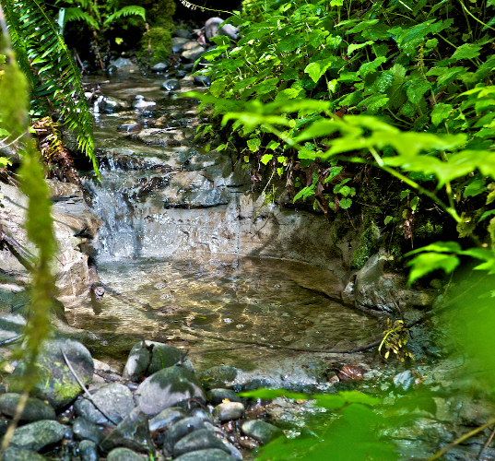
Need: Named Location
King Co. Groundwater Protection Program (note 3)
Meets King County’s need to protect headwater wetlands, seeps, and groundwater recharge areas in basins including North Creek, through acquisition.
Notes:
THE KING COUNTY GROUNDWATER PROTECTION PROGRAM SITES THE NEED TO PROTECT HEADWATER WETLANDS, SEEPS AND GROUNDWATER RECHARGE AREAS IN BASINS
INCLUDING NORTH CREEK, THROUGH ACQUISITION. WITH 9 WETLANDS AND SEVEN STREAMS NORTH CREEK FOREST FILTERS WATER ALONG ALMOST A MILE OF WATERSHED.

Slide 19
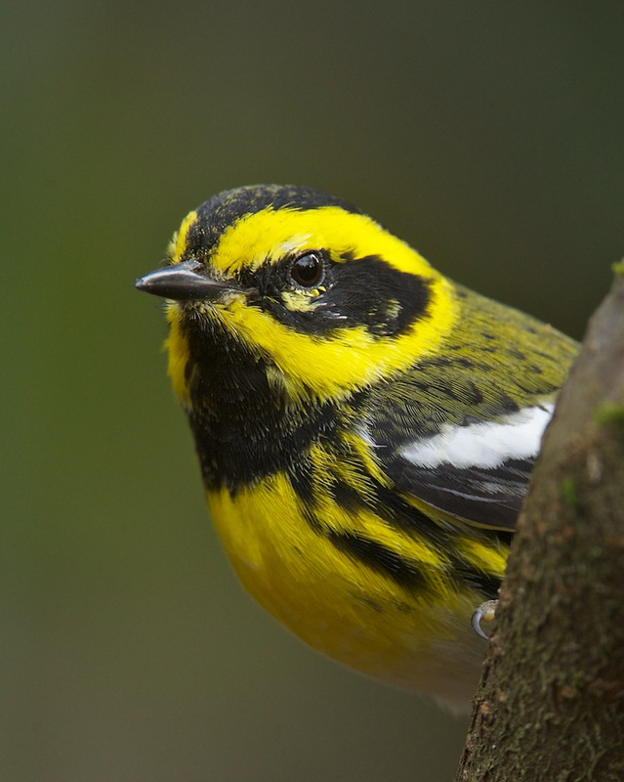
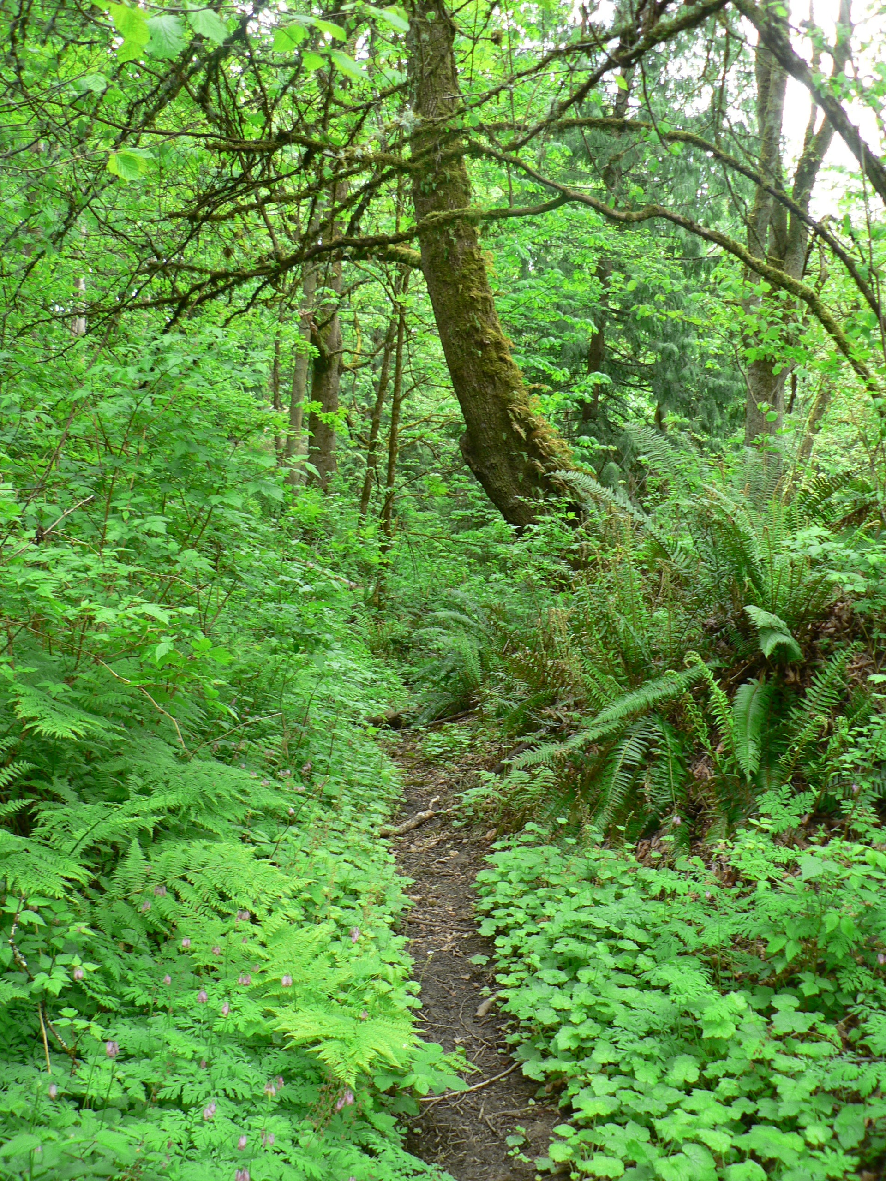
NEED: Named Location
North Creek Forest acquisition is a named priority in King and Snohomish County Conservation Futures grants, and a Washington Department of Commerce capital grant.
Notes:
FINALLY NORTH CREEK FOREST IS A NAMED PRIORITY IN KING AND SNOHOMISH COUNTY CONSERVATION FUTURES GRANTS, AND A WASHINGTON DEPARTMENT OF COMMERCE
CAPITAL GRANT.

Slide 20
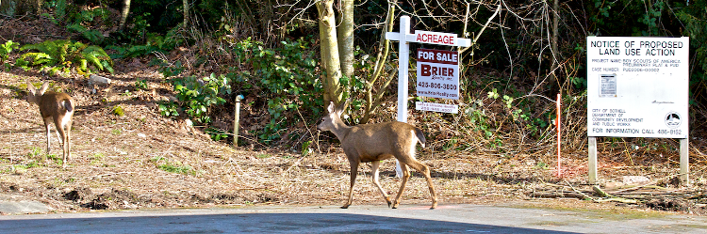
URGENCY
APPROVED PRELIMINARY PLAT FOR 54 LOTS
Notes:
ON URGENCY: THE TOP PHOTO SHOWS A 54 LOT SHORT PLAT AND DRAIN FIELD THAT WAS PROPOSED JUST BEFORE THE HOUSING MARKET CRASH.
THE INTERESTING BOTTOM PHOTO WAS TAKEN ON THE EDGE OF THE FOREST BEFORE THE ECONOMIC DOWNTURN. WITH THE RETURN OF MARKET PRESSURE, THE OPPORTUNITY
TO KEEP NORTH CREEK FOREST INTACT COULD BE LOST. UNIQUE RECREATION OPPORTUNITIES WILL BE LOST. A GIANT OUTDOOR LABORATORY WHERE 9000 STUDENTS CAN
STUDY A FOREST WITHIN WALKING DISTANCE WILL BE LOST.

Slide 21
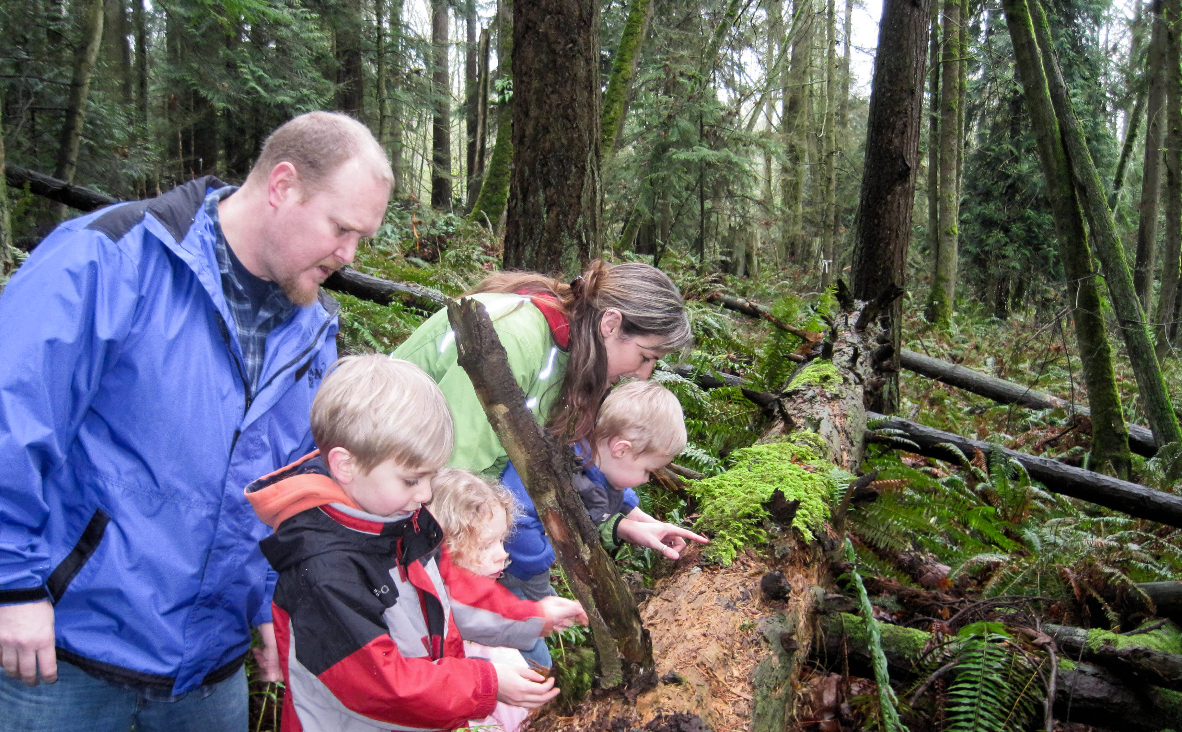
Previously Planned Development
URGENCY
Notes:
OUR GOAL IS TO AQUIRE THIS VALUABLE PROPERTY BEFORE IT IS LOST IN THE NEXT BUSINESS CYCLE.

Slide 22
VIABILITY
An Interim Solution
6
35
Notes:
WE ARE AQUIRING PARCELS AS GRANTS ARE AWARDED. GRANT AWARDS ARE ALREADY IN PLACE FOR THE 35 ACRE PARCEL. A MATCH IS IN PLACE FOR THE 6 ACRE PARCEL, THE
SUBJECT OF THIS GRANT APPLICATION, AND WE HAVE A WILLING SELLER. PASSIVE RECREATION IS VIABLE ON BOTH THE 6 AND 35 ACRE PARCELS UPON PURCHASE AS THEY ARE CONNECTED BY 112 TH AVE NE AND A POTENTIAL, BUT LIKELY UNNECESSARY, LINKING TRAIL SHOWN IN GREEN. REGARDING THE REMAINING TWO LAND OWNERS: CASCADE LAND CONSERVANCY IS PURSUING A ROLL TO FACILITATE THE ACQUISITION OF THESE PROPERTIES FOR CONSERVATION PURPOSES, AND THE ORGANIZATION INTENDS, UPON ACCEPTANCE OF THEIR AGREEMENT, TO WORK WITH LANDOWNERS, THE CITY AND THE COMMUNITY IN THIS REGARD. ALL PARTIES HAVE EXPRESSED INTEREST BUT THE CONTRACT WILL NOT BE SIGNED FOR ANOTHER WEEK. THIS MAY BE A GOOD PLACE TO ADD THAT WE HAVE ALSO RECEIVED A WRITTEN ENDORSEMENT FROM THE TULLALIP TRIBES.

Slide 23
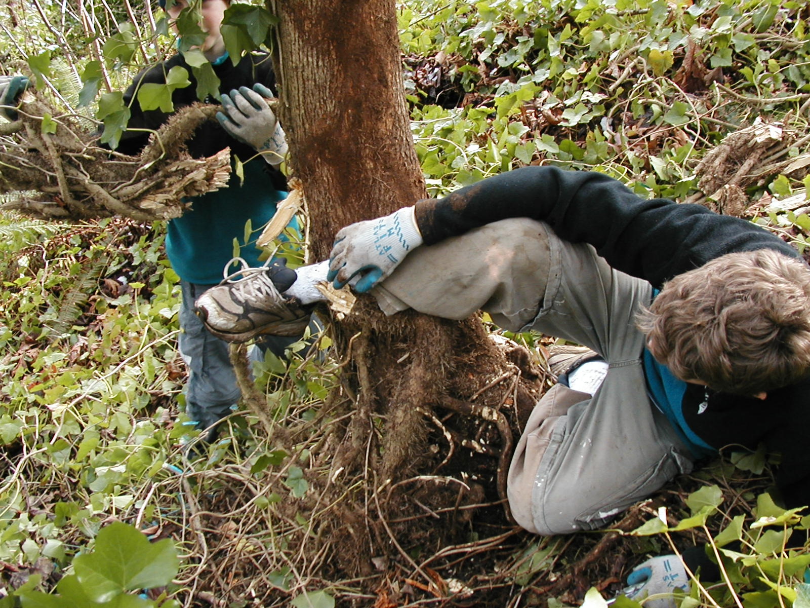
VIABILITY
Stewardship BY:
Bothell Parks
Friends of North Creek Forest
UWB/CCC Sustainability Organization
Eastside Chapter, Washington State Native Plant Society
Notes:
COMMITTED STEWARDSHIP PARTNERS INCLUDE BOTHELL PARKS, FRIENDS OF NORTH CREEK FOREST, UNIVERSITY OF WASHINGTON/CASCADIA COMMUNITY COLLEGE
SUSTAINABILITY ORGANIZATION AND MEMBERS OF THE EASTSIDE CHAPTER OF WASHINGTON NATIVE PLANT SOCIETY.

Slide 24
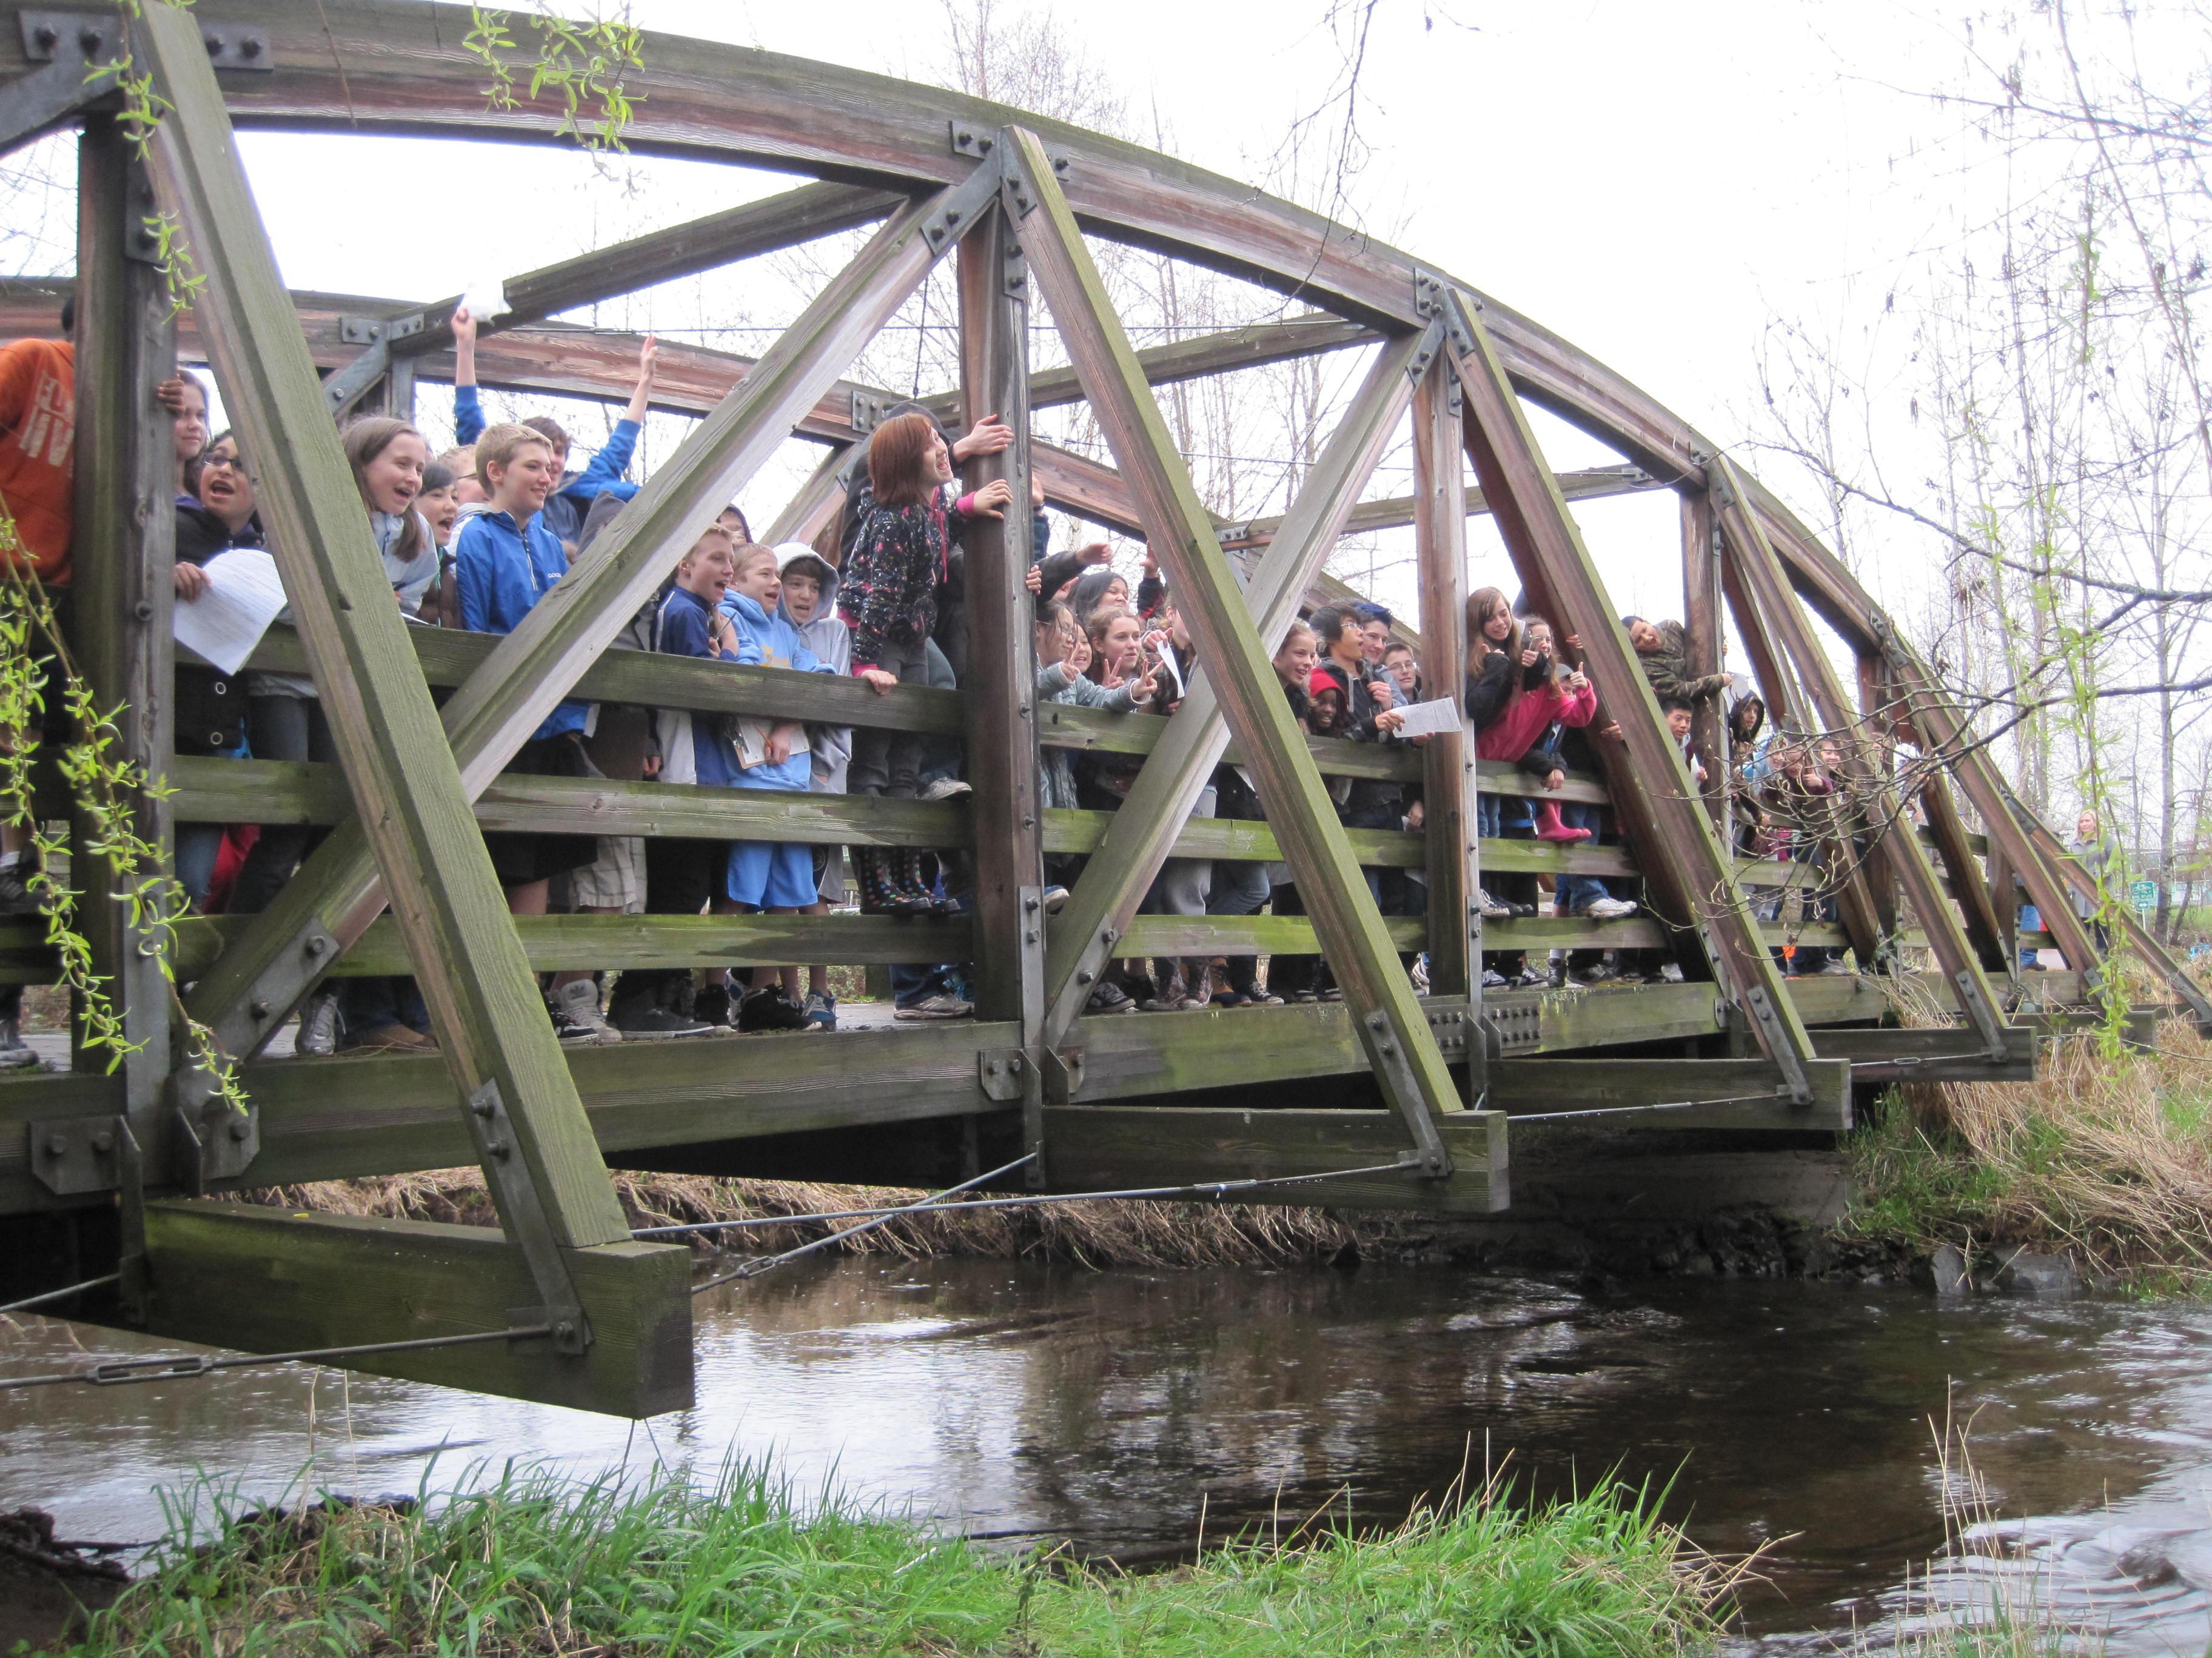
Federal grant program goals:
2) Enhance recreational access and opportunities.
4) Engage young people in conservation and the great outdoors .
6) Establish great urban parks and community green spaces.
Notes:
THIS ACQUISITION WILL ENHANCE RECREATION ACCESS AND OPPORTUINTIES, ENGAGE YOUNG PEOPLE IN CONSERVATION AND THE GREAT OUTDOORS, AND WILL HELP
US ESTABLISH A MAGNIFICENT URBAN PARK LAND. AS AN EXAMPLE OF ENGAGING YOUNG PEOPLE IN RESTORATION, NORTHSHORE SCHOOL DISTRICT TEACHERS ARE MAKING PLANS FOR THEIR STUDENTS TO BE INVOLVED IN FOREST ACTIVITIES AND EDUCATION AND UW FACULTY IS POISED TO ASSIGN 6 SENIORS TO A 10 CREDIT 1 YEAR RESTORATION DESIGN AND IMPLEMENTATION PROJECT.
UNDER THE 2011 GOALS FOR POINT 5, NOT SHOWN ON THE SLIDE:
FOR 1A & 1E WE SEEK TO AQUIRE A UNIQUE URBAN NATURAL AREA RICH IN WILDLIFE HABITAT OTHERWISE UNAVAILABLE IN THE SERVICE AREA. 3C, WE SEEK TO CONSERVE AN IMPORTANT NATURAL AREA VALUABLE TO WILDLIFE THAT PROTECTS RIVER CORRIDOR AND WILL BE ACCESSIBLE TO THE PUBLIC. THIS MILE LONG FOREST IS ONE OF THE MOST SIGNIFICANT FORESTS LEFT IN THE NORTH CREK SUB BASIN, FILTERING SURFACE WATER FLOWING INTO NORTH CREEK, AND THE SAMAMMISH RIVER, STREAMS SUPPORTING CHINOOK SALMON, A SPECIES CURRENTLY LISTED UNDER THE ENDANGERED SPECIES ACT.

Slide 25
Federal Grant Program Goals
NORTH CREEK FOREST
CANYON PARK JR HI SCHOOL
PARKING
Notes:
ALSO NOTE THE FIT WITH FEDERAL PROGRAM GOALS: WHILE OTHER SCHOOLS ARE CLOSE, CANYON PARK JR HI SCHOOL AND THEIR RUNNING TRACK ARE RIGHT ON THE
FOREST BOUNDARY WITH AN ENTRY POINT TO PLANNED FOREST TRAILS.

Slide 26
READINESS
King County Conservation Futures matching funds have already been received.
Restoration work has already begun with the cooperation of the owners.
Landowner has been contacted and is a willing seller.
A simple appraisal is complete.
The property is ready for passive use by the public immediately upon purchase.
Notes:
ON READINESS; KING COUNTY CONSERVATION FUTURES MATCHING FUNDS HAVE ALREADY BEEN RECEIVED. RESTORATION WORK HAS ALREADY BEGUN WITH THE COOPERATION
OF THE OWNERS WHO HAVE BEEN CONTACTED AND ARE WILLING SELLERS. A SIMPLE APPRAISAL HAS BEEN COMPLETED AND THE PROPERTY IS READY FOR PASSIVE USE BY
THE PUBLIC IMMEDIATLEY UPON PURCHASE.

Slide 27
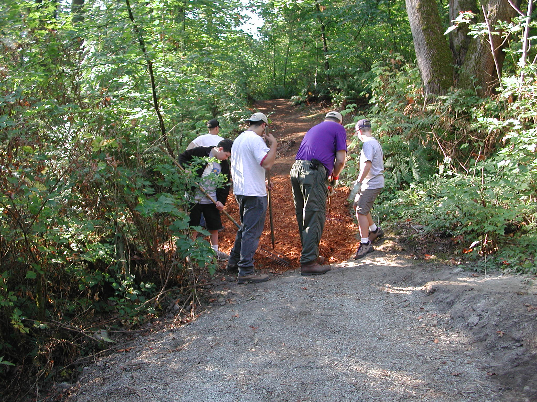
Volunteers:
Over 2000 hours annual pledges including restoration ecology experts
Donations:
$8000 donated for conservation outreach over last 7 months
Planning:
UW Bothell is already surveying the property for restoration
COST
EFFICIENCIES
Notes:
FOR COST EFFICIENCIES: OVER 2000 HOURS HAVE BEEN PLEDGED FOR FOR RESTORATION AND STEWARDSHIP INCLUDING RESTORATION ECOLOGY EXPERTS. $8000 HAVE
ALREADY BEEN DONATED BY CITIZENS FOR CONSERVATION OUTREACH OVER THE LAST 7 MONTHS. IN ADDITION THE UW BOTHELL RESTORATION ECOLOGY NETWORK IS
ALREADY SURVEYING THE PROPERTY FOR RESTORATION.

Slide 28
NORTH CREEK FOREST
A
RARE
URBAN
PARK
LAND
Photo credits: Dan Paquette, Jeff Larsen, Gregg Thompson, Paul Clements, Woody Wheeler, Jim Freese
Notes:
THE ACQUISITION OF NORTH CREEK FOREST WILL HAVE A PROFOUND EFFECT ON THE FUTURE OF BOTHELL. IT WILL COMPLETE A VISION FOR A CITY THAT POSSESSES A RARE
COMBINATION OF HIGH DENSITY HOUSING, A VIBRANT DOWNTOWN CORE, A JOB RICH CORRIDOR, COLLEGE AND UNIVERSITY CAMPUSES, WETLANDS, SALMON STREAMS AND AN
UPLAND CONIFER FOREST PARK LAND ALL WITHIN WALKING DISTANCE, A REGIONAL BICYCLE TRAIL SYSTEM AND EASY FREEWAY ACCESS. THANK YOU.

