Slide 1
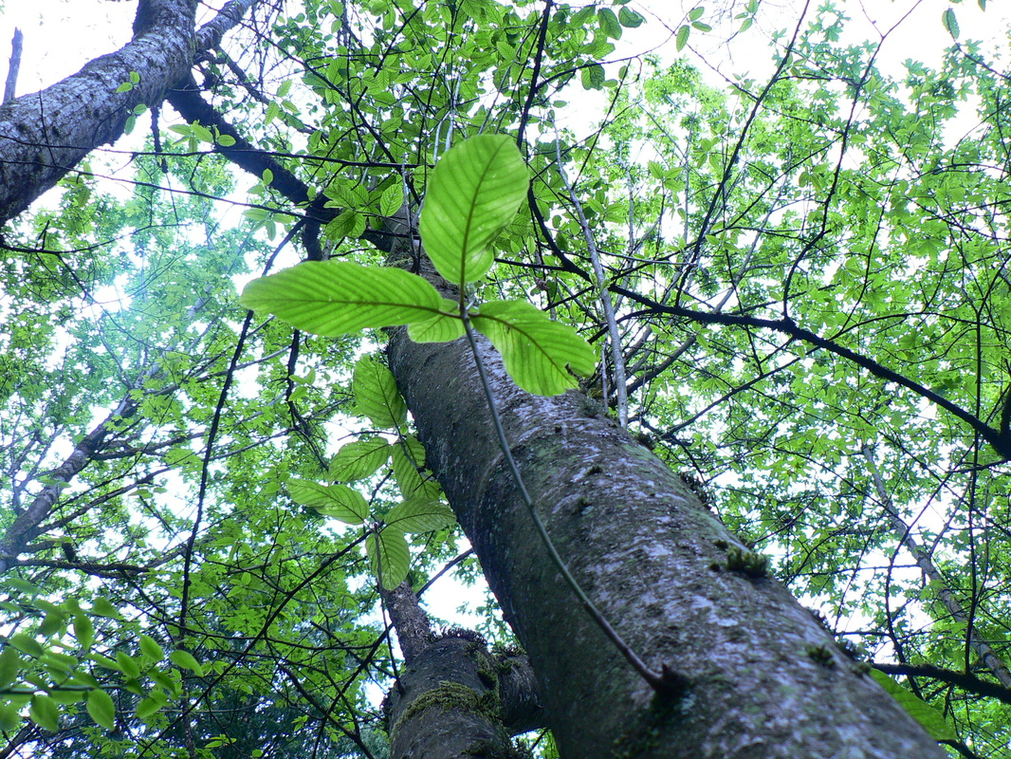
Bothell’s Last Great Forest
Save
Notes:
For the past decade, members of Friends of North Creek Forest and other Bothell-area citizens, have been working hard to save Bothell’s Last Great Forest, aka North Creek Forest. We invite you to join us in this effort.

Slide 2
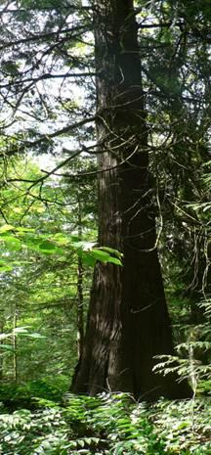
Did you know?
Did you know
…that Bothell has a 64 - acre undeveloped mature forest just one mile from city hall?
Notes:
It is amazing that a forest of this quality and magnitude exists in a 32,000 person city, contiguous to the larger 3.5 million-plus person Seattle metropolitan area... the 15th largest urban area in the United States.

Slide 3
“Prize the natural spaces and shorelines most of all, because once they’re gone, with rare exceptions they’re gone forever.”
- Richard Louv, Last Child in the Woods -
Notes:
Richard Louv, in his seminal book, wrote eloquently about the importance of places like North Creek Forest to our youth. We could not agree with him more. Once our natural are gone they are gone forever.

Slide 4
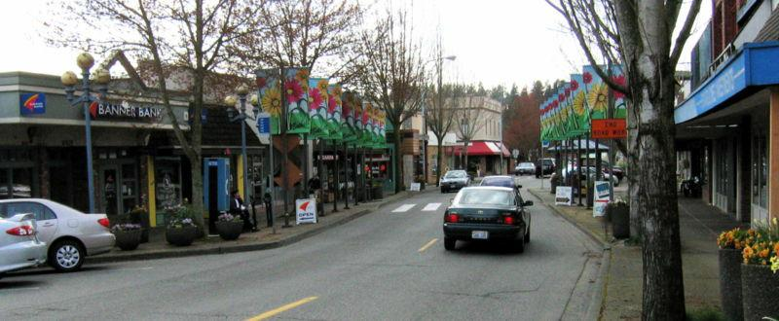
Bothell – “A Great Place to Call Home”
Population 33,000
Projected to grow to 42,000+ by 2025
Downtown/Bothell Landing renovation
Pedestrian-friendly features and green city hall
Notes:
Bothell is a fast-growing city where the open spaces will be developed unless we consciously protect them. Doing so will help the city live up to its slogan for years to come. We think it will help Bothell’s economic development too.

Slide 5
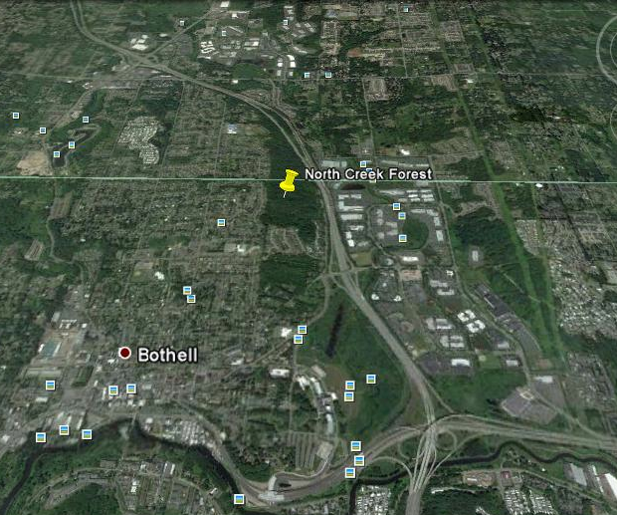
North Creek Forest:
Location, Location, Location!
Notes:
North Creek Forest is located one mile northeast of downtown Bothell, straddling the border of King and Snohomish Counties. It is linked to a green corridor and and natural matrix that connects all the way from the forest to Lake Washington.

Slide 6
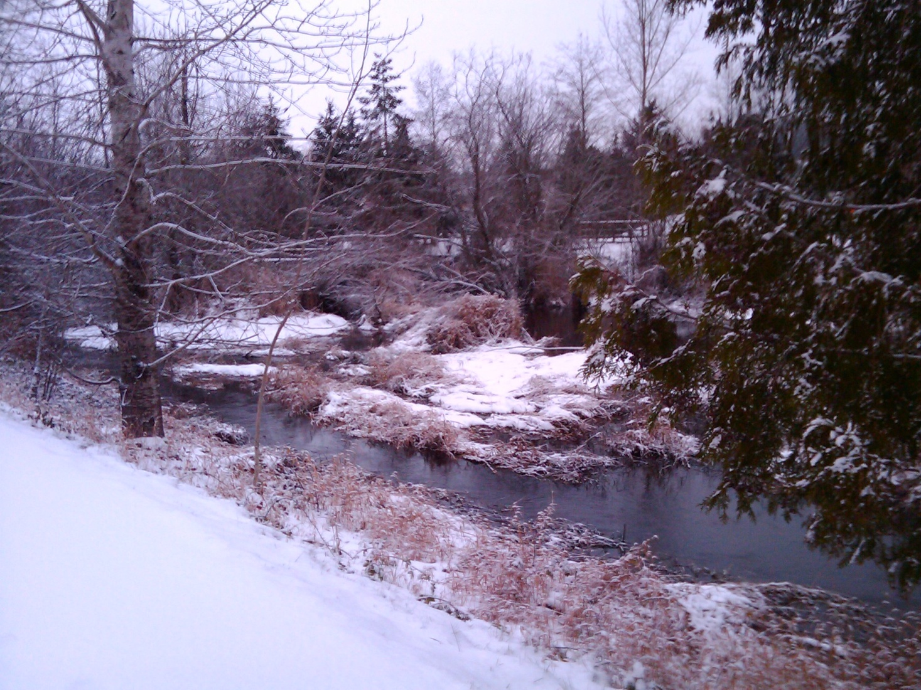
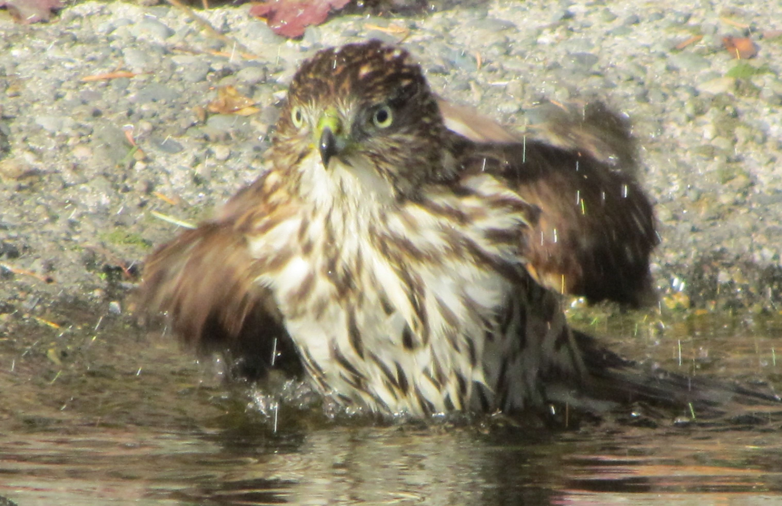
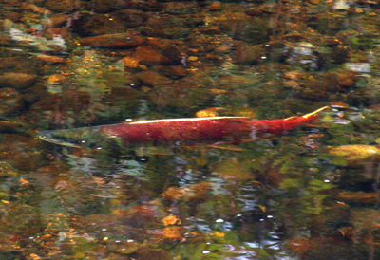
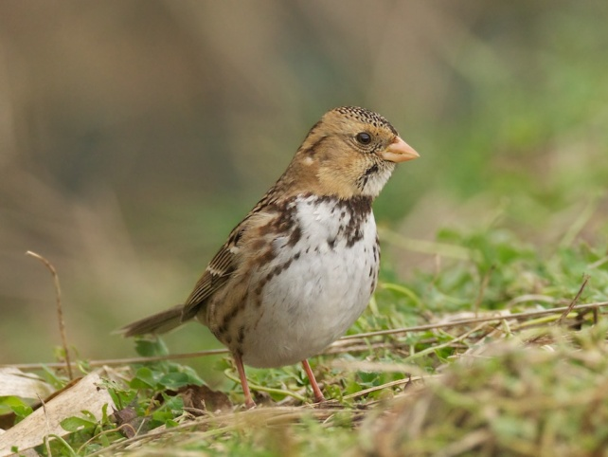
North Creek: Just Downstream
Notes:
Let’s take a trip from the forest downstream. Here is the first stop, just below and east of the forest. North Creek flows trough a business park with restored wetlands.

Slide 7
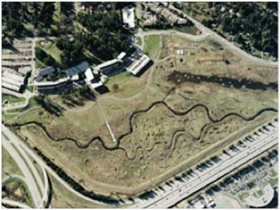
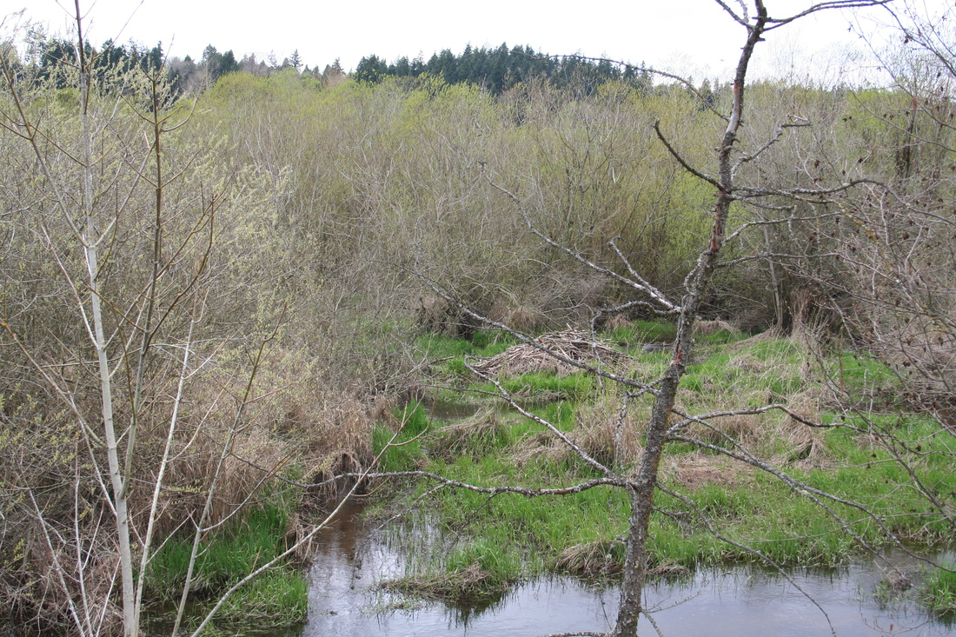
Farther downstream:
UW Bothell& UW Wetlands
Notes:
Waters from the forest recharge the UW Bothell wetlands. It was once the the largest successful wetland restoration in the United States. It serves as a major watershed feature, recharged by North Creek and water flowing through North Creek Forest. UW Bothell, one of the first to call for saving North Creek Forest, also engages students in restoration ecology programs in the forest hosted by Friends.

Slide 8
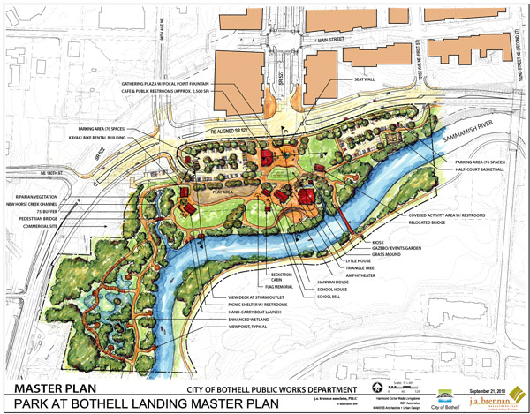
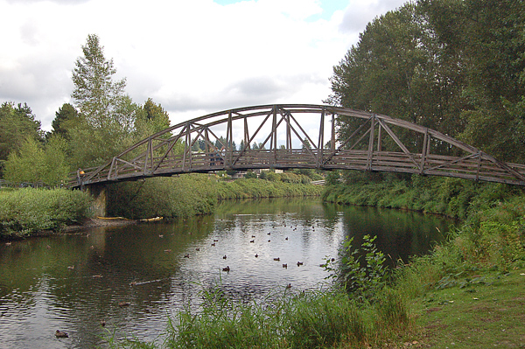
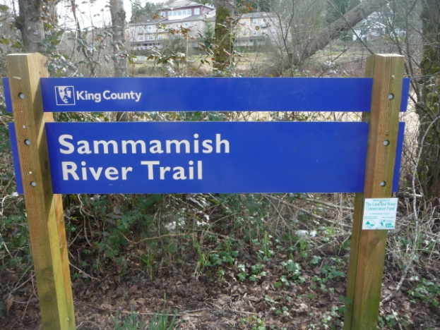
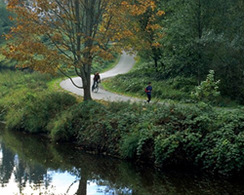
North Creek flows into Sammamish River near Bothell Landing
Notes:
Just below UW Bothell campus, North Creek enters The Sammamish River which flows west to Lake Washington through Bothell Landing Park and alongside the popular Sammamish River bicycle/pedestrian trail. This trail extends, via a spur through UW Bothell, north to within 1/8-mile of North Creek Forest.

Slide 9
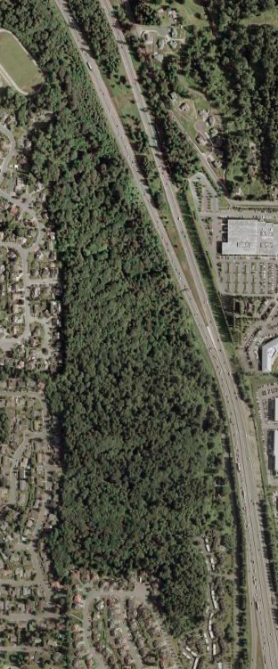
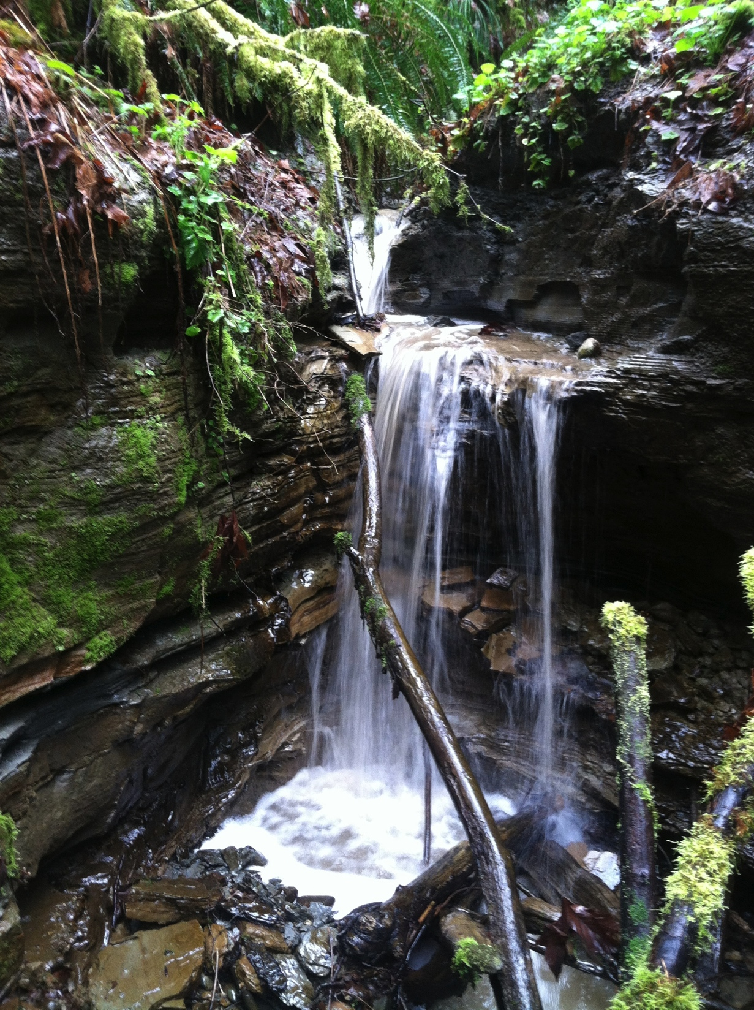
North Creek Forest by the Numbers
64 acres
1/3-mile wide
7 streams
9 wetland areas
Notes:
Let’s look at the forest more closely. North Creek Forest is an ecologically significant large, mature forest located in a rapidly-growing urban area.

Slide 10
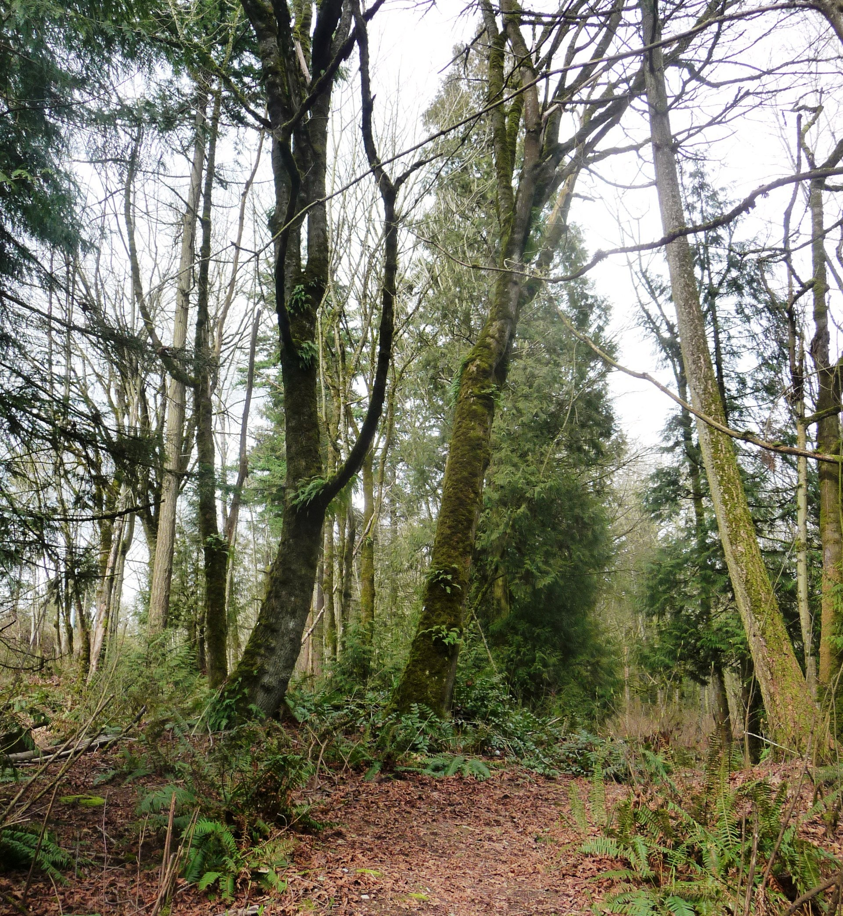
North Creek Forest Residents
Black-tailed Deer
Douglas Squirrel
Mountain Beaver
Barred Owl
Western Screech Owl
Great Horned Owl
Cooper’s Hawk
Merlin
Pileated Woodpecker
Pacific Tree Frog
Western Hemlock
Western Red Cedar
Douglas Fir
Grand Fir
Big Leaf Maple
Red Alder
Pacific Yew
Pacific Dogwood
Cascara Tree
Pacific Rhododendron
Notes:
This is just a sampling of North Creek’s diverse flora and fauna, which encompasses well over 100 species.

Slide 11
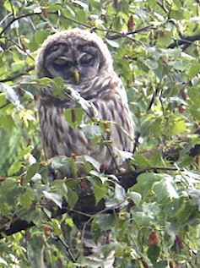
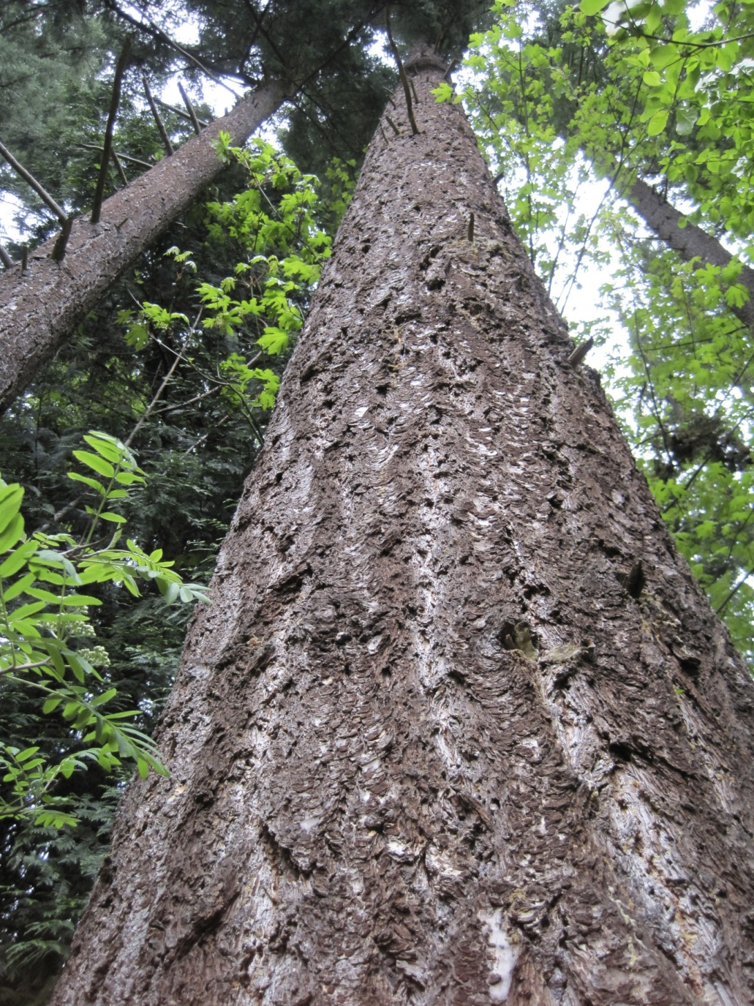
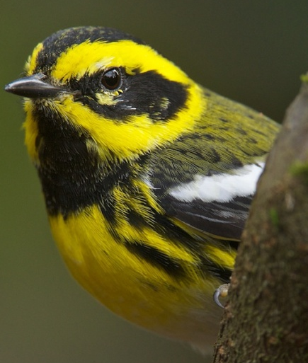
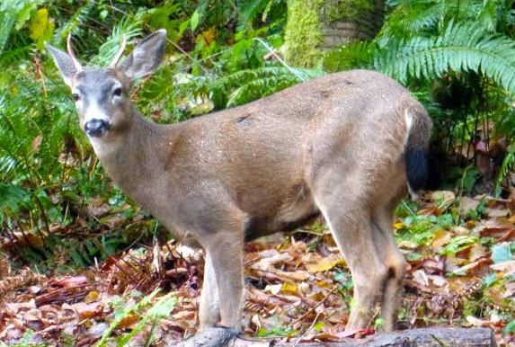
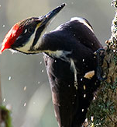
Meet a Few
Notes:
Barred Owl, Townsend’s Warbler, Black-tailed Deer and Pileated Woodpecker all inhabit NC Forest.

Slide 12
FREE!
Forest Values: Ecological Services
Runoff Reduction - Forested areas are like a natural sponge that absorbs water and releases it slowly
Salmon Recovery – Filters and cools water for salmon.
Cleaning Air and Storing Carbon – Trees produce Oxygen and absorb CO2
Reducing Energy Expenditures - Trees cool our neighborhoods in the summer , saving us money on energy costs and related air pollution
Notes:
Sometimes we take trees for granted, especially here in the Pacific Northwest. They provide invaluable free services like filtered clean cool water for salmon, clean air, carbon storing and natural heating and cooling.

Slide 13
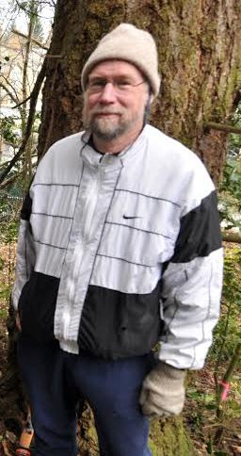
Forest Values: Fish
“The fate of our salmon streams depends on the health of the forest. Nothing man-made can replace the North Creek Forest.”
- David Bain
North Creek anadromous fish:
    Chinook Salmon
    Sockeye Salmon
    Coho Salmon
    Chum Salmon
    Steelhead
David Bain PhD, Orca Research Specialist and Bothell resident
Notes:
With half of the 33 square mile watershed now impervious to water, it is remarkable that four species of salmon, including the Endangered Chinook salmon, still spawn in North Creek. North Creek Forest is significant watershed feature, and is thus vital to its health and the salmon species and Steelhead it hosts.

Slide 14
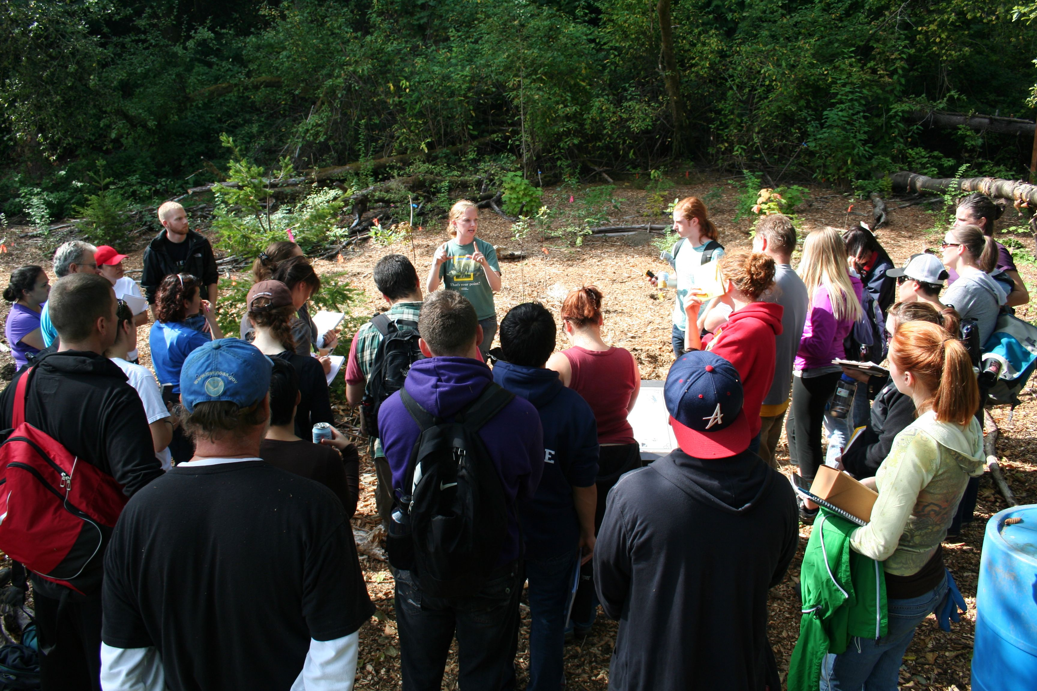
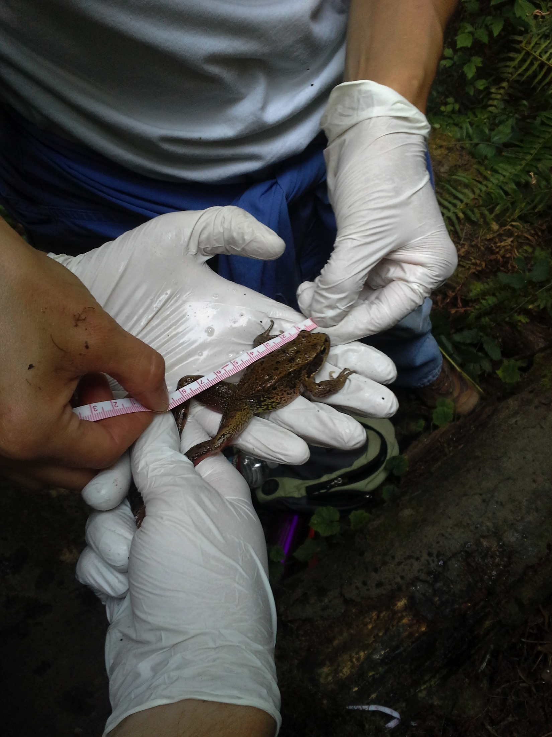
Forest Values: Education
“In a lifetime of teaching I have never seen a more perfect place for students to learn about a forest.”
- Carolyn Freese, Bothell resident and former educator
Within walking distance of 9000 students, K-PhD.
A giant outdoor laboratory inspiring art, science and literature.
Notes:
With successful conservation this could be a giant outdoor laboratory inspiring art, science and literature. 9,000 students are within ½-mile of the forest. Friends education programs are already underway that use the forest as a learning laboratory. Until the forest is saved these opportunities are very limited.

Slide 15
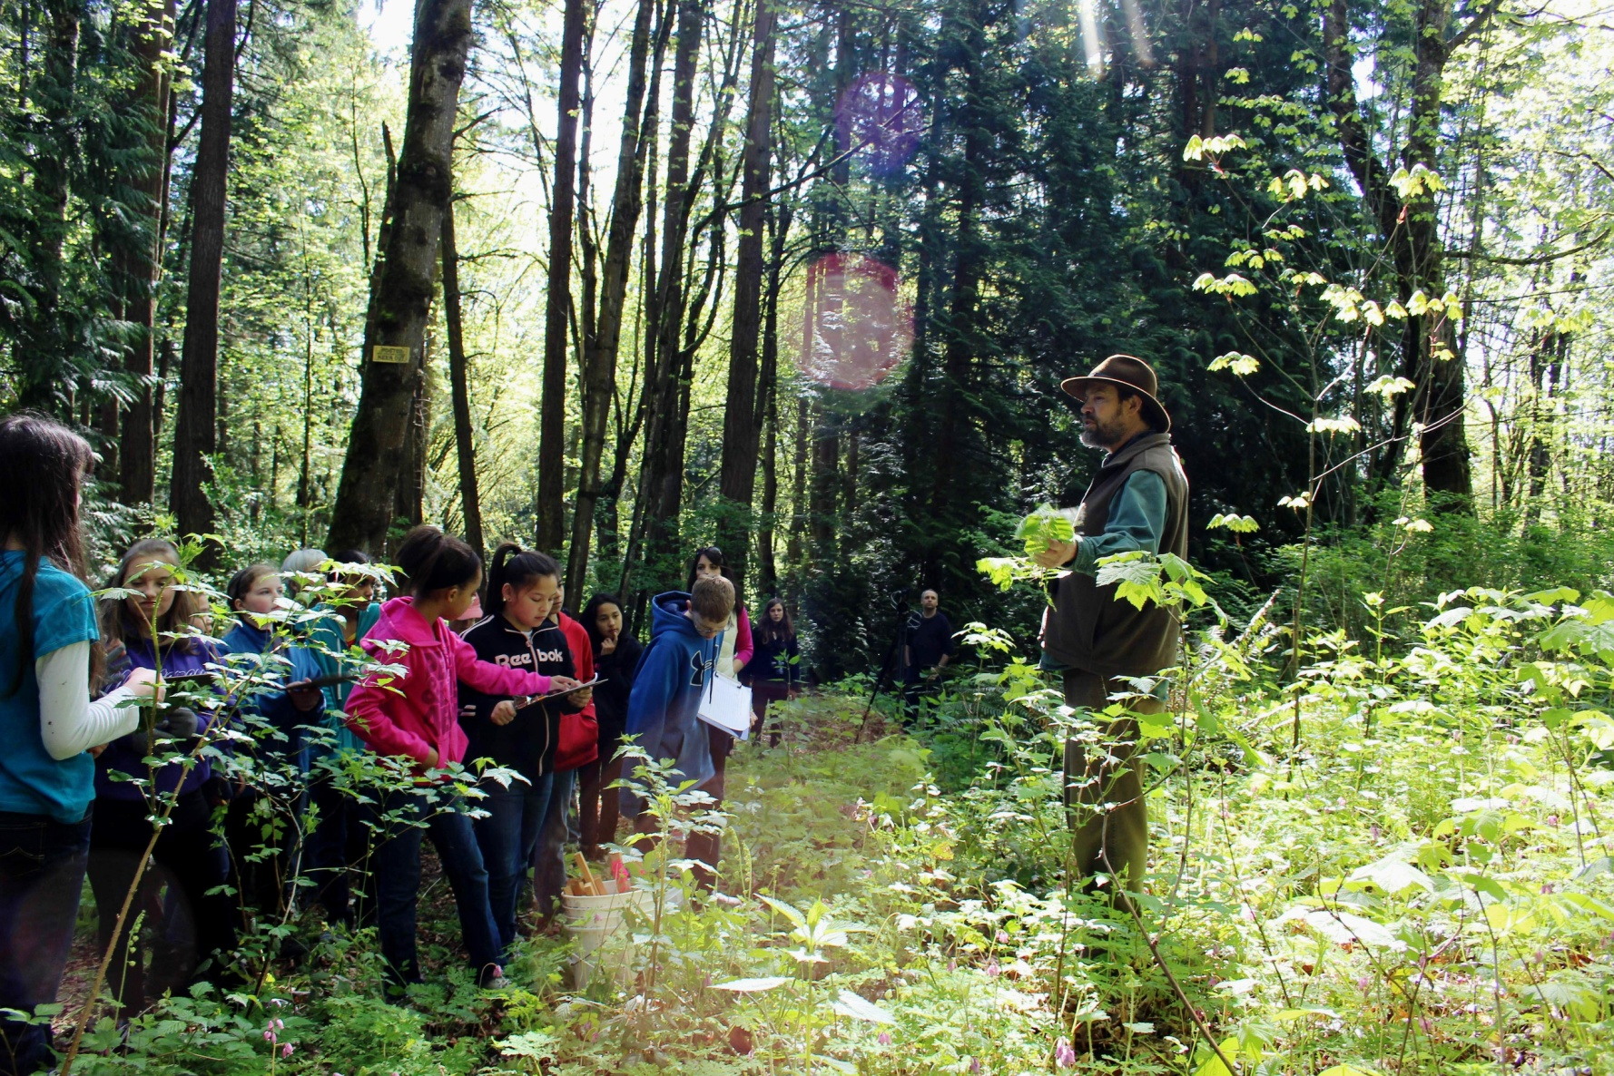
Education Partners
UW Bothell
Cascadia Community College
Northshore School District
Chrysalis School
Saint Brendan School
Soundview International
Baccalaureate School
Tulalip High School
Woodinville Montessori
Canyon Creek Elementary
Notes:
Active education programs are already happening in North Creek Forest with these schools, ranging from Kindergarten through post graduate research..

Slide 16
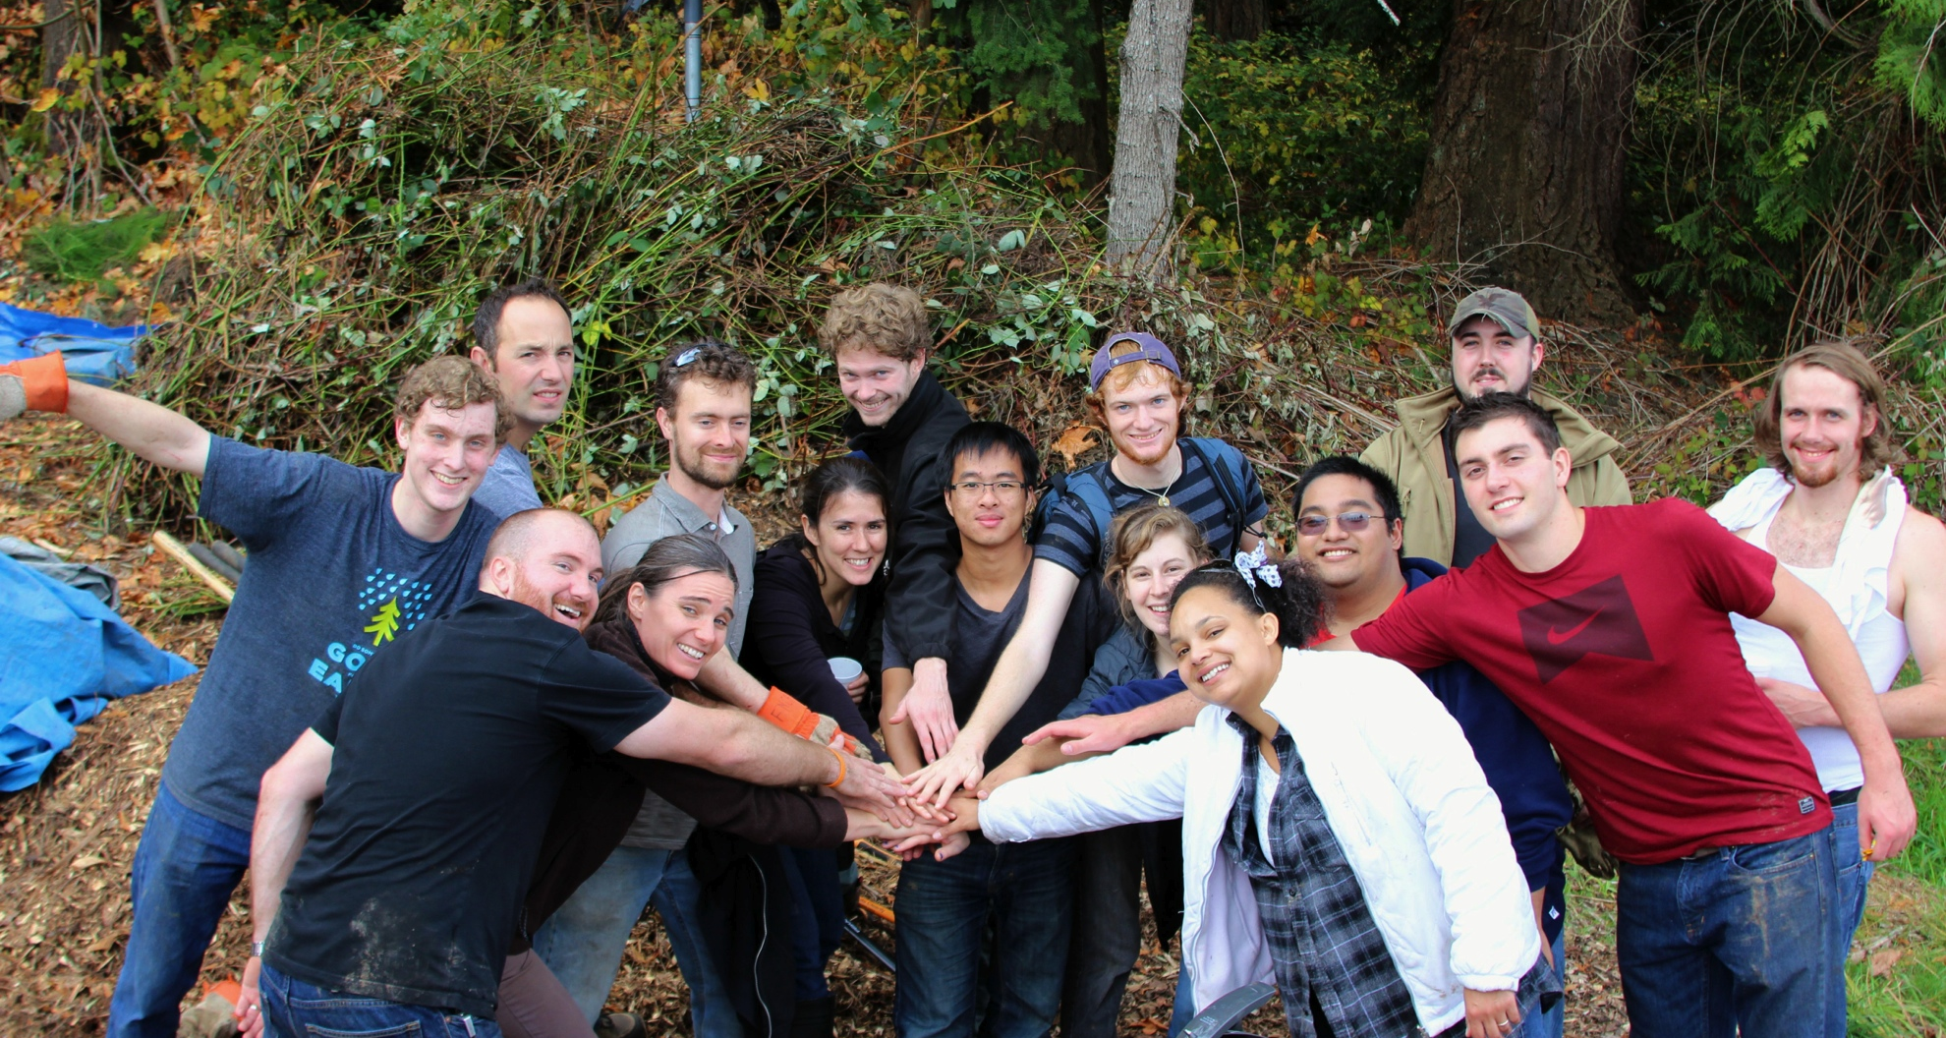
Forest Values: Stewardship
Planting Native Plants
Removing Invasives
Trail Maintenance
Erosion Control
Garbage Removal
2013 – 14 UW Restoration Ecology Network
Notes:
Protecting land and making it into a park is one part of the story. The other is ongoing stewardship. Along with education, Friends of North Creek Forest, in partnership with the City of Bothell, is committed to providing stewardship now and into the future. Almost 4000 hours have been donated in less than three years.

Slide 17
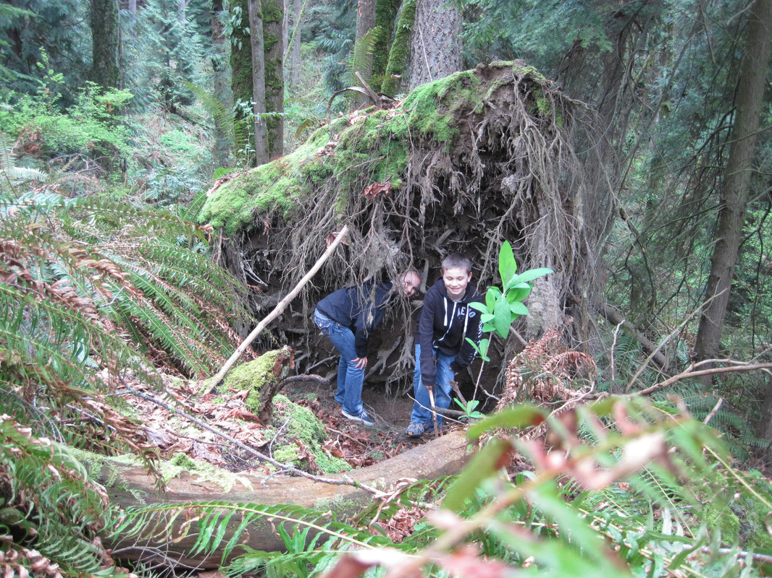
Forest Values: Play
Children of today are growing up with so much technology, excessive TV and computer use that playing outside is really important and must not be sidelined or lost, because it develops a child’s imagination, their physical stamina, as well as keeps them fit… - Sue Adkins
Notes:
For many, many reasons, it is important for our children to have access to natural areas. The absence of natural areas has profound implications. How can tomorrow’s new adults care about, and care for, the offerings of nature if they never experience it? Children need places to roam and make discovers. North Creek Forest is special for it’s proximity to so many students.

Slide 18
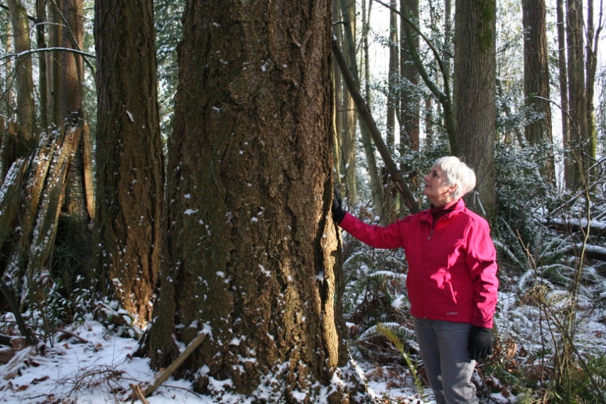
Forest Values: Inspiration
“The forest healed me during a time of depression. It represents a holy place to me. “
– Jeanie Robinson, Bothell resident
Notes:
In addition to their many tangible benefits, forests provide beautiful, inspirational refuges that nourish our souls.

Slide 19
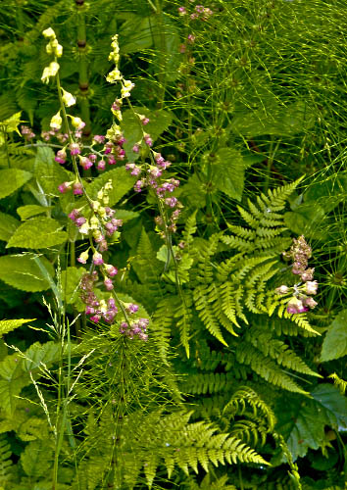
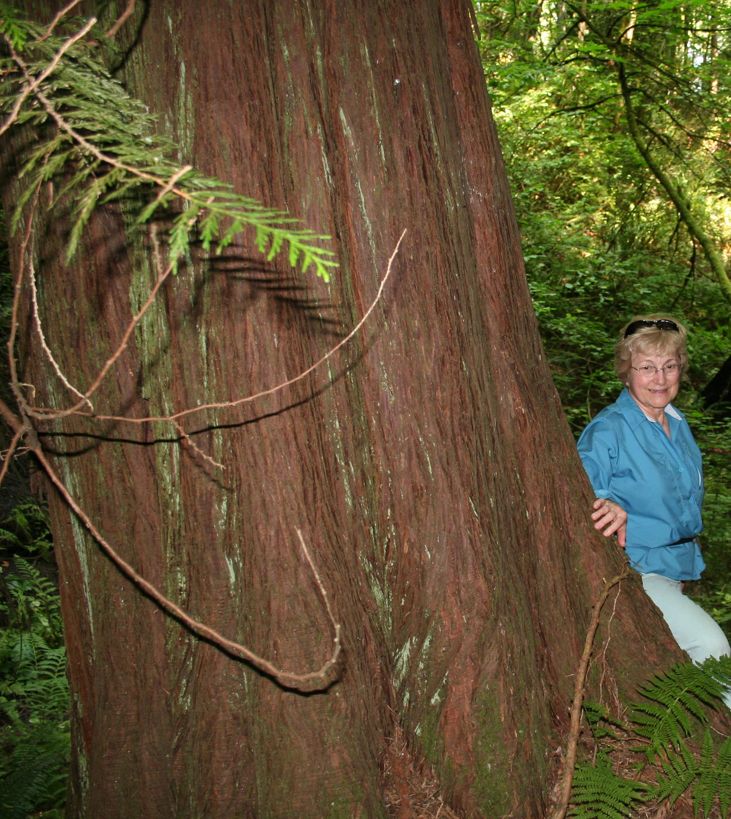
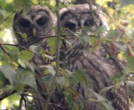
Saving North Creek Forest is Key
Notes:
This forest is a strategically important natural area, vital to the well-being of people, salmon, birds, wildlife, clean air and water. We have a historic opportunity to create a beautiful legacy for present and future generations. The choice is ours.

Slide 20
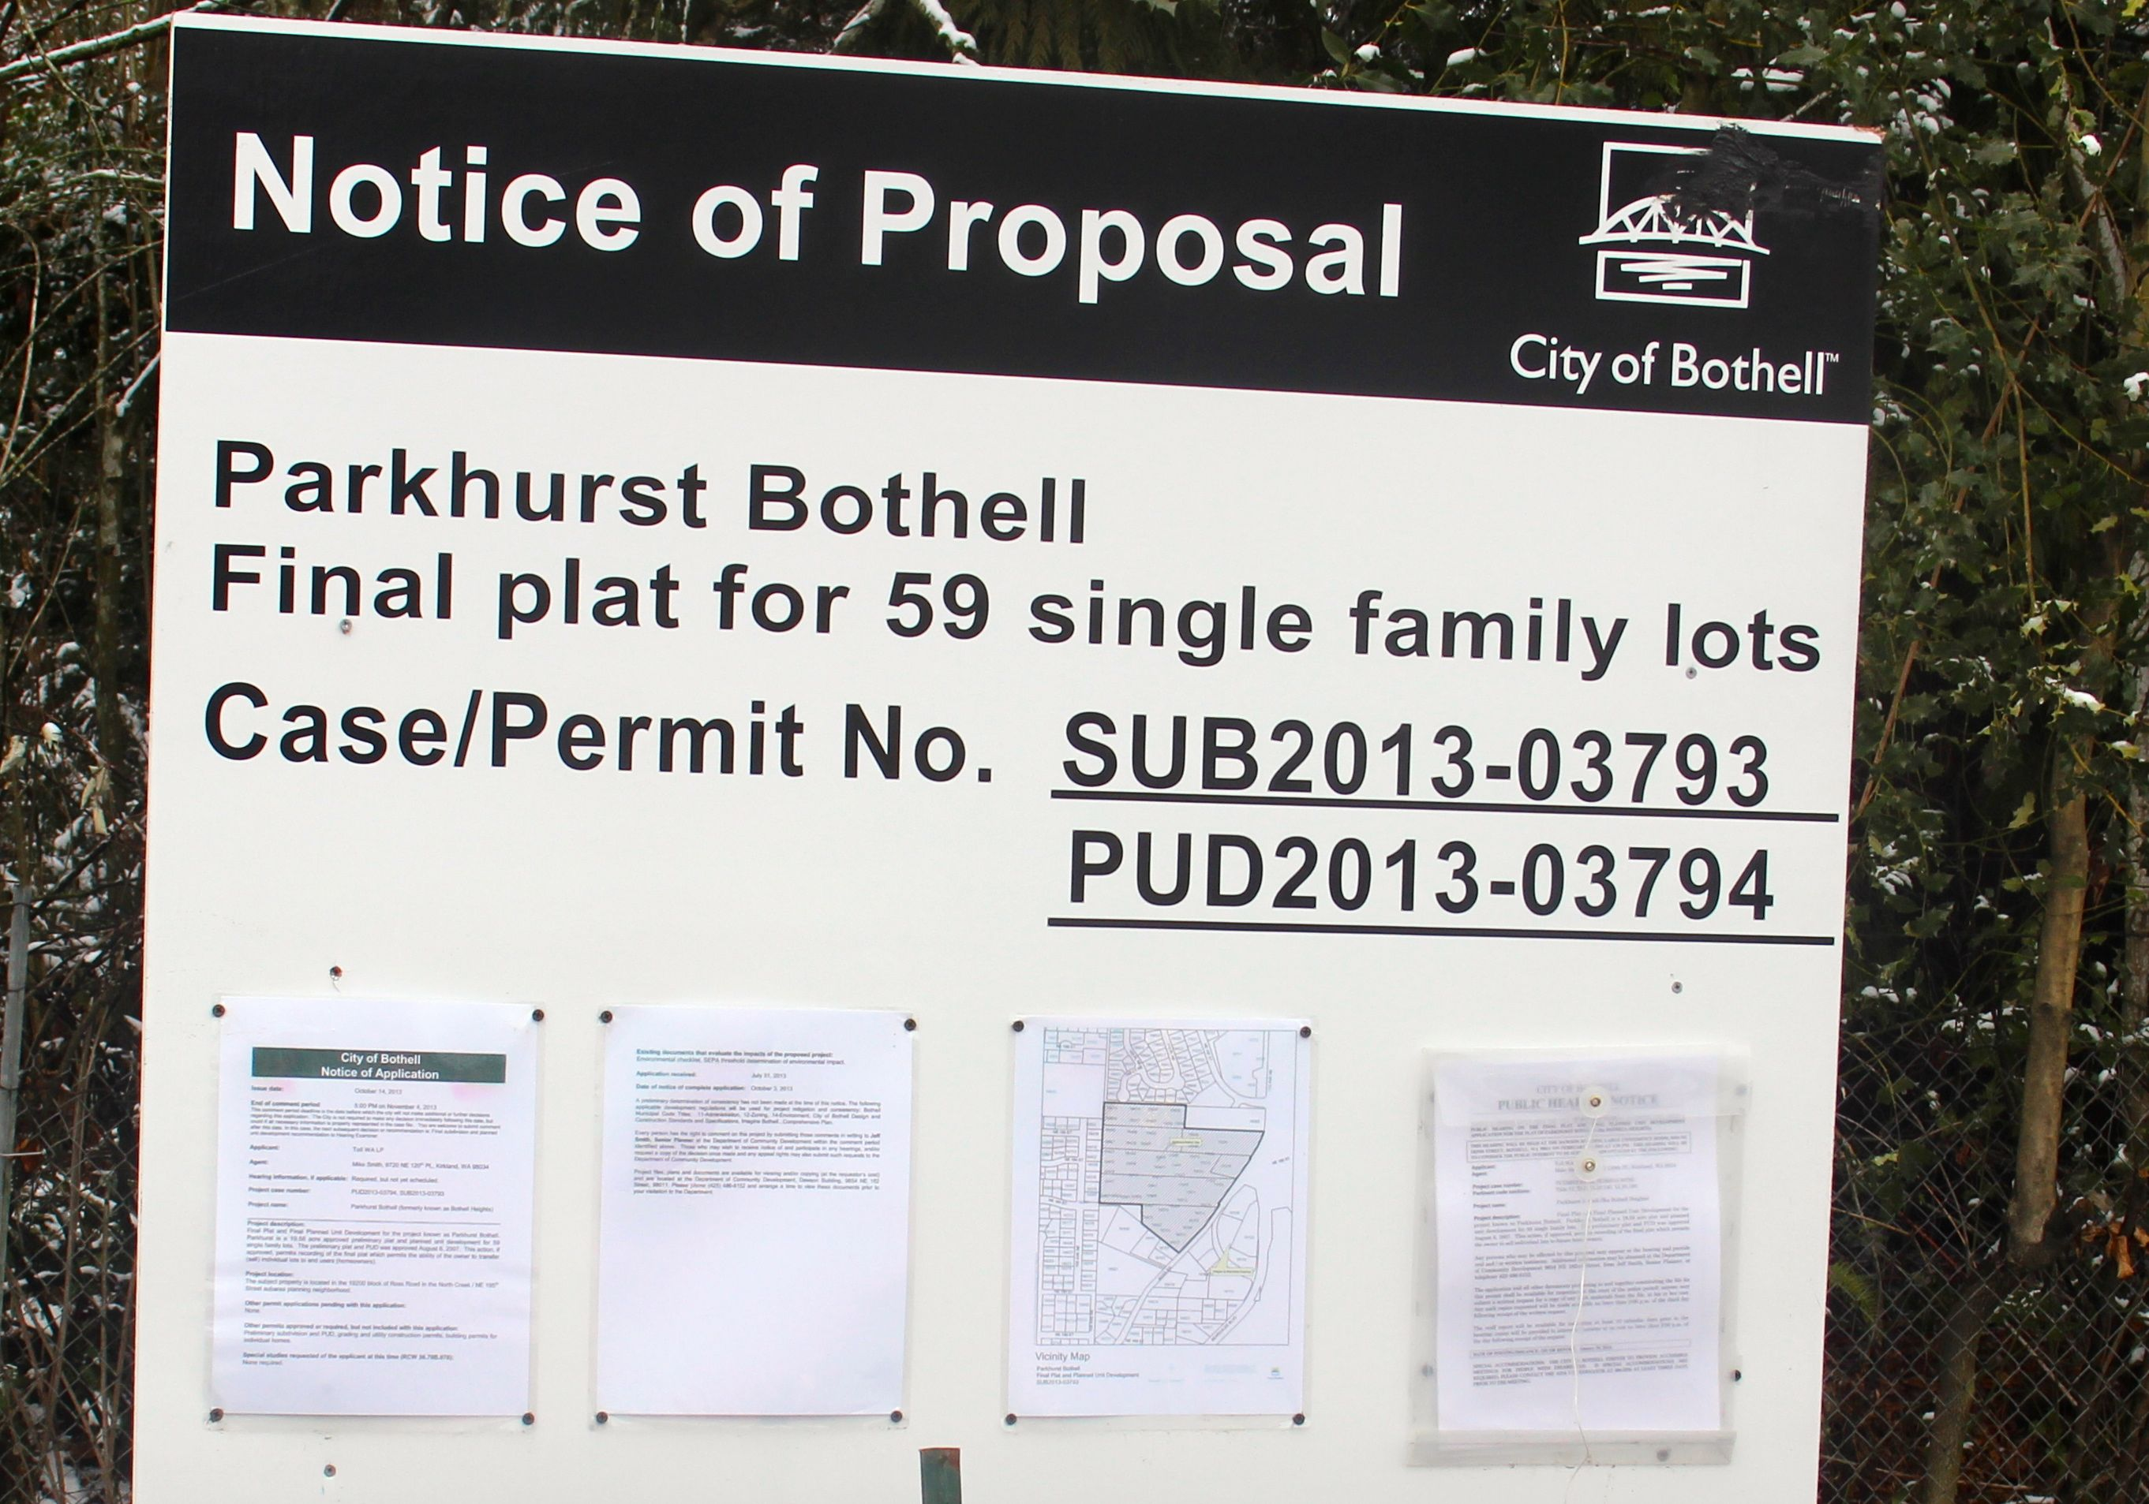
How Forests Vanish
1
Notes:
If we do not act to save the forest, this will happen.

Slide 21
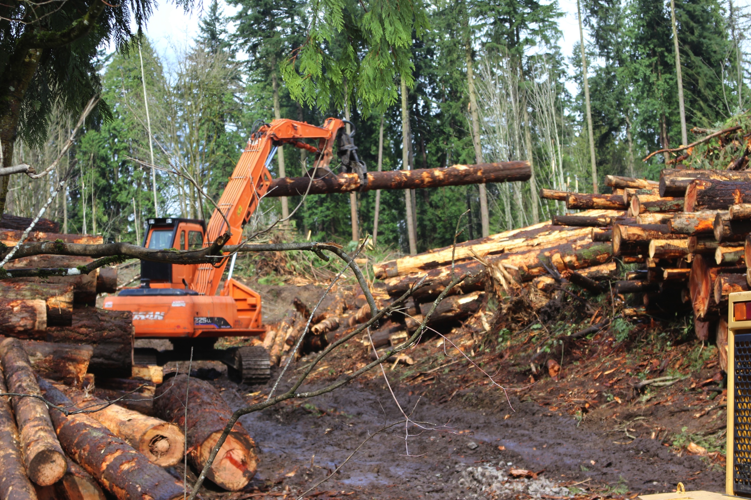
How Forests Vanish
1
2
Notes:
All of us have seen this “movie” before.

Slide 22
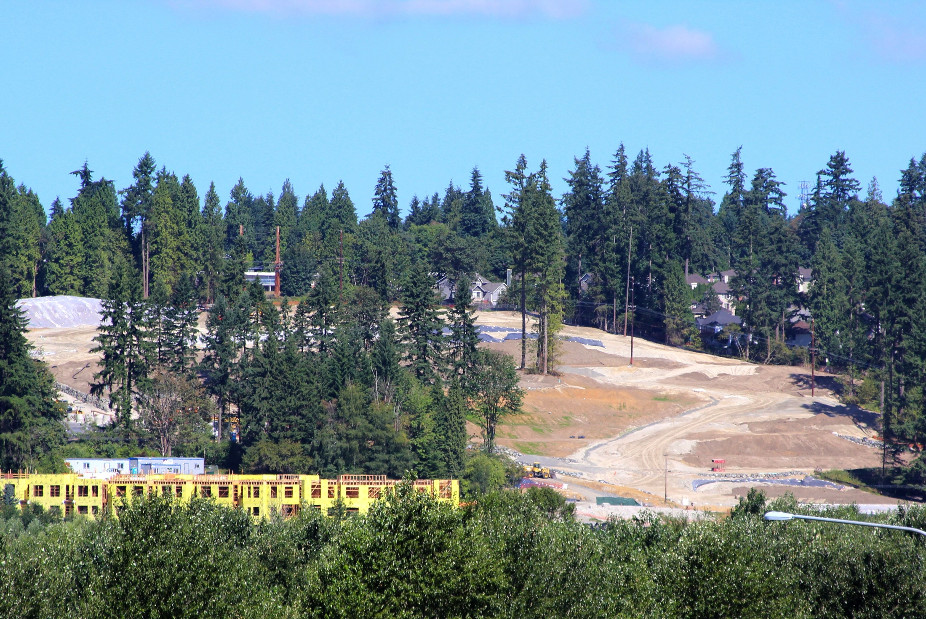
How Forests Vanish
1
2
3
Notes:
Let’s be a part of a different, greener outcome.

Slide 23
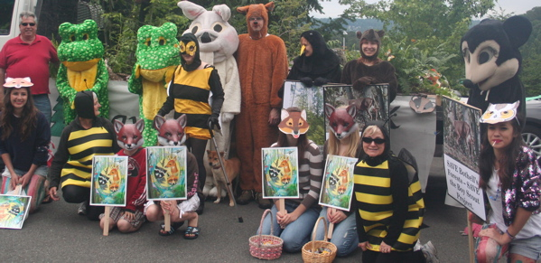
Our Vision
Protect a forest to benefit people, wildlife and salmon.
Crown Bothell’s visionary downtown redevelopment with a magnificent walk-to-forest.
North Creek Forest advocates at Bothell 4th of July Parade
Notes:
We have a different, greener vision for Bothell. Considering that 41 of the 64 acres have already been protected, and that active educational and stewardship programs are currently underway in the forest, we are well on our way to achieving it! But we cannot do it alone. We need additional supporters to make this vision a reality.

Slide 24
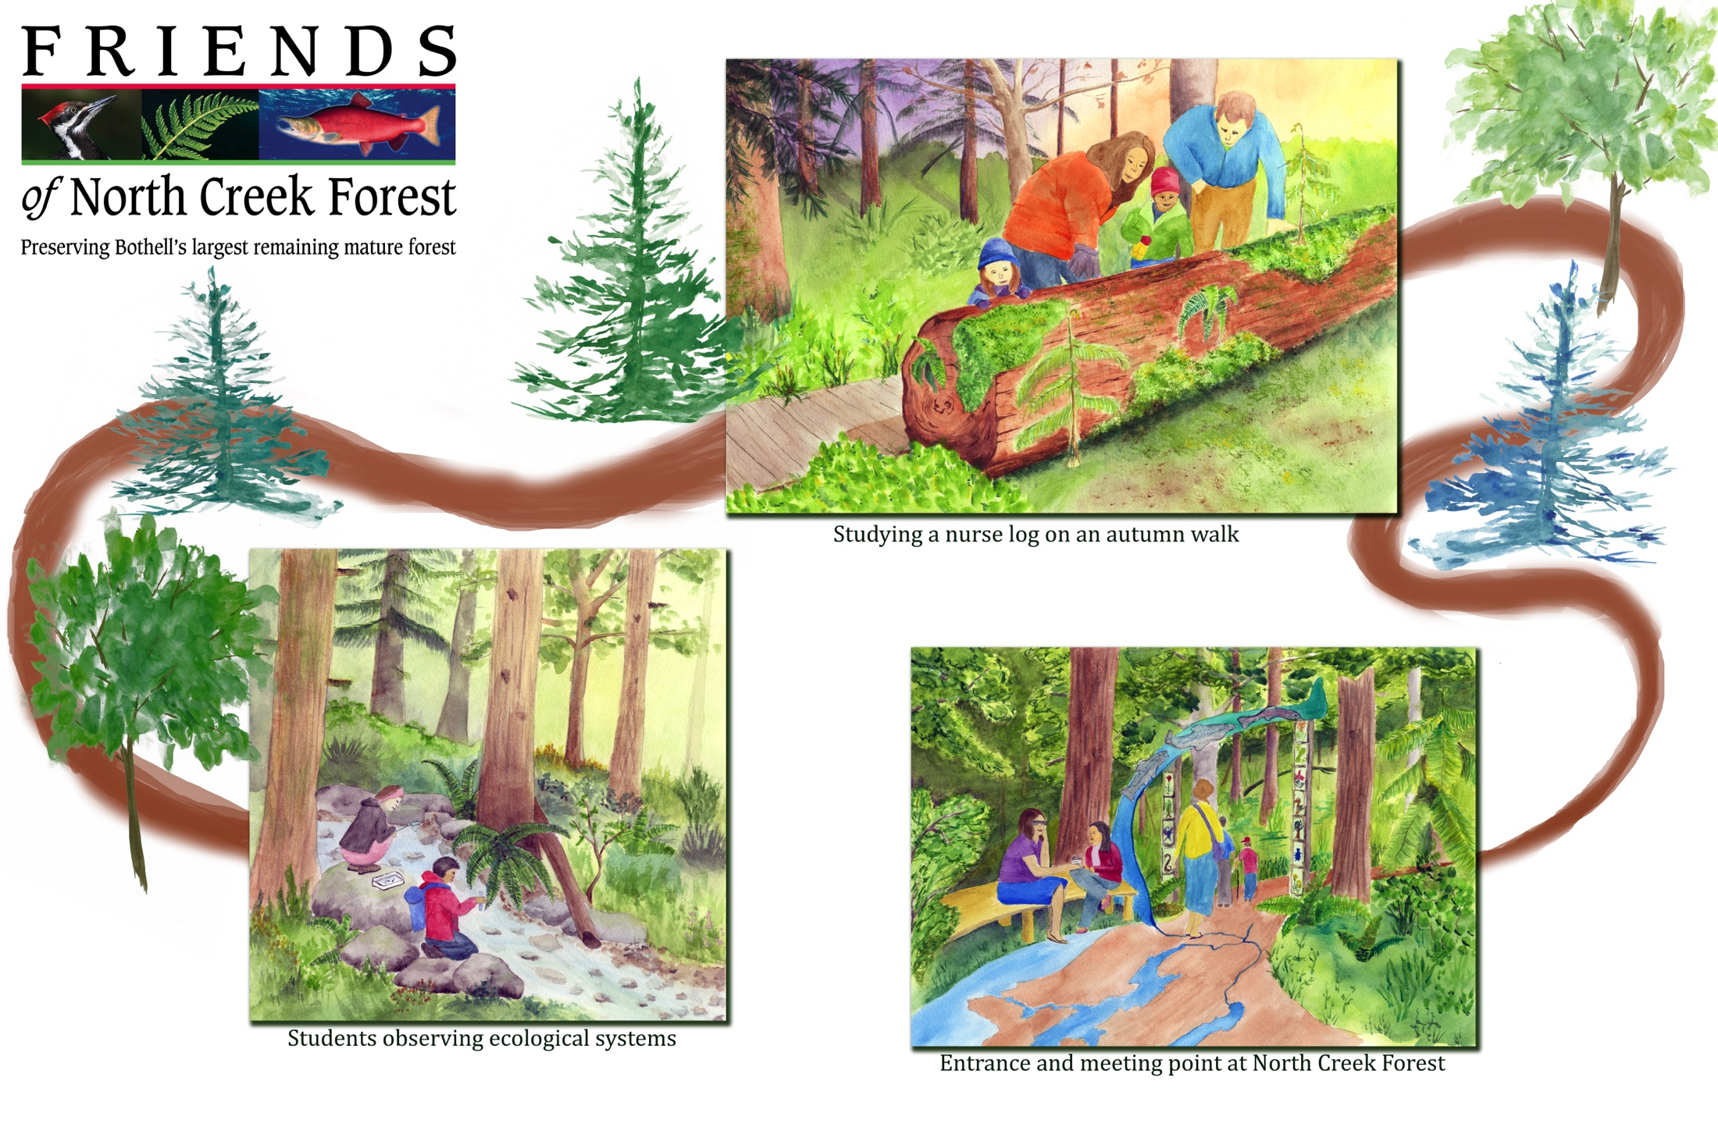
Begins with Protecting North Creek Forest:
Schematic Drawing of NC Forest Park
Notes:
Here is what our vision looks like in the form of a drawing. This is what the future can hold in Bothell’s North Creek Forest with your help.

Slide 25
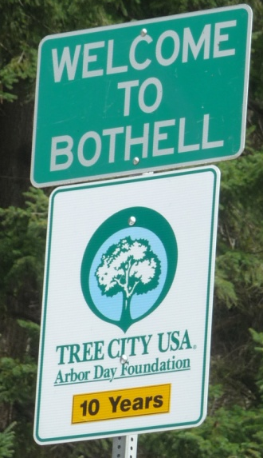
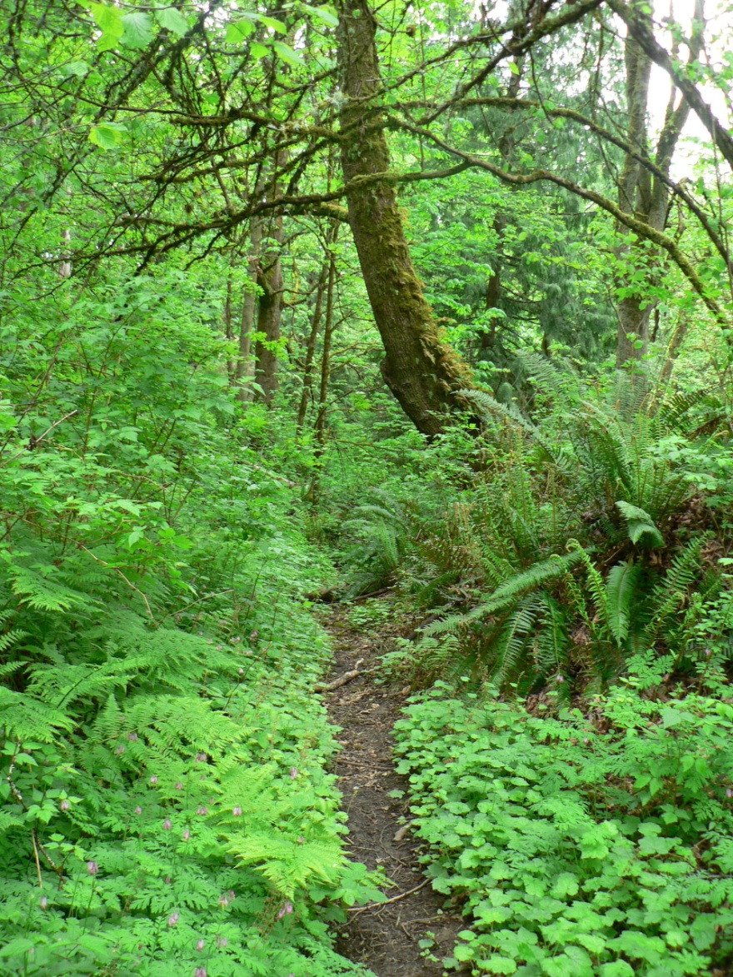
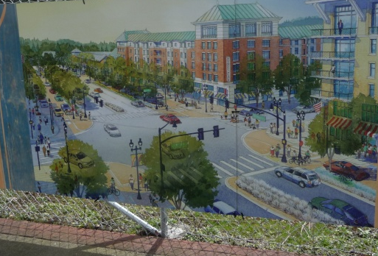
Bothell’s Future
A great place to live
A blend of urban
& natural amenities
Notes:
Saving North Creek Forest fits hand-in-glove with Bothell’s downtown renovation and its status as a Tree City. Bothell can become a model city of the future if it saves its natural areas while transforming its urban areas. It is a golden opportunity for this city to get it right!

Slide 26
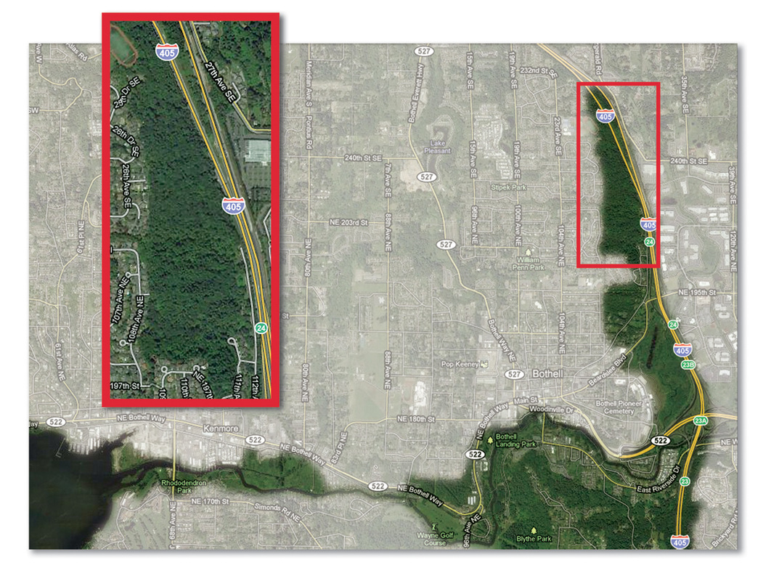
KEEP BOTHELL’S GREEN CORRIDOR INTACT!
Now under development
Notes:
Keeping large green corridors like this one keeps them viable in the future as places for people, fish and wildlife. It also makes them outstanding recreational areas. North Creek Forest is a keystone natural area to the integrity of this green corridor. But development is attractive to remaining owners. This is the location of the clear-cut you saw earlier.

Slide 27
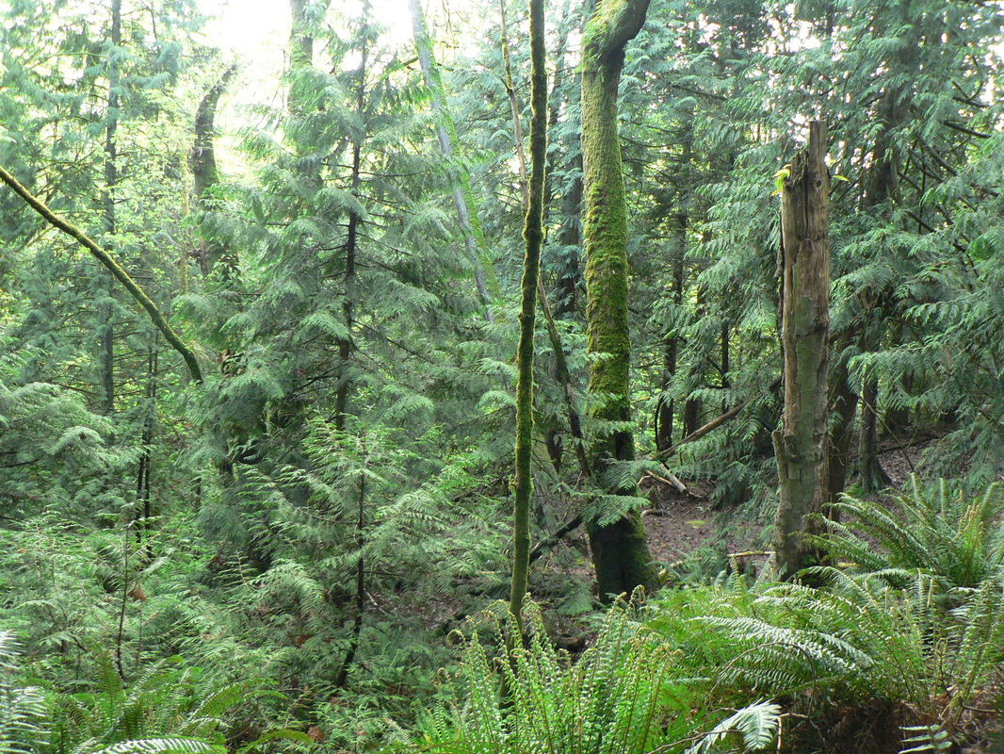
“ Land, they ain’t making it anymore.”
– Mark Twain
Notes:
This was true long ago when Mark Twain wrote these words, and even more true now that natural areas have become so rare.

Slide 28
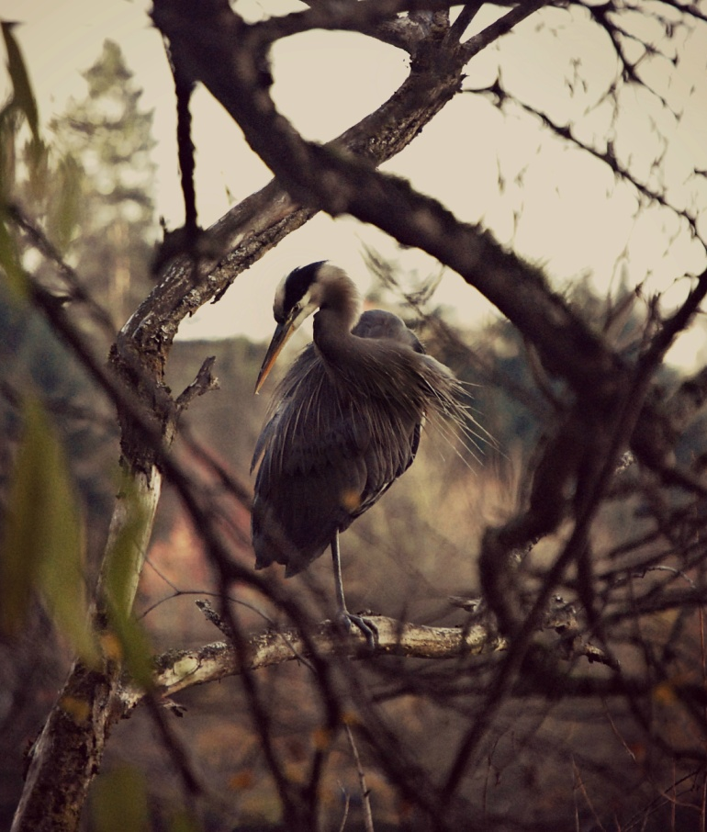
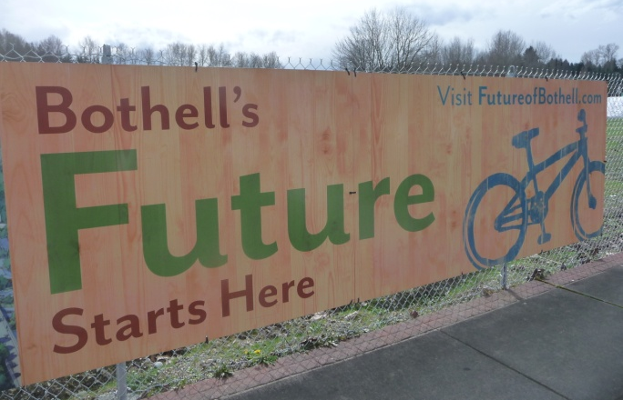
The Timing is Ripe!
41.5 acres protected so far
22 need protection
Downtown Bothell
revitalization underway
Notes:
Now is the time to make this project happen. Their is a harmonic convergence of events: the economy, the willing sellers, the downtown Bothell re-development, all underscore the importance of saving this forest while we still can!

Slide 29
North Creek Forest Acquisitions
Saved 2011
31.45 acres
Snohomish
County
Saved 2011
4.2 acres
Saved 2013
5.9 acres
1
King
County
Remaining Parcels:
Main Street Development (8.8)
Fries (8.2)
Main Street Development (4.8)
22 acres total
2
3
*All willing sellers!
Notes:
Of NC forest’s 64 acres, 41.5 have been protected. We need to purchase 22 more to sufficiently protect the forest. The two owners of these remaining three parcels are willing sellers.

Slide 30
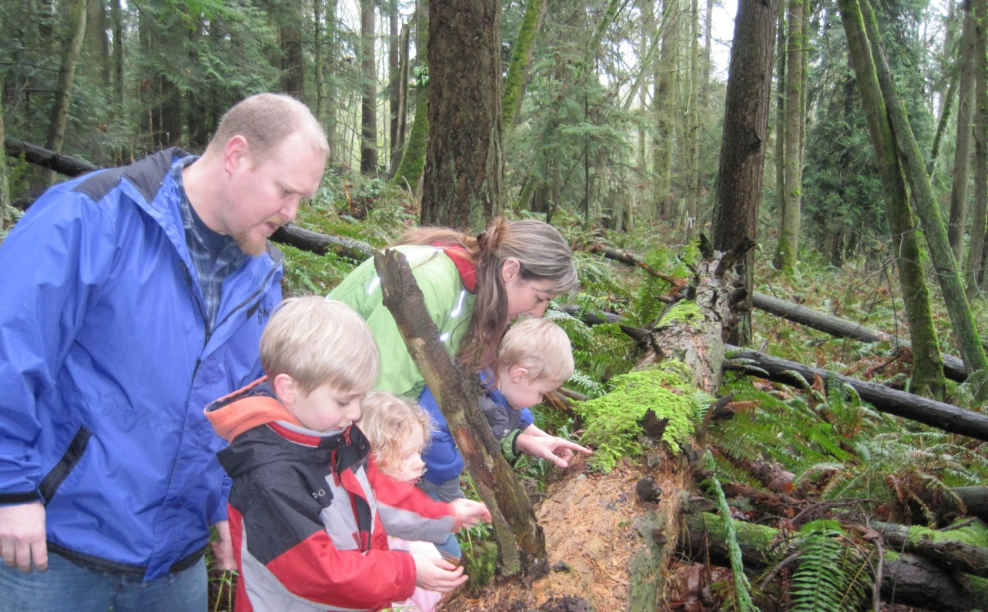
Bothell’s Last Great Forest Campaign
$2.52 million needed
$697,500 raised
$1.83 million to reach our goal
Notes:
For this final phase we need $2.52 M.
Almost $700,000 has been raised.
We need $1.8 M more and a vision of an intact forest will come true.

Slide 31
Bothell’s Last Great Forest
Campaign Budget
Item | Expense
Land Acquisition | 2,167,000
Appraisals | 22,500
Closing costs, cultural assessment, level 1 hazard assessment | 33,500
Site preparation (asbestos abatement, removal of debris, structures) | 36,000
Stewardship Endowment (10%) | 216,700
Campaign Administration (2%) | 43,300
TOTAL: | $2,519,000
Notes:
This is our campaign budget to acquire and steward North Creek Forest. It is a lean budget, made leaner by hours of volunteer labor that we have been able to marshall, and plan to continue marshalling in the future.

Slide 32
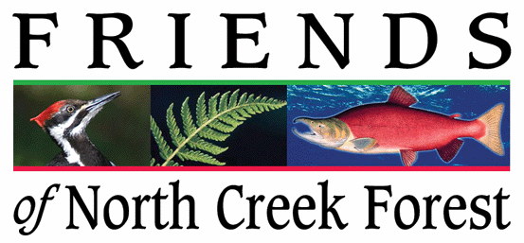
Major Donors
Bothell’s Last Great Forest
$20,000 to $100,000
Tom and Jeanie Robinson
Bothell Parks Fund
$5,000 to $20,000
Rose Foundation
Special Events
Steve and Tricia Trainer
Tulalip Tribes Charitable Fund
$100,000 and above
King County Futures (2)
Land & Water Conservation Fund (2)
Snohomish County Futures
Washington State Commerce
Notes:
We have benefited from tremendous support from public sector grants. In this quiet stage of the campaign we are especially seeking private lead gifts at the $100k and above level.

Slide 33
Pending Requests Future Requests
Murdock Charitable Trust
Land and Water Conservation (third)
Department of Commerce (second)
Boeing
Vulcan
Acorn Foundation
Campion Foundation
Fund for Wild Nature
Kongsgaard-Goldman Foundation
Northwest Fund for the Environment
Notes:
On the left are requests now underway. On the right are our first requests to be made in the first quarter of 2014.

Slide 34
Board and Staff
Warren Gold
Professor Ecology & Environment, UW Bothell
Ron Kreizenbeck
EPA Region 10 Administrator (retired)
Jeri Molloy
Nurse, neighborhood Activist
Amy Lambert
Professor, Art and Science of Restoration, UW Bothell
Jerry Smedes
Environmental Consultant
Grant Advisors:
Woody Wheeler
Freeda Babson
Board:
Jeanie Robinson – President
Counselor, Educator (retired)
David Bain – Vice President
Orca Biologist
Ann Goff – Secretary
Administrative assistant, neighborhood activist
Carolyn Freese – Treasurer
Educator, Lake Washington District (retired)
Cathy Ferbrache-Garrand
Science Educator, Kenmore School District
Staff:
Jim Freese, Volunteer Executive Director
Former electrician, labor organizer
Notes:
Who is running this operation? A deeply committed, competent group of people – all who have a stake in the forest’s protection. Most of our board members live and work within site of the forest.

Slide 35
“A society is defined not only by what it creates, but by what it refuses to destroy ”
– John Sawhill, former president , The Nature Conservancy
Notes:
Please consider joining us in our effort to create a North Creek Forest refuge and park. You can be a part of the solution... part of a positive green legacy.

