Slide 1
Education in the North Creek Forest
By Isaias Robert & Logan Compau

Slide 2
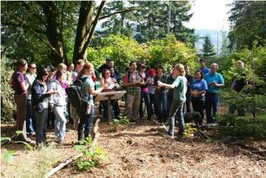
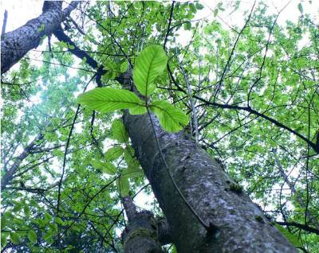
Our Mission
Maintain and improve the biological functions
of North Creek Forest through education,
stewardship, and conservation through
perpetuity.
Make the North Creek Forest the epicenter
for life science and education programs.
Our Method
Our Commitment
To insure all vested interests are winners:
the City of Bothell, landowners, conservation
interests, educators and the community.
To find a conservation solution that satisfies
the need of landowners, Bothell, Northshore
School District, UW Bothell, and Cascadia
Community College.

Slide 3
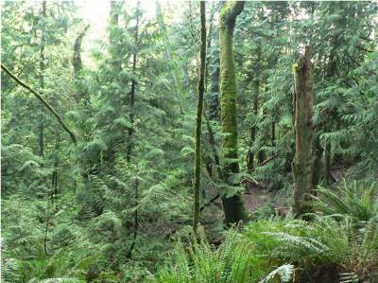
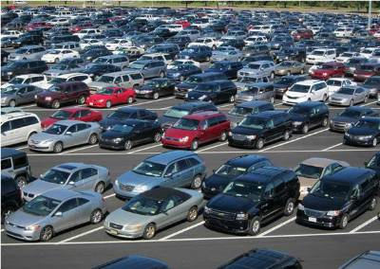
Why do we Educate?
Before
After
The biological functions of nature are in danger.
Urban environments are spreading.
Forests and wetlands are dwindling.
Promote sustainability and stewardship.
Protection of the forests and wildlife.

Slide 4
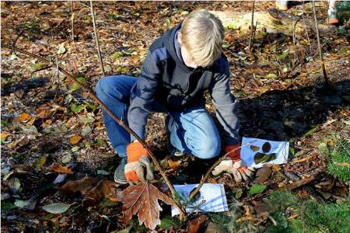
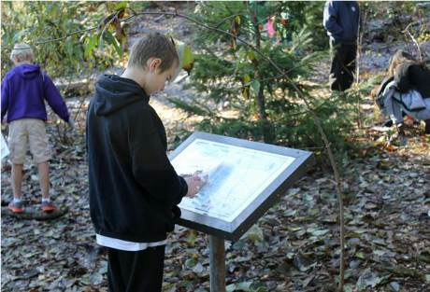
Why use the hands-on approach to
education?
To provide an adaptable worthwhile education.
Supply an education that expands out of the classroom experience.
To give a first-hand view of the environment, how it changes, and how we
affect it.

Slide 5
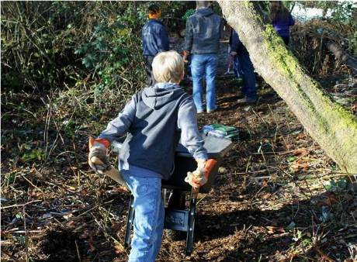
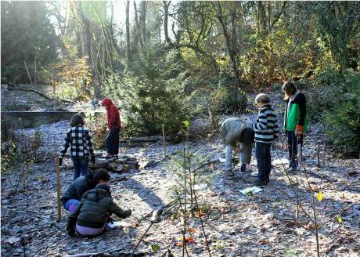
The benefits of the hands-on
approach to education
Teach conservation of the environment.

Slide 6
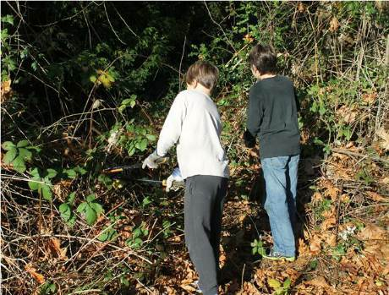
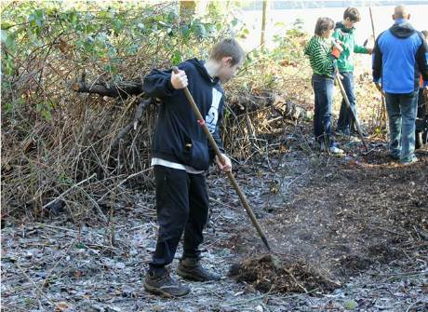
The benefits of the hands-on
approach to education
Teach maintenance of the environment.

Slide 7
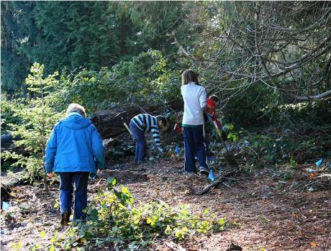
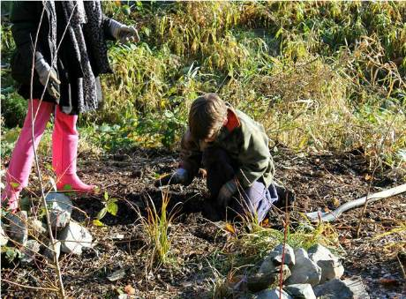
The benefits of the hands-on
approach to education
Teach stewardship of the environment.

Slide 8
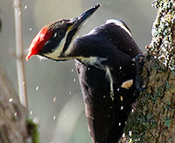
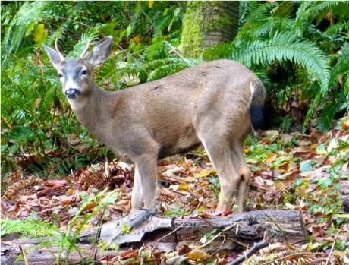
The benefits of the hands-on
approach to education
Stewardship awards us with a flourishing wildlife.

Slide 9
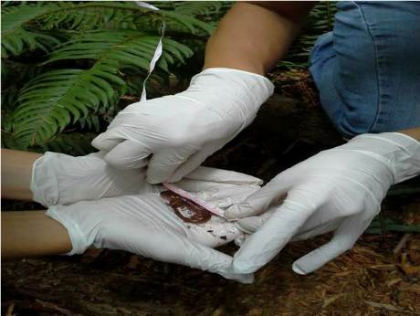
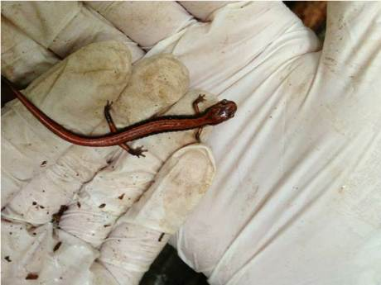
“The most important part of participating in natural systems, or more generally, nature, is allowing yourself to feel it, breathe it, to get your feet wet or cold, and then you gain an appreciation for it. You end up building a relationship with your natural world. As you build a relationship with it, you begin to care about it.”
-Amy Lambert
Board of Directors
Friends of North Creek Forest
PhD Conservation Biology
University of Washington

Slide 10
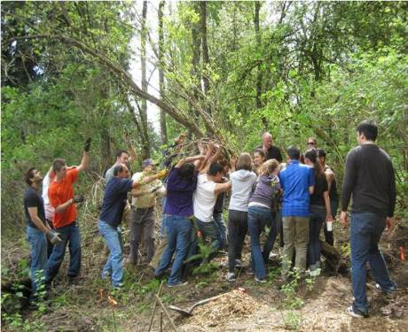
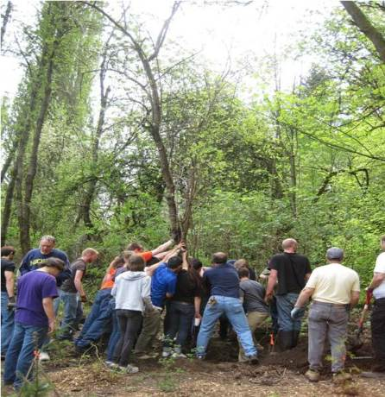
Education and restoration…
…through participation

Slide 11
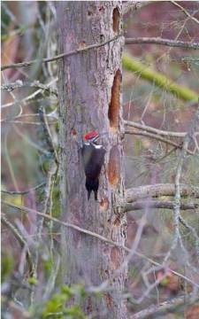
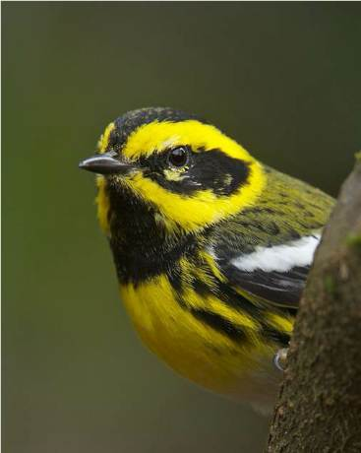
Habitat for wildlife…
…through stewardship.

Slide 12
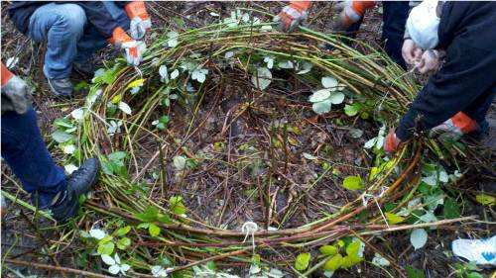
We are all…
…part of a larger ecosystem.

Slide 13
For more information…
http://wilderdom.com/phd2/Neill2008EnhancingLifeEffectivenessTheImpactsOfOutdoorEducationPrograms.pdf
http://www.tandfonline.com/doi/abs/10.1080/00958964.1981.9942638?journalCode=vjee20
http://www.wilderdom.com/research/researchoutcomesmeta-analytic.htm
http://link.springer.com/article/10.1007/BF03173202#page-1
http://www.leopold.wilderness.net/research/fprojects/docs12/ISSRMChapter.pdf
http://books.google.com/books?hl=en&lr=&id=gwsenf9DisQC&oi=fnd&pg=PR5&dq=impacts+of+outdoor+education+on+ecological&ots=aZ8f_ssv7W&sig=G10p13Ys1R4wJPH-V6be3tPjKBM#v=onepage&q=impacts%20of%20outdoor%20education%20on%20ecological&f=false
http://www.ecy.wa.gov/services/ee/resource.html

Slide 14
Bibliography
Slide one picture: http://www.friendsnorthcreekforest.org/
Slide two Parking lot Cars: http://www.headlinemiami.com/wp-content/uploads/2013/09/20130904-210253.jpg
Slide two forest: http://www.friendsnorthcreekforest.org/
Other photos: https://www.facebook.com/pages/Friends-of-North-Creek-Forest/200452686657291

